Slide 1
Camp Session Plans- World Dance Party
Equipment: Speaker, tablet with kids playlist
Rise and Energise: Dance Party | Time 9.45 – 10.00
How To Play Country statues When the music is on the children must show off their best dance moves. When the music stops they must freeze, still like a statue. You can get children to freeze in different poses like they are from different countries e.g. England can celebrate a goal, Spain hold a flamenco pose, France pretend to be the Eifel tower, Italy lean like the leaning Tower of Pisa. Award children points for the best dance moves and poses. You do not have to get anyone out. Musical bumps When the music is playing children dance around. When the music stops children have to sit down as fast as they can with their legs crossed. Again give points to children who are showing great dance moves and sitting down the quickest. Play different songs from around the world for children to dance to e.g. can can, ballet music, tango, digeridoo etc Country pass the parcel The children stand or sit in a circle. When the music is on they pass the crown around the circle. When the music stops whoever is left holding the parcel has to do a forfeit. This could be star jumps, a silly pose or move for example. After a few go’s children can pick the forfeit. World Country Thrones Arrange chairs in a circle so there is one throne (chair per child). Each child puts something on or under the chair to know where they have to sit. When the music on children have to move around the thrones in a big circle, if this is proving tricky children can dance in assigned box in the room. When the music stops children have to go back to their chair and sit down. Depending on your children you can give them 3 lives or have children out for that round. World celebration Marching Band Each child picks a music instrument (currently nothing that goes in mouth) if you do not have instruments you can clap hands, stomp feet and make vocal noises. Children follow each other in a line like a marching band playing their instruments to make some music. Children take turns at the front of the lines leading the marching band. Set up Set up a box for children to move and dance around in. You will need a speaker and a kids playlist on the camp tablet. Use chairs or floor spots for bumps and to help children have their own space to dance.

Slide 2
Coaching Tips and Questions: Give lots of praise to children who are showing great movements and are confident. If children are shy give them different moves each round they can do e.g. jumping, hopping, skipping etc See if children can help you to explain the rules of the game. Be silly and say them in the wrong order. For example when the music is on we freeze and when it stops we dance. Watch how children are performing different movements and how they manage to move around the space within the other children. It may be easier to give children a spot or space to move in so they do not bump into each other. | Phrase Perfect Script It’s time for a world dance party. To celebrate all the fun and different countries we have visited this week. Who is ready to show me their best dance moves? I don’t think anyone can beat my dance moves though, I am the best dancer in the whole world. We have got lots of different musical games we can play today so have a listen and then we will vote for which game we play first.
Progressions: Let children choose the different ways to move around each time the music restarts. | Differentiation Easier – children can be given lives to loose instead of being out straight away.

Slide 3
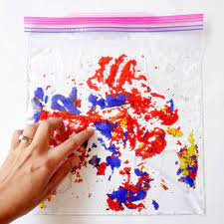
Camp Session Plans- Flag colour sensory bags
Equipment: Named ziplock bags, sensory bag how to sheet
Messy Play; |  | Time 10.00 – 10.45
How To Play Have 4 or 5 children round the tuff tray at a time to make their bags then they can play with them on a table or in a space. Label a zip lock bag per child Follow the messy play sensory bag sheet Set up . Tuff tray on table or floor with tablecloth underneath
Coaching Tips & Questions: Children can all have the same sensory bag or give children the option of what they would like in their bag. If you are worried about children breaking the bag add cello tape around the edges. Let children squish and draw pictures with the contents of the bag. | Phrase Perfect Script Today we are going to make a sensory bags the colours of different countries flags to show all the fun we have had this week. There are lots of things we can fill it with and I will give you all a choice of what you would like. We are then going to play with the bag and see what it feels like, if we can draw any shapes.

Slide 5
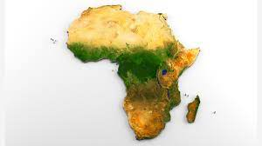
Theme/Focus: Round the world orienteering. |  | Time​​ 11.00 – 11.45 | Image/Video link/​​ Parent Link​​
How To Play​​ Children are going to make outlines of the different continents using cones. There are outlines of the continents for children to follow. Depending on numbers you can split children into teams to see who can make the cones look closet to the picture. For the first one work all together and show the children the continent and try to place the cones down to make the same shape. Children then try again with a different continent. ​ ​ ​ |  |  | ​​
Coaching/Teacher Tips/Questioning:​​​ Show the children picture of their continents. | Phrase Perfect Script​ Ok everyone we are going to make our very own planet earth, we are going to put you into different team and each team is going to have to make a different continent. (now put the kids into teams with their colour cones and then assign them a continent) Or if no teams Today we are making our very own planet earth and seeing if we can turn the cones into different shapes just like the different continents of earth.

Slide 6
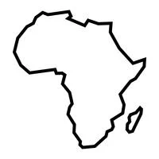

Slide 9
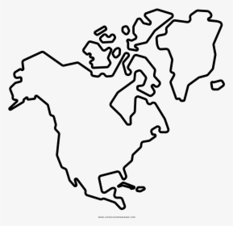

Slide 10
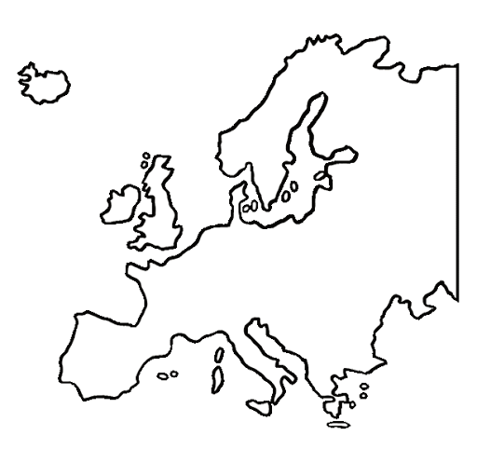

Slide 11
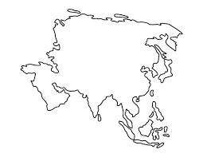

Slide 13
Camp Session Plans- Children`s Choice
Circle Time: Children`s Choice |  | Time 12.00 – 12.30
How To Play Ask the children if they can think of a game that they would like to play. It could be a game that they have played during the week or any other circle game they have played before (as long as they can explain the rules) If you get lots of ideas then you can vote on what game you do first. Set up . Have the children sat ready to play a game in a circle
Coaching Tips & Questioning: If they cannot think of any games on their own, give them some options of the games that you have played in circle time during the week. | Phrase Perfect Script Today, we are going to let you decide what game you would like to play for circle time. Is there a circle game you have really enjoyed this week or a game you have played before and would like to play?
Progressions: If they get bored of the games, mix it up and choose another game. | Differentiation If two children have an idea of a game do one first and remember to do the second one as well to be fair.

Slide 14
Camp Session Plans- Junk modelling structures around the world
Equipment: Junk modelling box – cardboard, plastic tubs, glue, cellotape
Imagine and Create: Junk modelling structures around the world |  | Time 2.00 – 2.45 | Image/Video link/ Parent Link
How To Play Place the junk modelling box (cardboard, egg boxes, left over craft supplies, plastic tubs etc) on the tuff tray Show children the pictures of different structures from around the world They have to work in groups or by themselves to create a structure from the materials on the tray Set up Sit the children down at a table with all the equipment they will need in front of them. Get children into groups or ask them to work by themselves
Coaching Tips & Questioning: Encourage lots of creativity here if they are struggling to make anything they can create their own structure e.g. house, bridge. Cut cellotape in strips for children to use or have multiple pots of PVA glue ready to be used by the different children. Working in groups may make this activity easier to manage but will mean children can’t take the end result home | Phrase Perfect Script Today we are going to do some junk modelling. We have lots of cardboard, plastic tubs and other materials we can use. We are going to see if we make famous structures from around the world. Have a look at the pictures here, does anyone recognise them? Do you know the names of any of them? Today we are going to see if we can build one of these structures using all the different materials here. We can work in groups of make things by yourself.
Progressions: Let children work on their own and see what they can make. Let their imagination run wild and they could even try and make their own new structure. |  |  | Differentiation To make it more simple see who can make the tallest tower or the best house. Give children ideas of what to do if they are struggling.

Slide 15
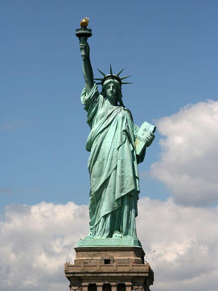
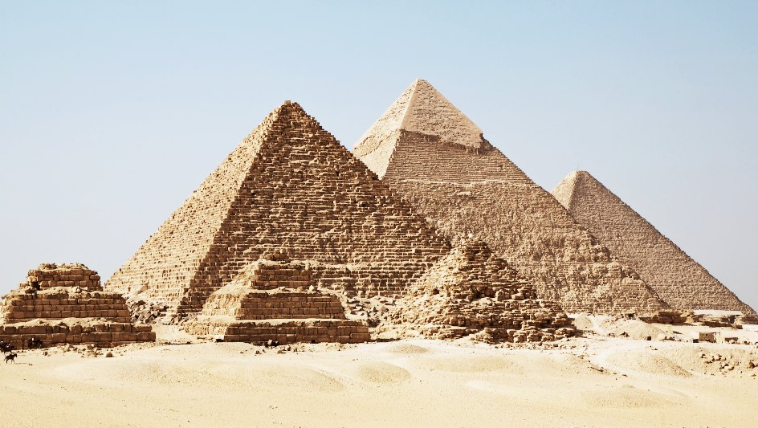
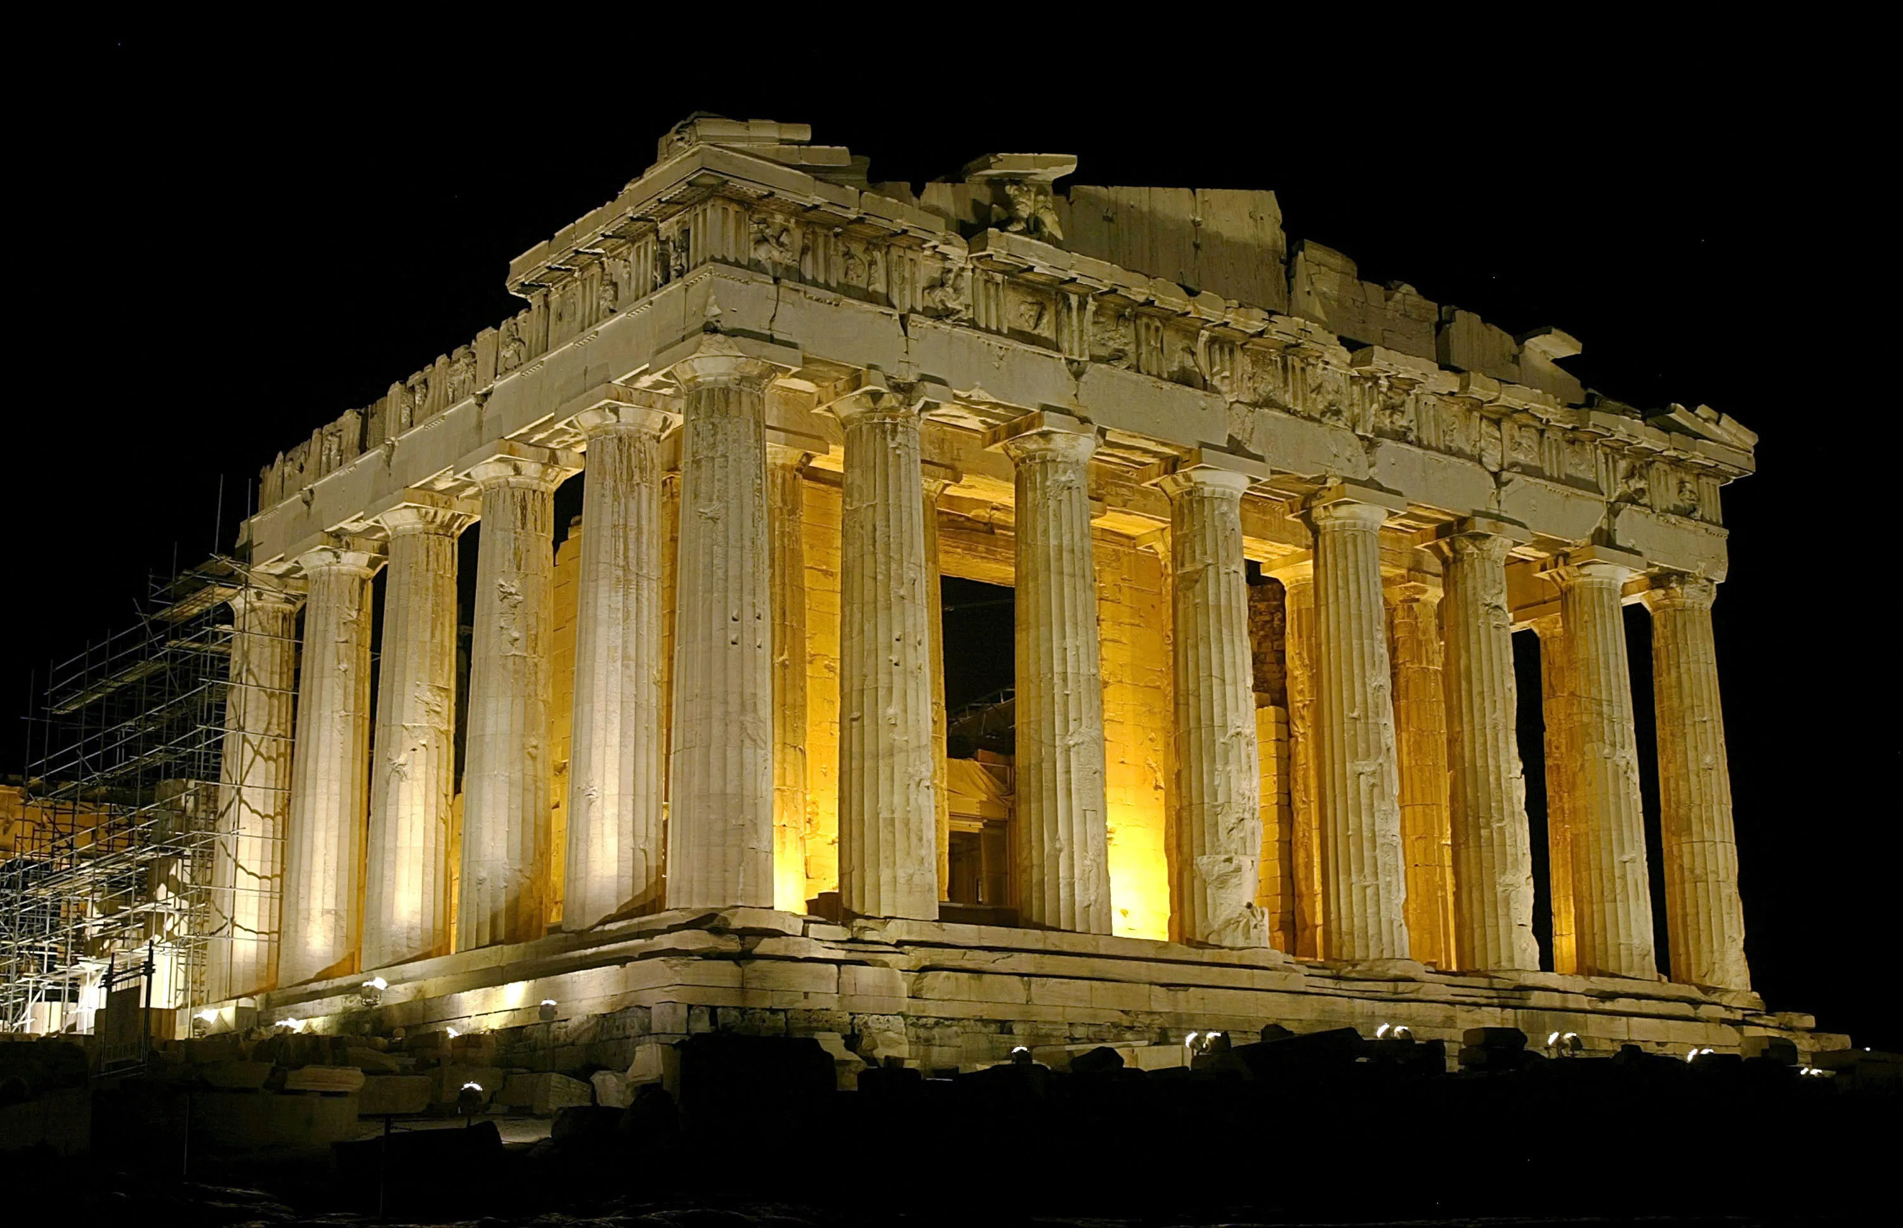
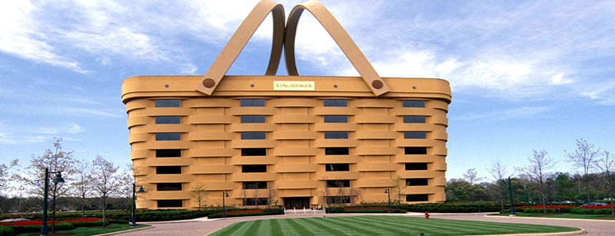

Slide 16
Camp Session Plans- Bat and Ball Games
Equipment: cones, cricket/rounders/tennis bats, tennis ball
Theme/Focus: Bat and Ball Games | Time 3.00 – 3.45
How To Play Bat and ball Races Split children into teams behind a cone and set another cone a reasonable distance away. Children must race from the start cone to the end and back, then their team mate can go. Can children balance a ball on the racket to the end cone and back Children need to roll a ball along the floor using a hockey stick or tennis racket Partner challenges Split children in groups of 2 or 3. Given them a bat each and a ball between the pair or trio. Can they pass the ball to each other and count how many they can pass back and forth in a row. How long can they pass an snowball before it breaks Bounce a tennis ball Hit a ball without touching the floor Pass a ball using a hockey stick Bat and Ball Challenges How many times can children hit a tennis ball without it breaking falling to the floor How high can they hit a tennis ball up into the air? How far can they hit a tennis ball? How long can they balance a tennis ball on a racket? How far can they pass a tennis ball with a hockey stick? Can they hit/bounce a tennis ball into a hoop? Can they pass (kick or throw) a tennis ball into a hoop? Split space into coloured sections, each section is worth a different amount of points depending where their ball lands. Cricket 2 teams, striking and fielding team. Striking team need to hit the ball and run between the two cones as many times as they can before the bowler gets the ball back. It is then the next players turn. Fielding team need to collect the ball and get it to the coach as fast as they can to stop the team collecting runs Once everyone has had a go, swap teams Rounders 2 teams, striking and fielding team.. Striking team has to hit the tennis ball after it has bounced as far as they can using a racket. They then try to run around the 4 cones back to the start. Each stump is worth 10 points. 1st = 10, 2nd = 20, 3rd = 30, 4th = 40 Fielding team have to get the ball to the bowler (coach) as quickly as they can. Once the coach has the ball the striking team can’t score nay more points. Hockey 2 teams and 2 goals. Give each team a coloured bib and matching coloured goal. The teams have to pass the ball to each other and score a goal. Golf Children can create a golf course, with a hoop at the end as the hole. Children have to hit the ball around obstacles to get it in the hole at the end. Count how many times they hit the ball. The person with the least will win for that hole. Set up Let children vote for what they would like to take part in Equipment will include, tennis balls, footballs, soft balls, beanbags, hockey sticks, tennis rackets, cricket bats, golf clubs

Slide 17
Coaching Tips and Questions: Always check if children understand or have questions Introduce rules gradually, and lots of demonstrations | Phrase Perfect Script It’s time for bat and ball games. We are going to play some different games that involve hitting a ball with a racket or bat. Does anyone know any games where you have to hit a ball with a racket or bat? There are lots of different games we can play so have a listen and we can vote on what to do next.
Progressions: See if older children can hit a ball without it bouncing, can they catch with one hand. Children can be team captains |  |  | Differentiation You can roll or bounce a ball to make it easier for a child to hit it. Let younger children stand closer to targets.

Slide 18
Camp Session Plans- Sit and Relax Circle time
Relax and Unwind | Time 4.00 – 5.00
How To Play Children and coaches sit in a circle. Movie questions Coach has a ball to roll or object to pass round the circle. Coach will ask a question to everyone and then whoever is holding the ball/object answers and then passes onto the next person. When everyone has answered change the question. Children can also ask the questions. What was the best part of your day today? What other activities would you like to play? Who did you enjoy playing with today? Who is your favourite country you have visited? Legs Eleven Children sit with both legs straight out in front of them in a circle. Starting from the coach you go around and count up to 11. If the number 11 lands on you then you have to loose a leg. Number 1 starts again to the person on the left of who lost their leg. Keep going until one person wins. When you loose both legs, cross legs over and are out of that round. Around the world drawing game Put children into pairs and sit one child in front of the other. The child at the back has to trace a picture or spell out a word for the child at the front to guess. They can then swap over. You can also try this is a circle like Chinese whispers with the last person having to guess what was draw/spelled out. Set up Sit the children in a circle and have a ball to roll round or object to pass round the circle so children understand when it is their time to talk.
Coach Tips and Questions: This is time for the children to calm down and sit for a period. We do not want them running around and making lots of noise. Sit children down in a circle for all the activities, you can have some calm music in the background. |  | Phrase Perfect Script As it’s nearly the end of the day we are going to have some time to relax and think about our day. We are going to play some games that need us to sit quietly on the floor. To start with we are all going to ask some questions and listen to all the fun everyone has had today.
Progressions: You can give the children drawing the same thing and see which pair can guess first. |  | Differentiation Children can pick questions and what to draw or count on their own

