Slide 1
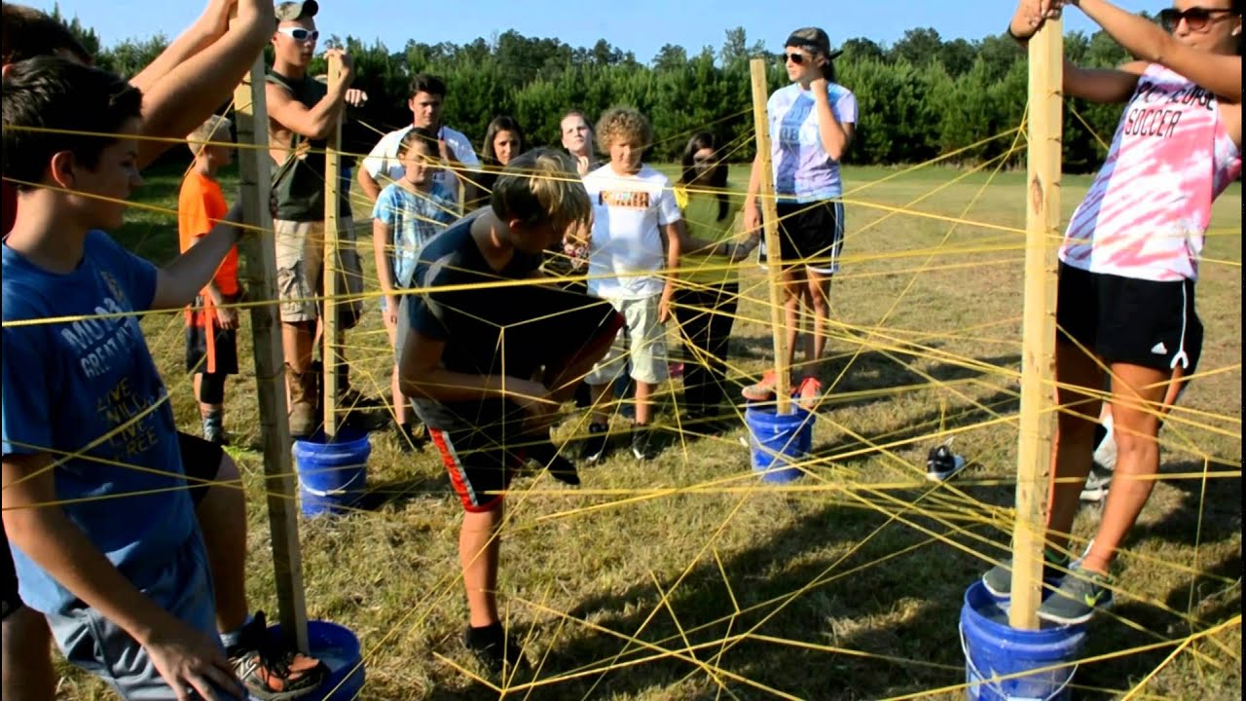
Camp Session Plans- SPIDEY’S WEB CHALLENGES
Overall Objectives | Outcomes/Success Criteria
Show good balance
Equipment: rope, beanbags, other equipment dependent
Theme/Focus: SPIDEY’S WEB CHALLENGES |  | Time 2-2.45pm | Image/Video link/ Parent Link
Set Up: Take the cord/rope/web and tie it on a tree or other available areas such as table legs or chair legs Then rap it around over trees and objects to form a web, criss crossing over each other at different levels Make sure you make the web high and low. How To Play​​​ Children are now Spidey (spiderman or spider woman) and have to perform skills over or under the spider webs CHALLENGES: Relays: Over the web one at a time in 2 teams, to retrieve an object from the other side. The team to collect the most objects wins Balance: Spidey must have good balance- can children go OVER from one side of the webs to another with a beanbag on their head Under- Spidey must be able to crawl under things as well as up things. Children must go under the ropes without touching. If they touch the ropes they have to go back to the start. Who can make it under to the other side the quickest? This can also be done with scooters if inside. ​
Coaching/Teacher Tips/Questioning: | Phrase Perfect/Technique:
Progressions: We can blind fold older children and sensibly guide them over the ropes. | Differentiation: |  | Differentiation:

