Slide 1
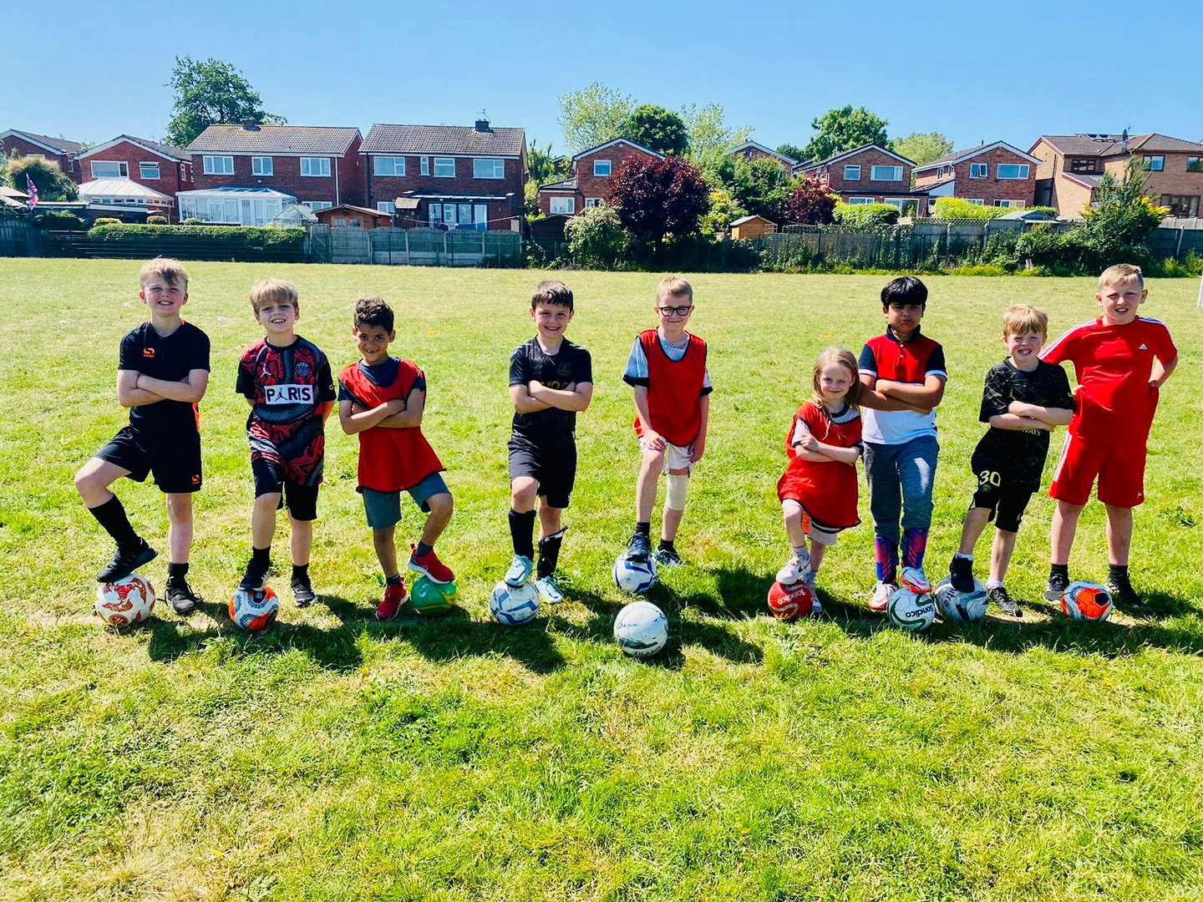


SUMMER HOLIDAY CAMP AT OLOP
ACTIVE • CREATIVE • FUN
Friendships • sport • crafts
water games • confidence
BE ACTIVE.
BE CONFIDENT.
BE YOU.
BE ACTIVE.
BE CONFIDENT.
BE YOU.

Slide 2

TAKE THE FLYER HOME!
SHOW YOUR GROWN-UP
QUESTION: Who might want to come with you?
BE ACTIVE.
BE CONFIDENT.
BE YOU.
BE ACTIVE.
BE CONFIDENT.
BE YOU.

Slide 3
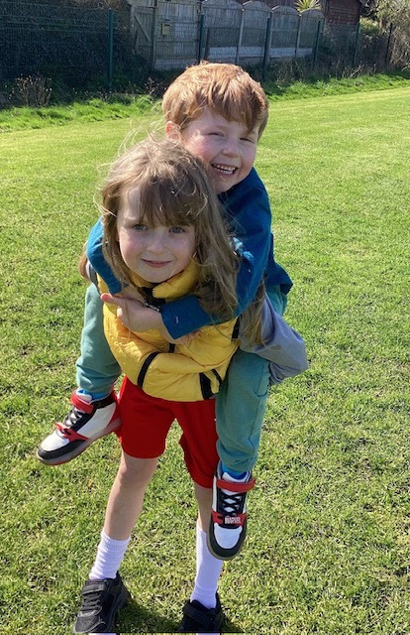
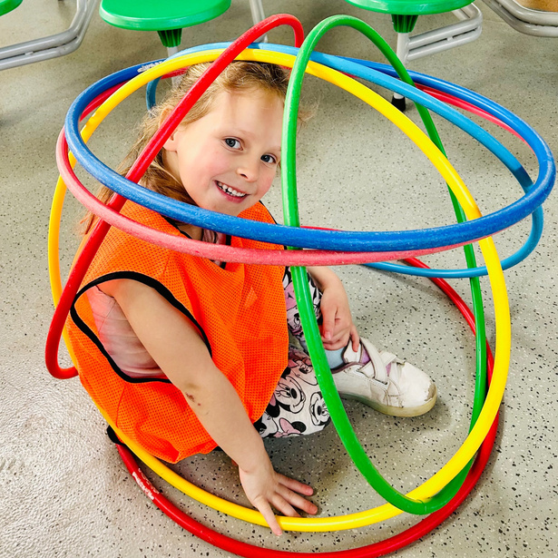
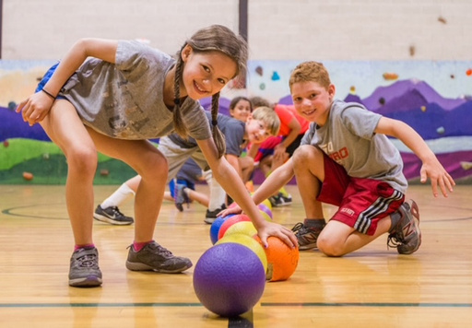
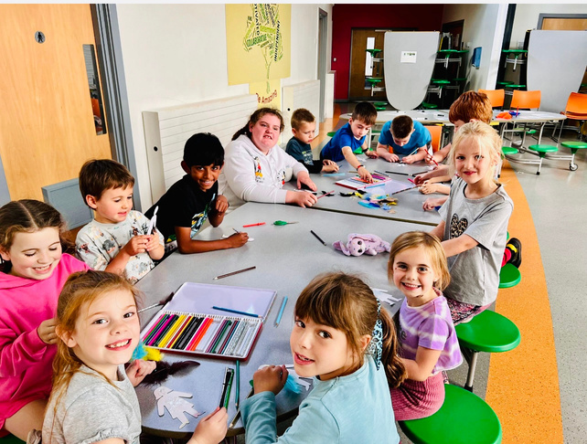
WHAT WILL WE DO AT CAMP?
SPORT
CRAFT
FRIENDS
CHOICE
A busy, happy day with lots of different things to try.
BE ACTIVE.
BE CONFIDENT.
BE YOU.
BE ACTIVE.
BE CONFIDENT.
BE YOU.

Slide 4
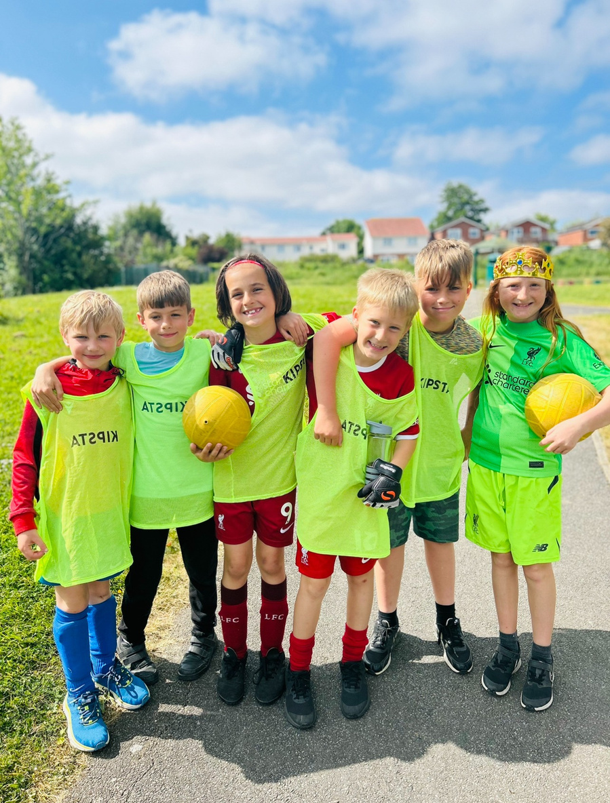
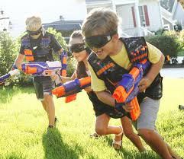
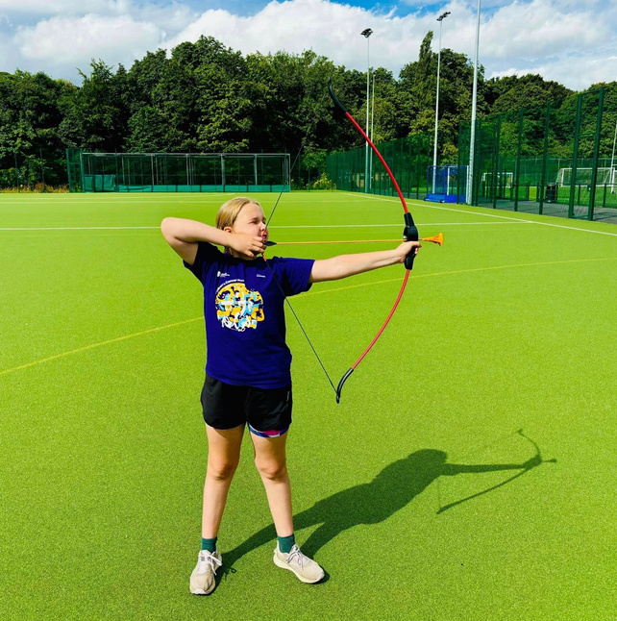
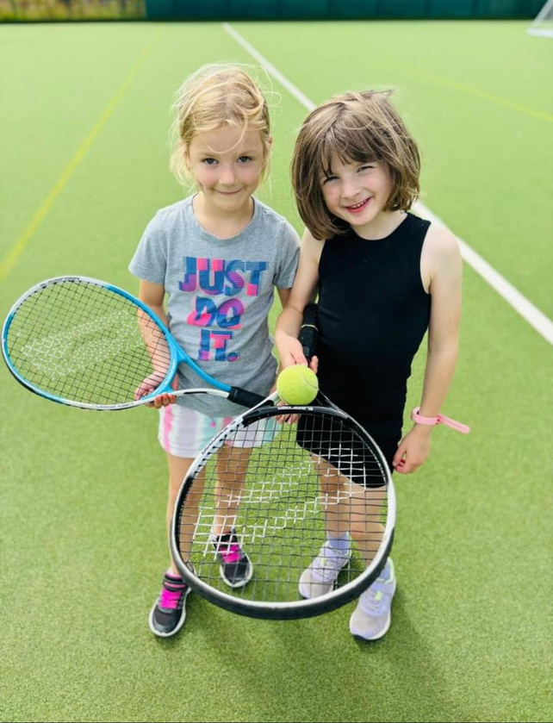
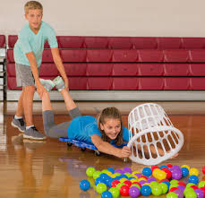
ACTION-PACKED VARIETY
DODGEBALL
NERF / ACTION
FOOTBALL
PLUS LOTS MORE
SPORTS & GAMES & CHALLENGES
ARCHERY
TENNIS
SCOOTERS
BE ACTIVE.
BE CONFIDENT.
BE YOU.

Slide 5

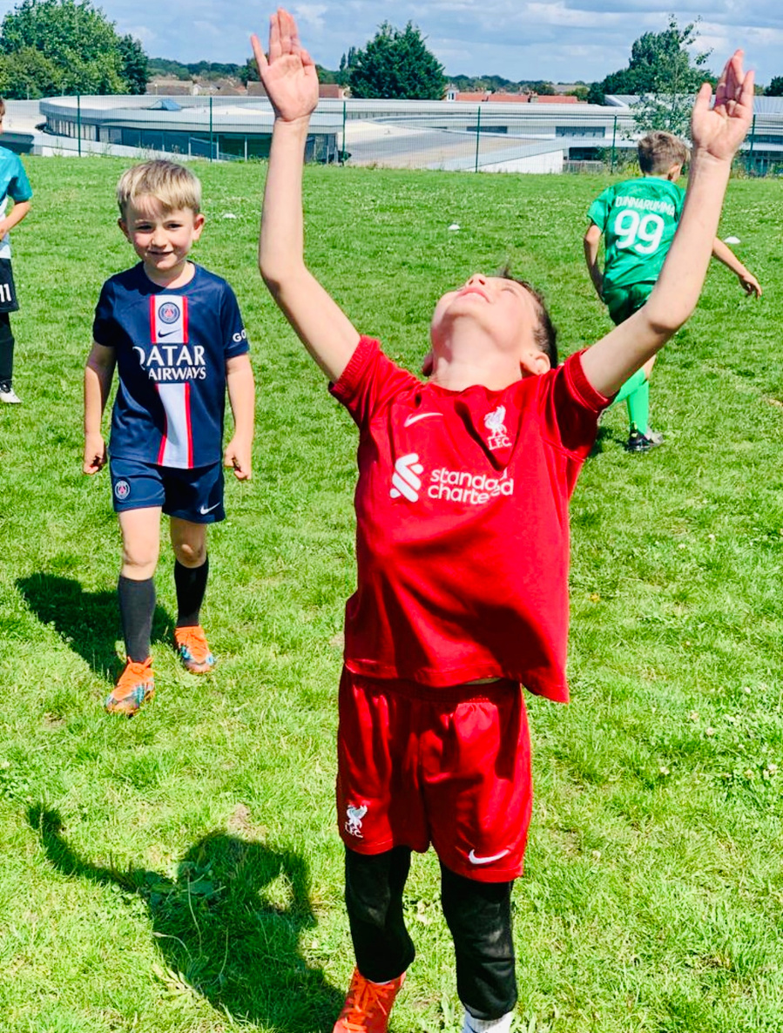
LOVE FOOTBALL?
REAL CAMP FOOTBALL
COACH ENCOURAGEMENT
FRIENDS • TEAMS • FUN
SKILLS • MATCHES • CHALLENGES • JUST FOR FUN
BE ACTIVE.
BE CONFIDENT.
BE YOU.

Slide 6
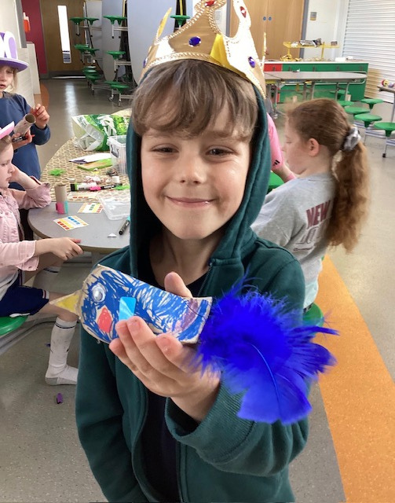
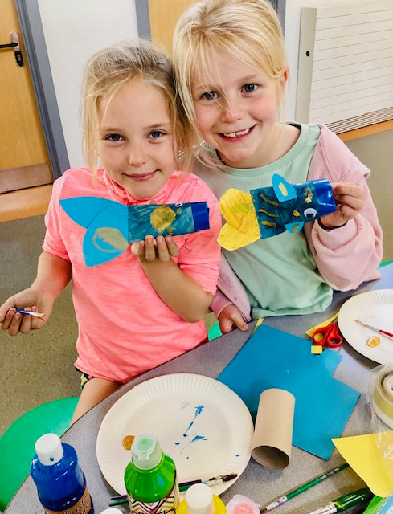
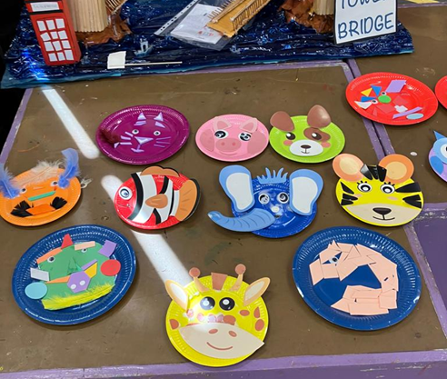
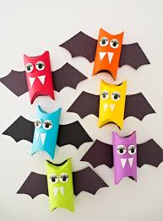
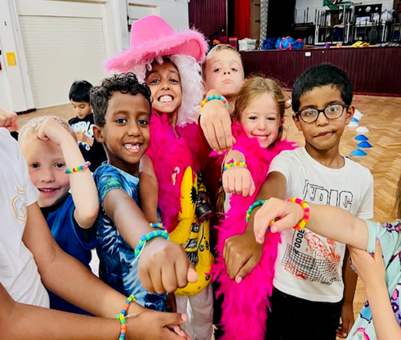
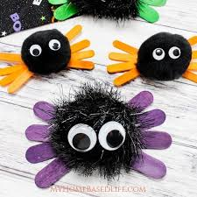
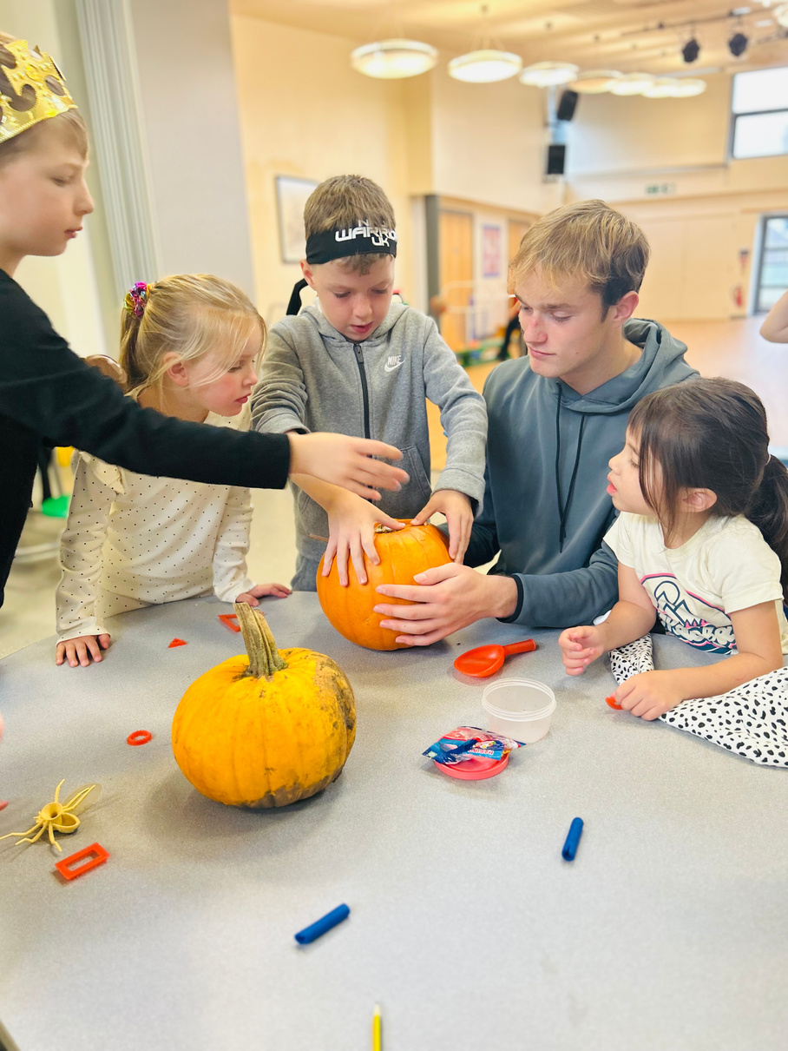
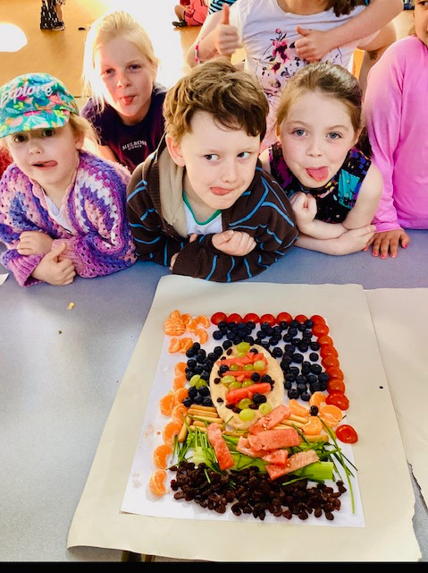
CREATIVE EVERY DAY
BE ACTIVE.
BE CONFIDENT.
BE YOU.

Slide 7

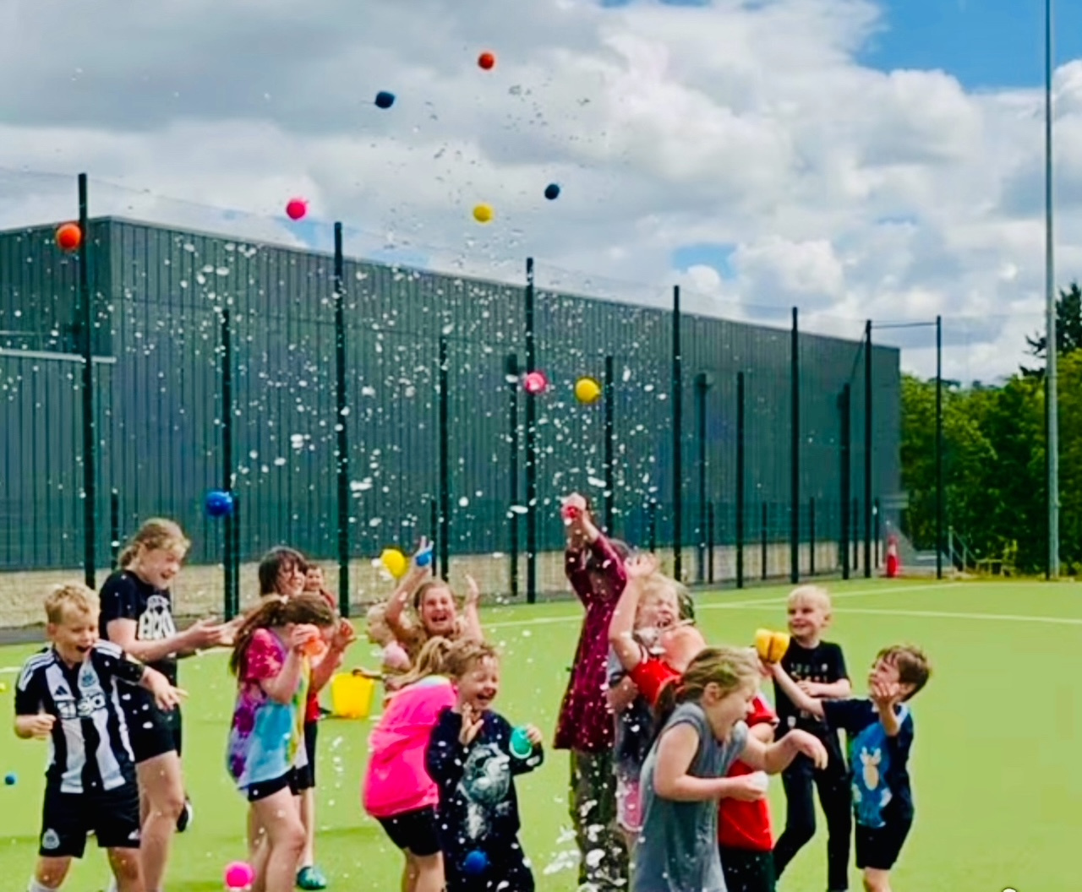
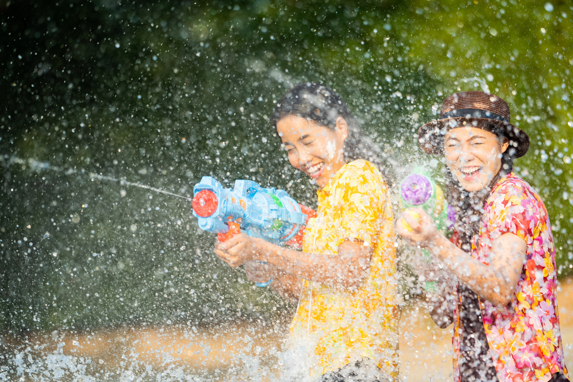
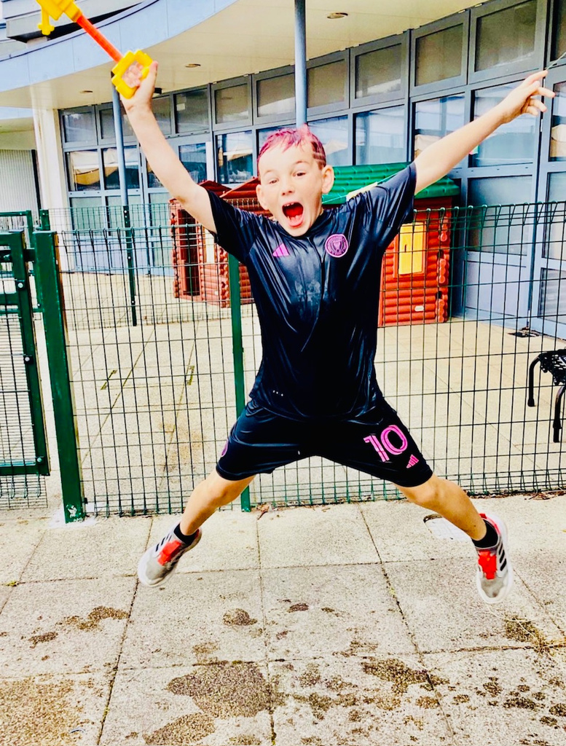
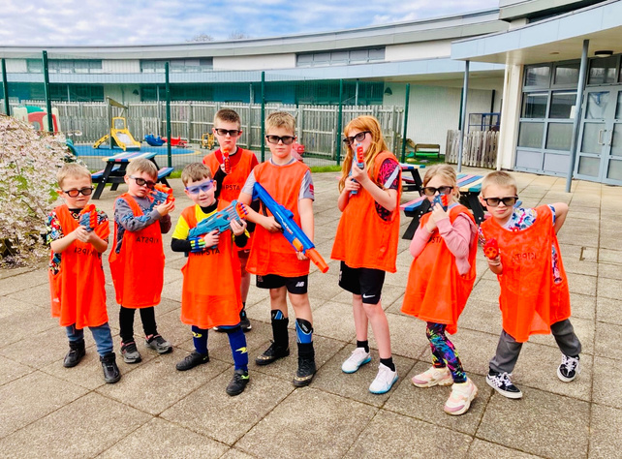
WET WEDNESDAY !
WATER GAMES
CHALLENGES
GET SOAKED!
BE ACTIVE.
BE CONFIDENT.
BE YOU.

Slide 8
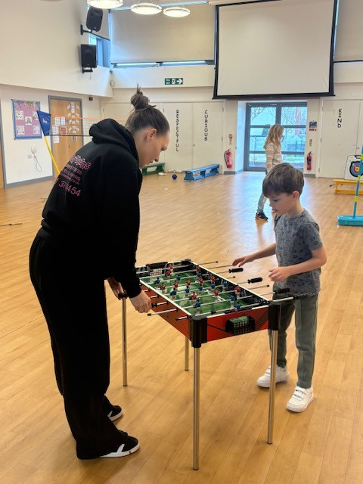
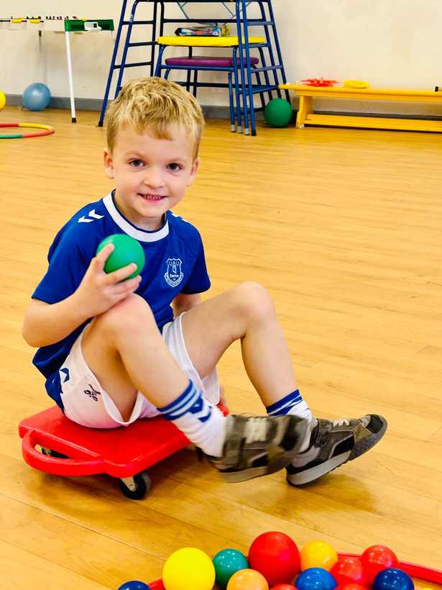
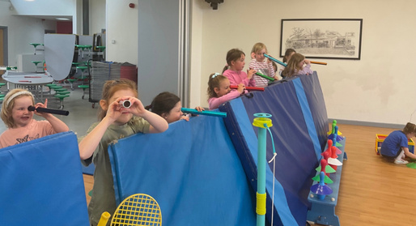
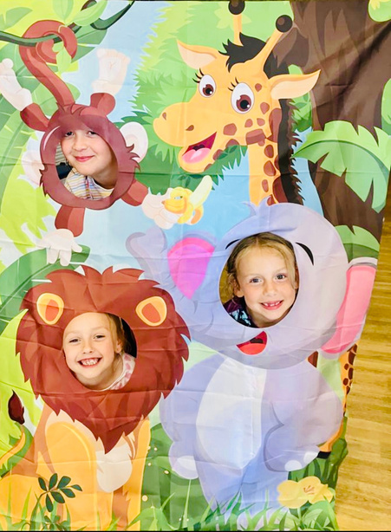

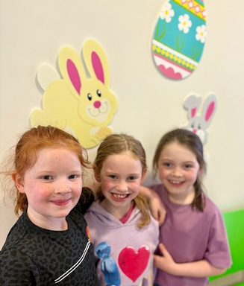
FREE TIME = YOUR CHOICE
TABLE FOOTBALL
HULA HOOPS
SCOOTERS
MAKE-BELIEVE GAMES
PHOTO FUN
FOOD ART
CHILL WITH FRIENDS
NERF BATTLES
BE ACTIVE.
BE CONFIDENT.
BE YOU.
BE ACTIVE.
BE CONFIDENT.
BE YOU.

Slide 9
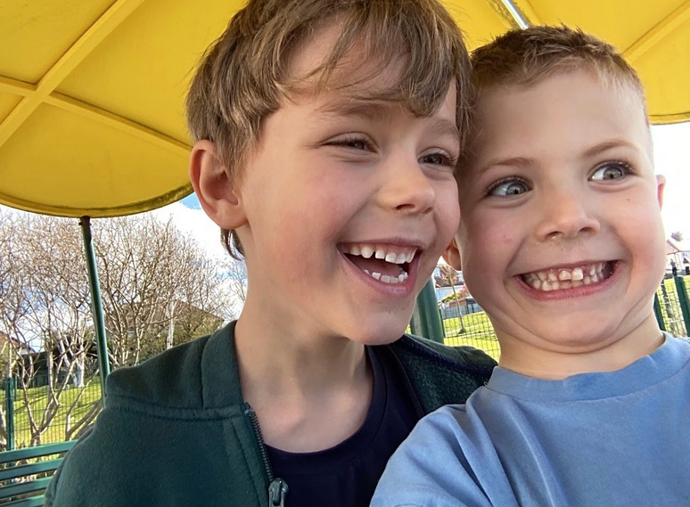
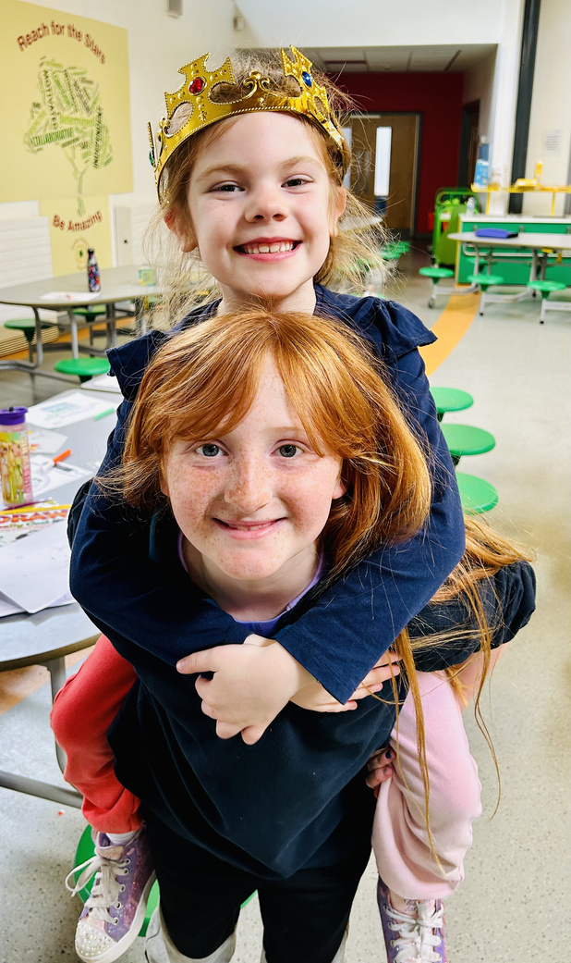
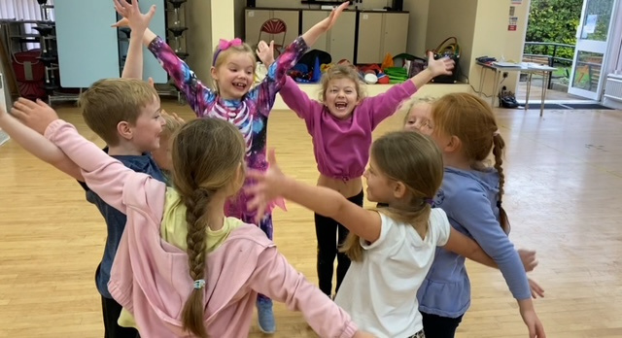
SAFE, FRIENDLY & WELCOMING
YOU DON'T NEED TO KNOW ANYONE
BE ACTIVE.
BE CONFIDENT.
BE YOU.

Slide 10
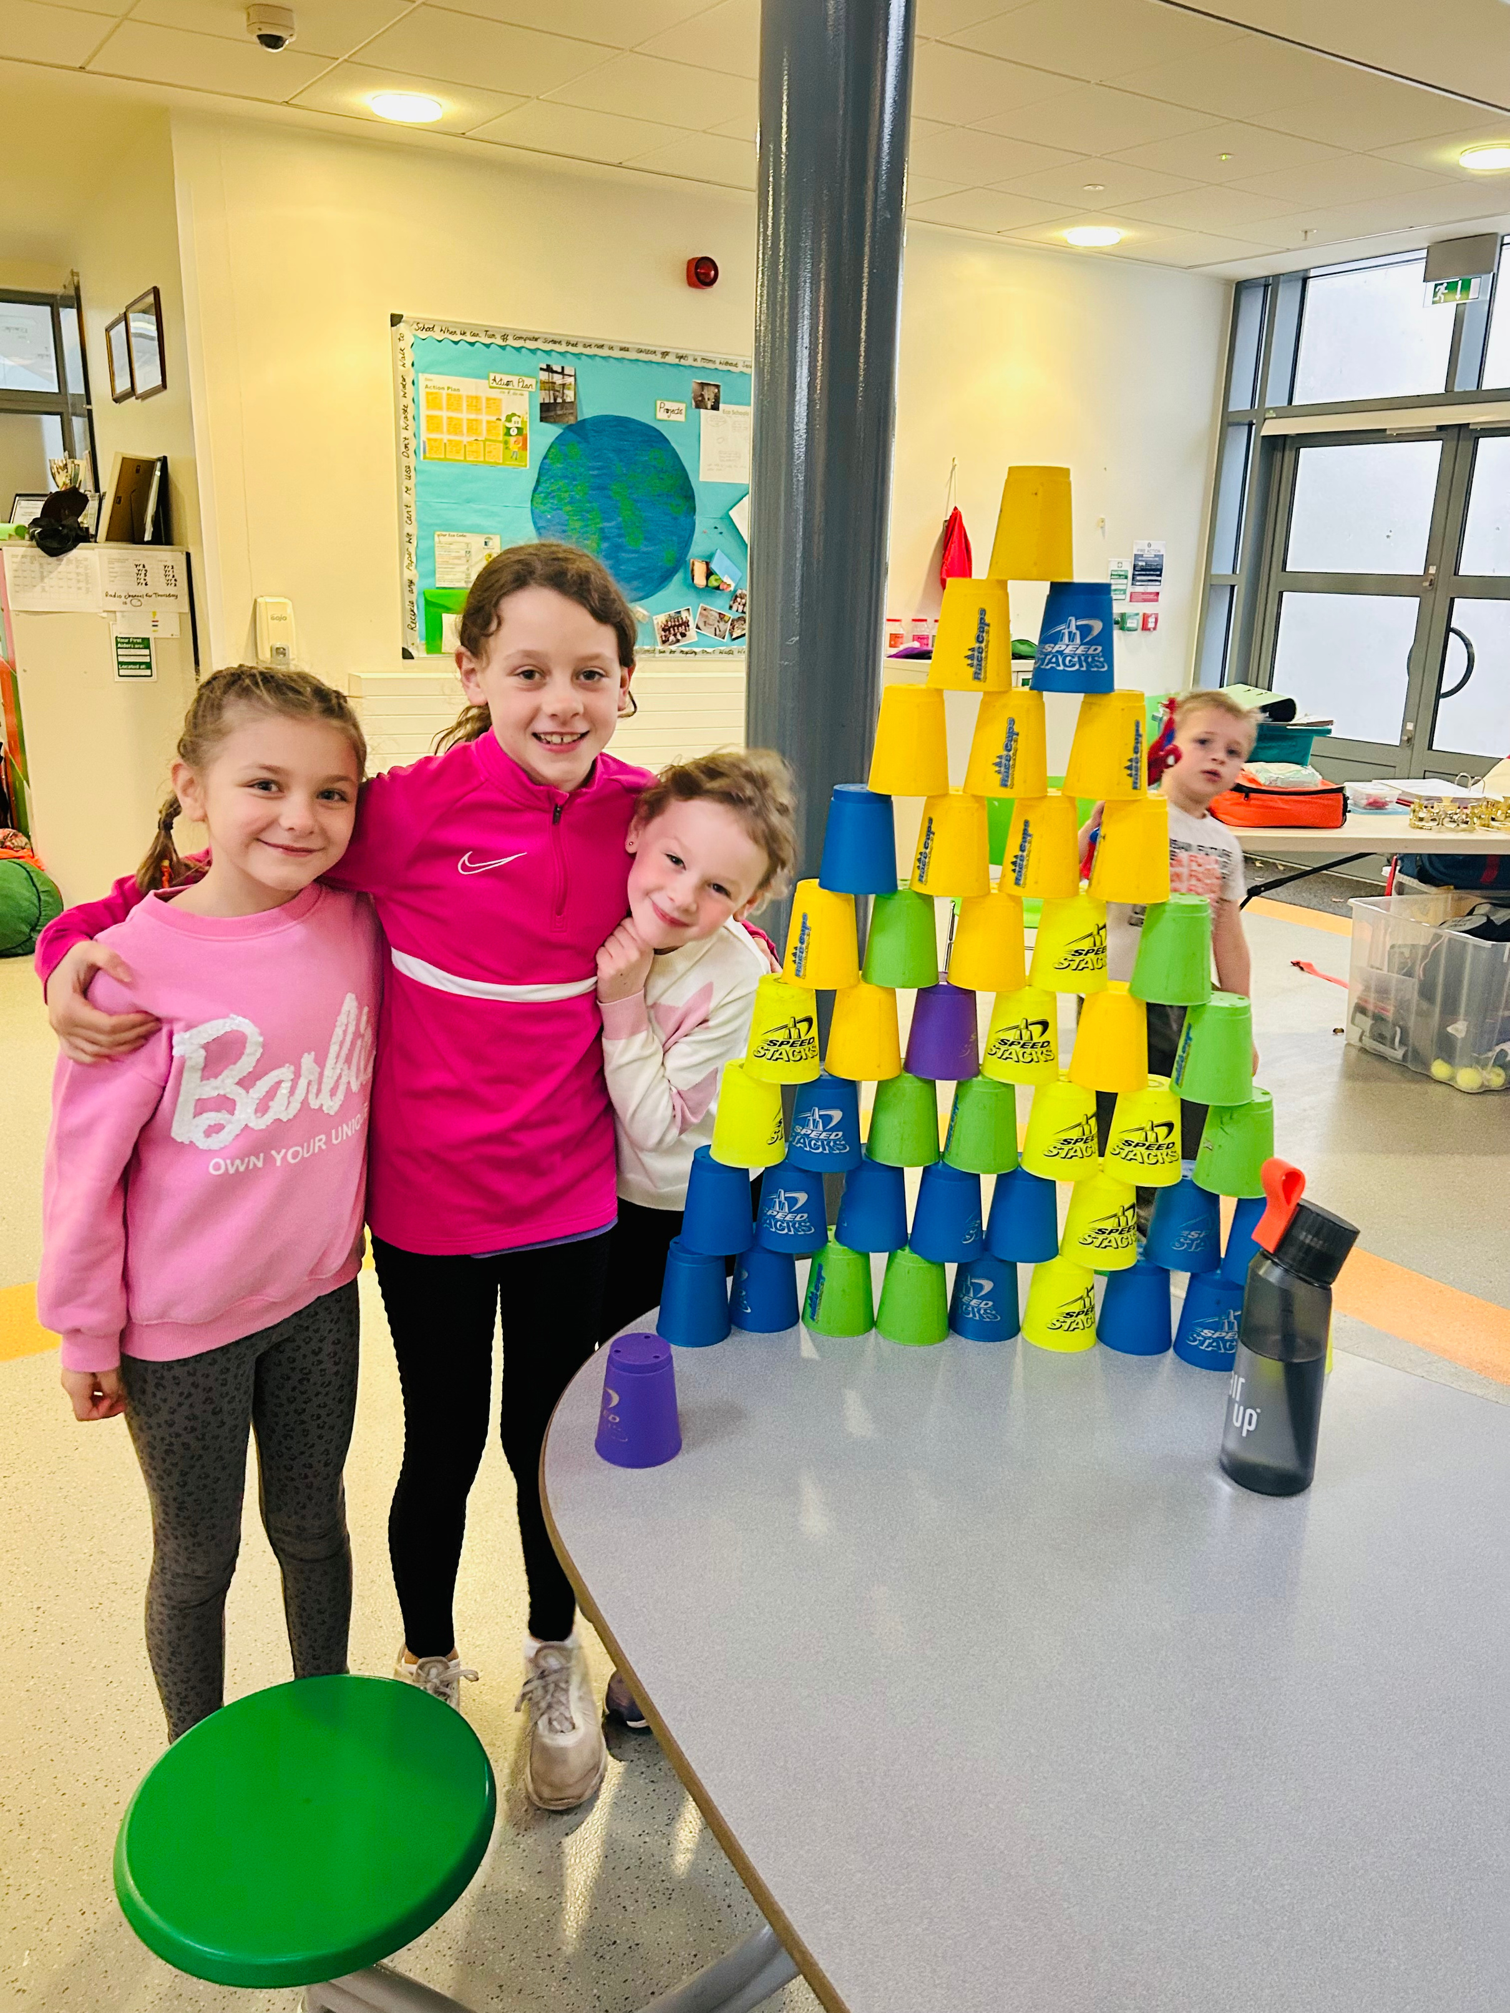
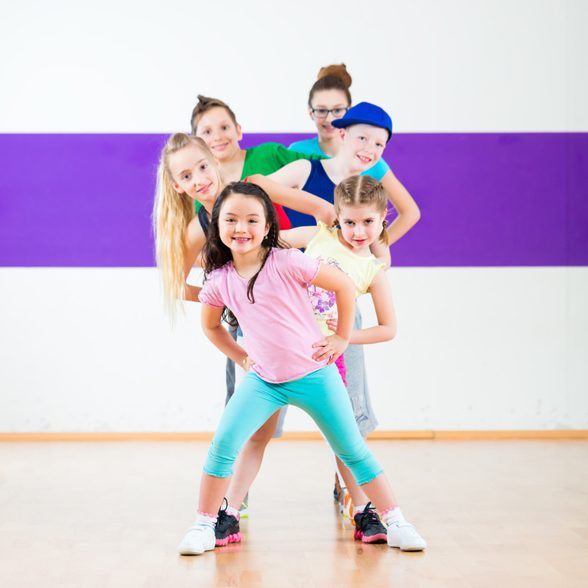
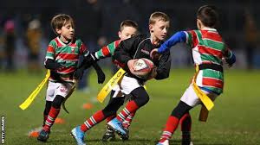
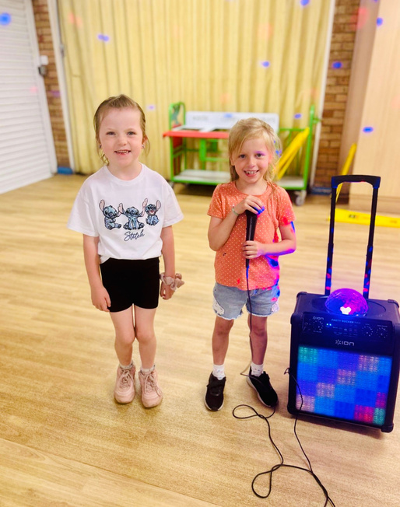
TRY SOMETHING NEW !
TRY SOMETHING NEW
ACTION GAMES
DANCE
ARCHERY
TENNIS
WHAT WOULD
YOU BE BRAVE
ENOUGH TO TRY?
RUGBY
BE ACTIVE.
BE CONFIDENT.
BE YOU.

Slide 11

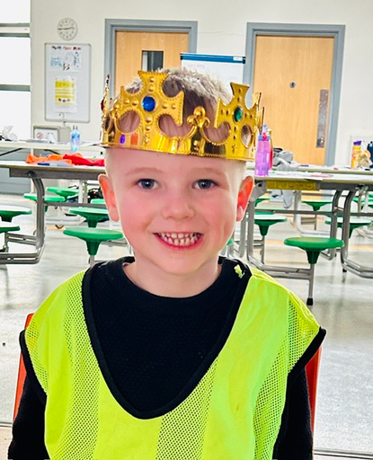
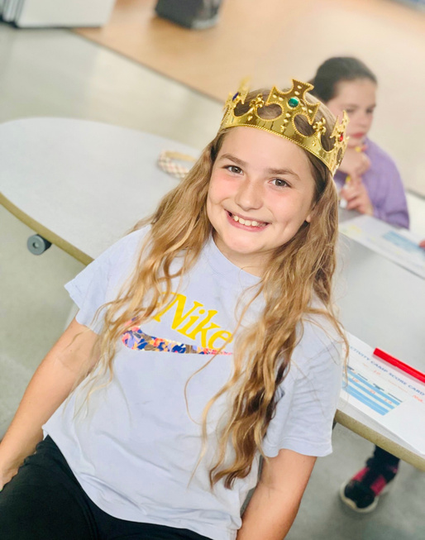
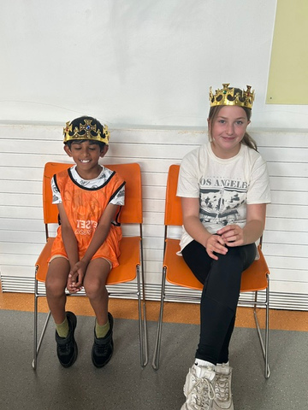
BECOME KING OR QUEEN!
Win challenges and games in your PE lessons and YOU could become King or Queen for the day!
Be active.
Be confident.
Be you.

Slide 12
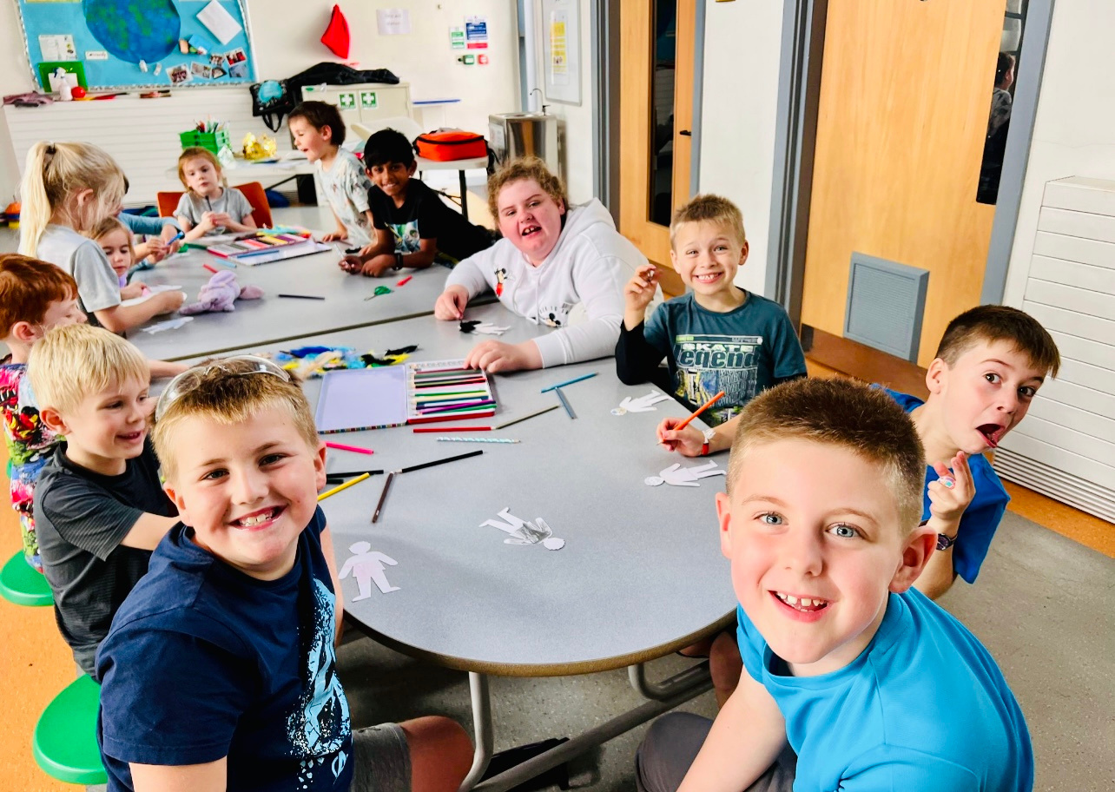
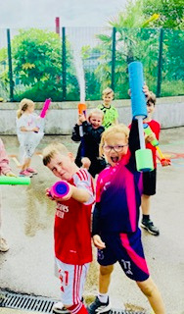

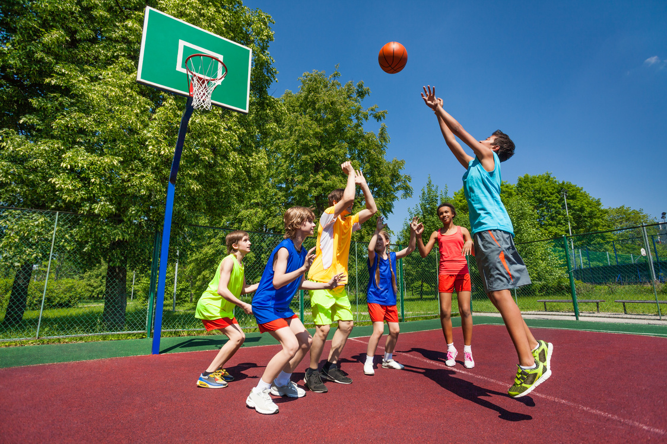

Could you be there?
Ask your grown-up to check the flyer
There will be sport, crafts, games, friends, Wet Wednesday and plenty of chances to try something new!
Be active.
Be confident.
Be you.

