Slide 1
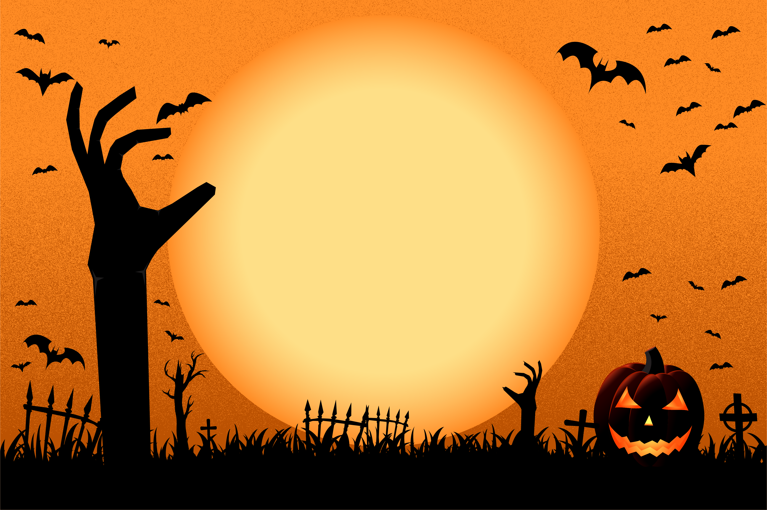


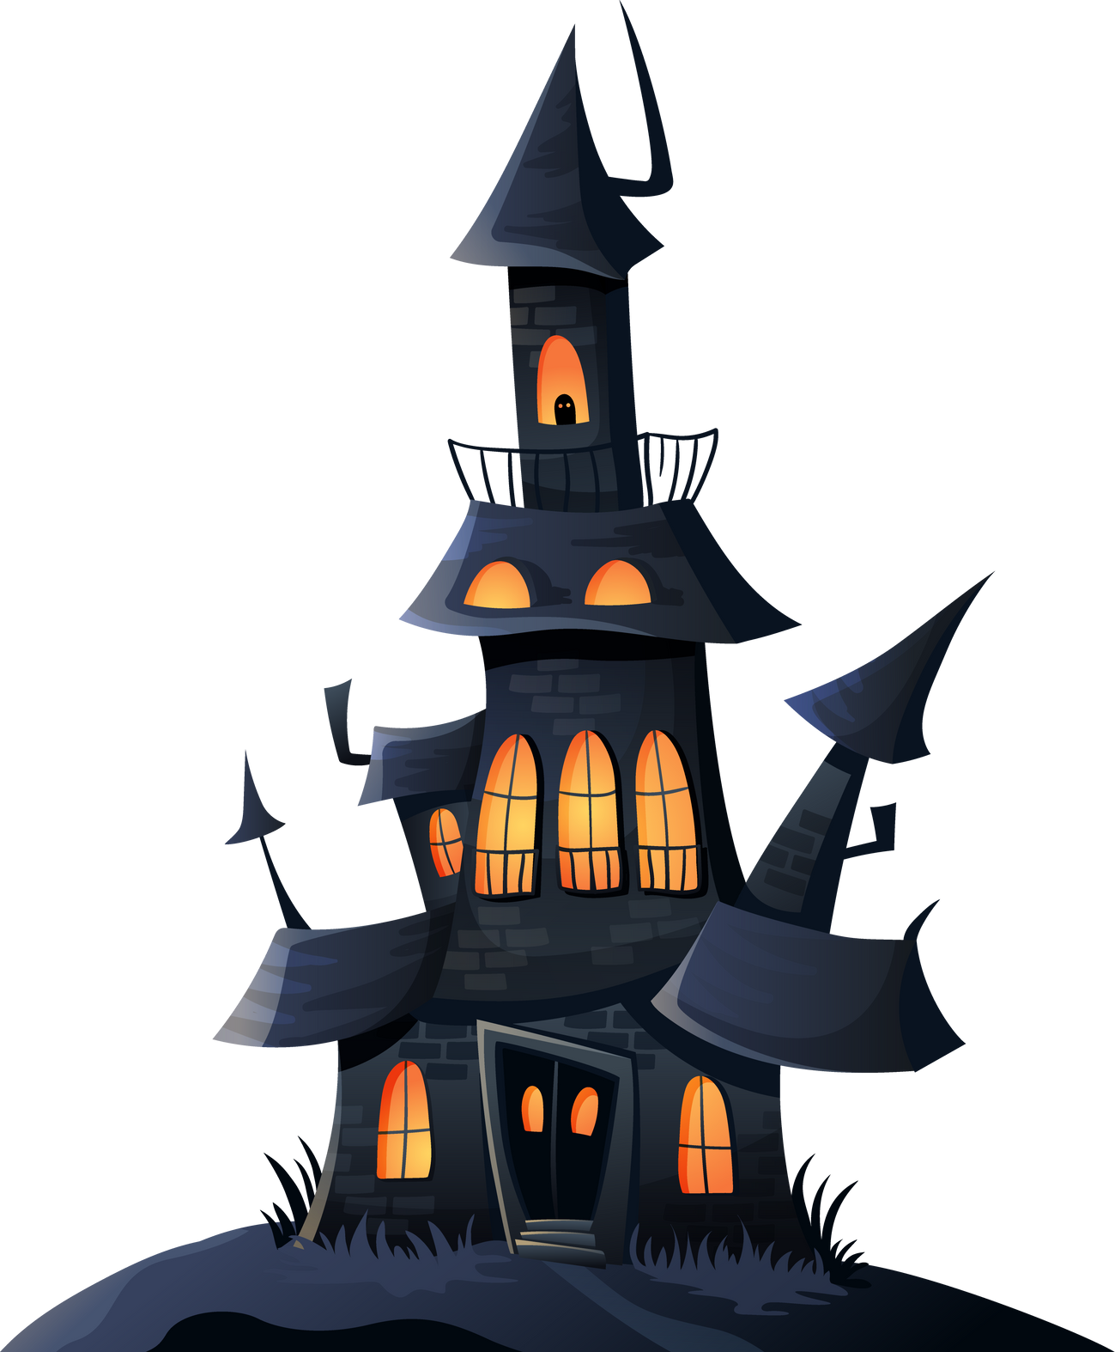

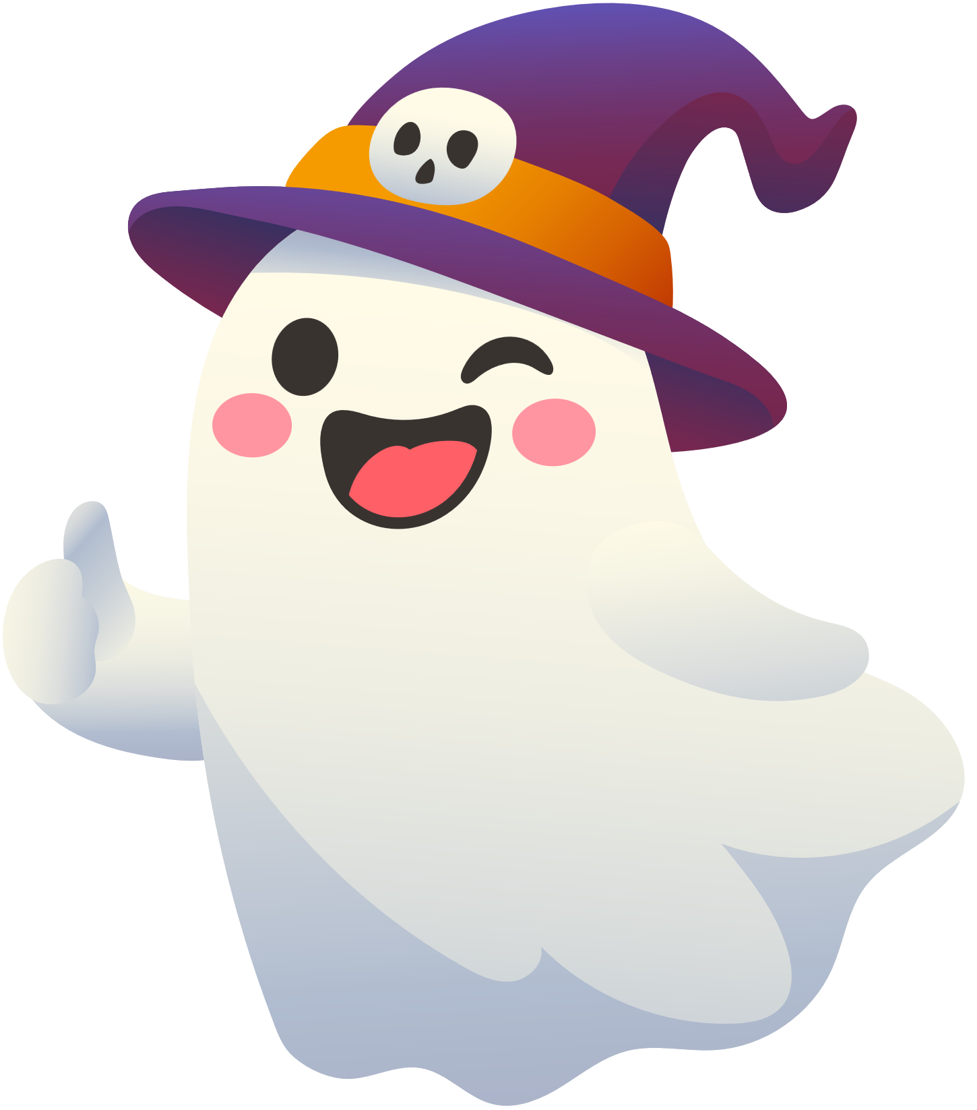
OCTOBER
HOLIDAY CAMP
Join us for 4 days of spooky fun, games & challenges!

Slide 2
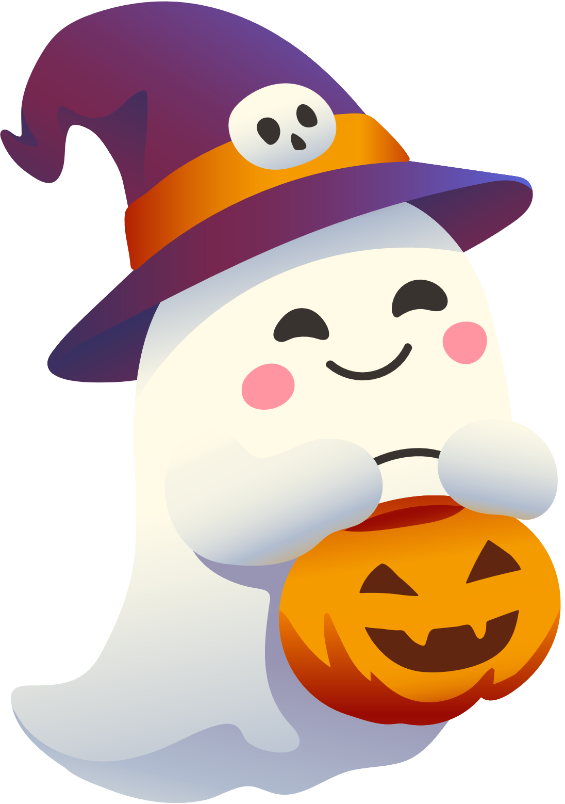
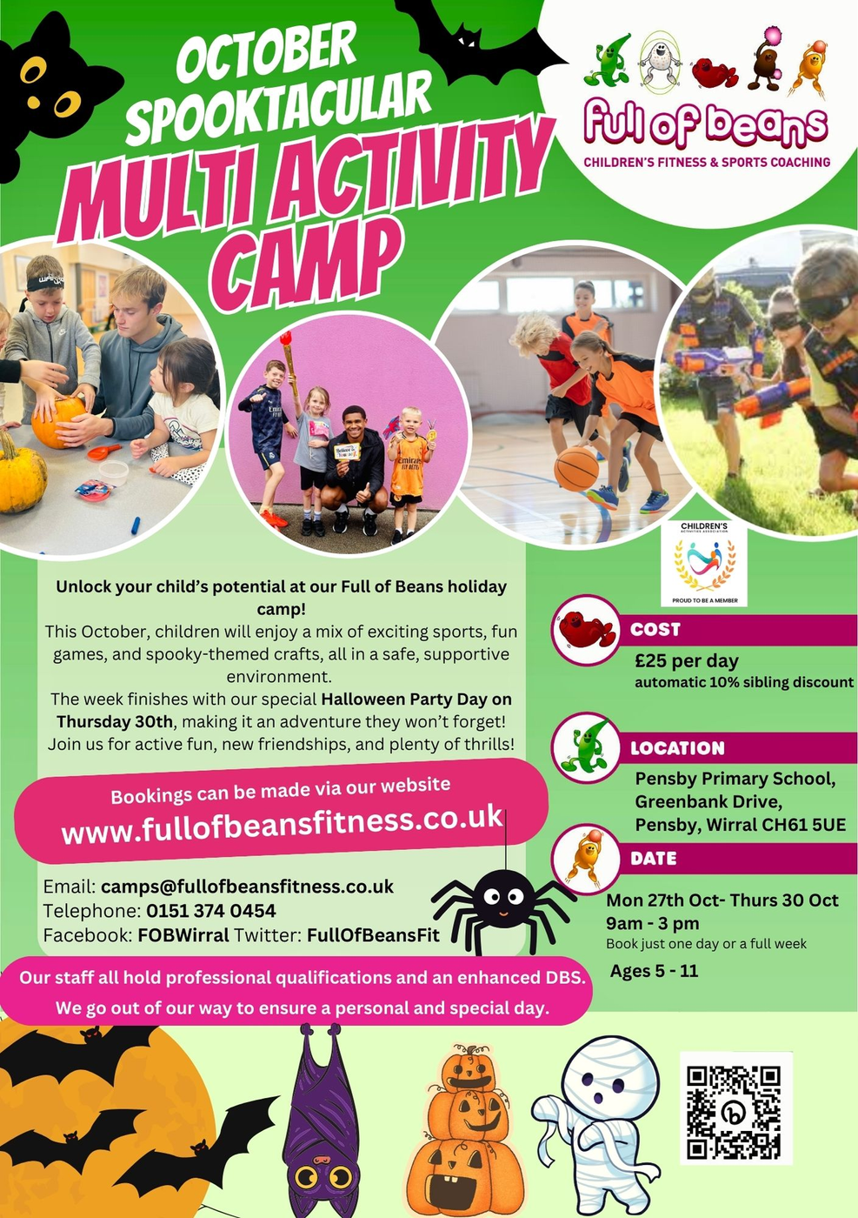
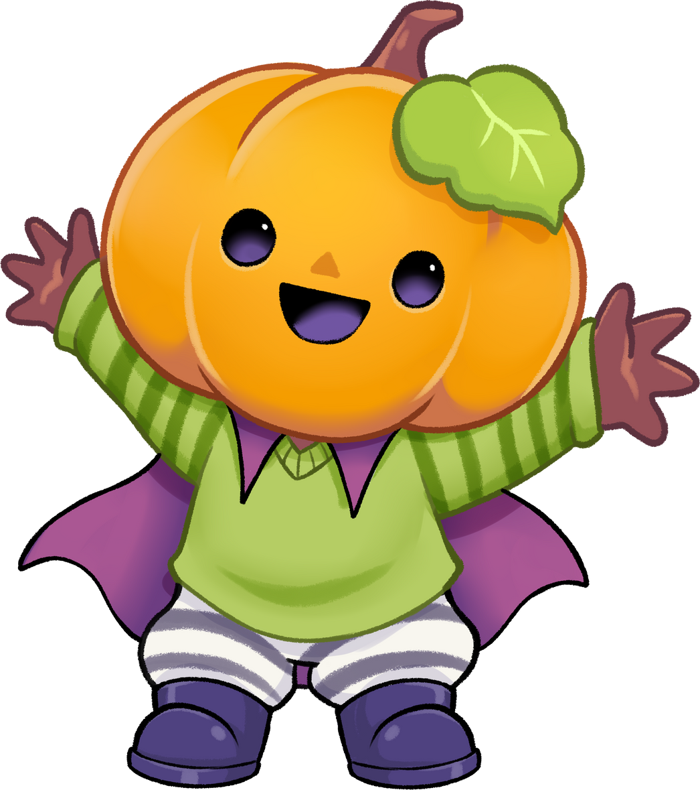
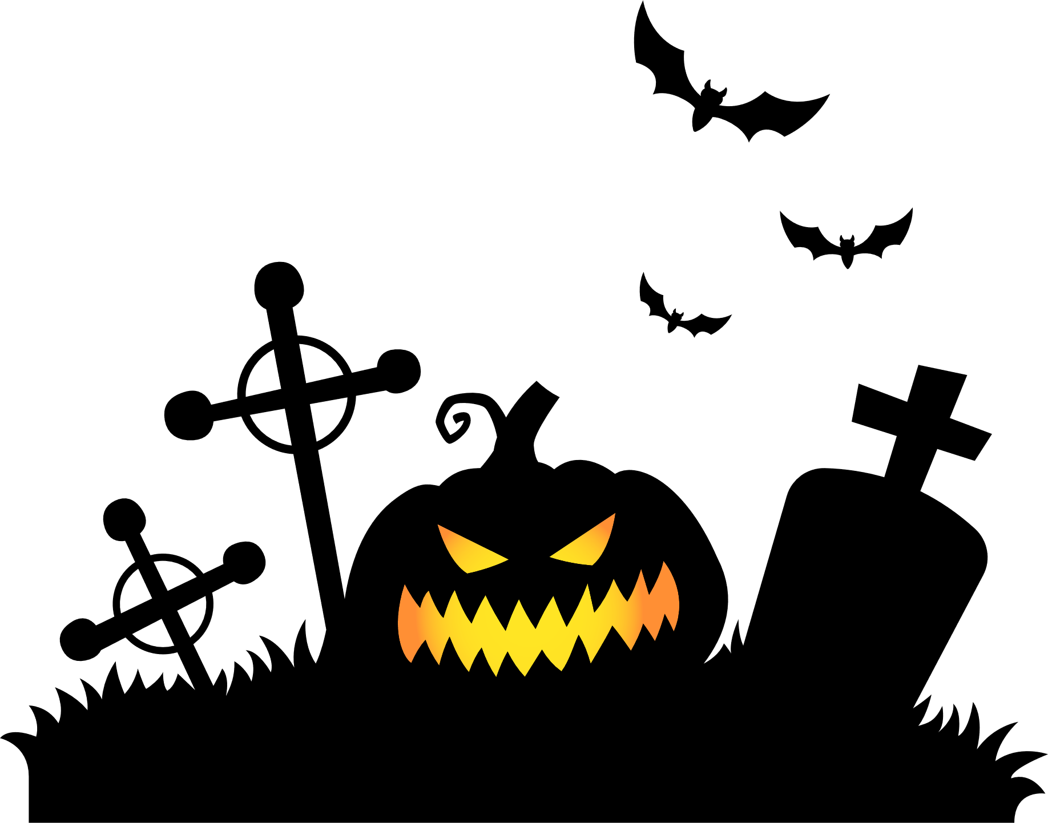

Slide 3

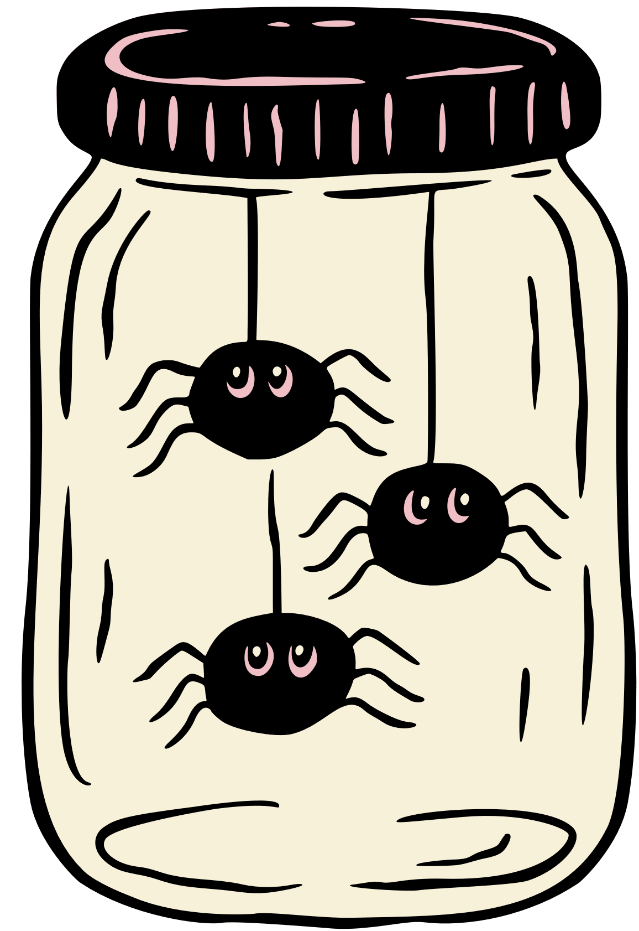
WHAT WILL WE DO?
MONSTER MADNESS MONDAY
  Spooky obstacle courses
  Monster Tag
  Ghoul Cup : Freaky Football
  Pumpkin Relay Races
  Creepy Crafts

Slide 4

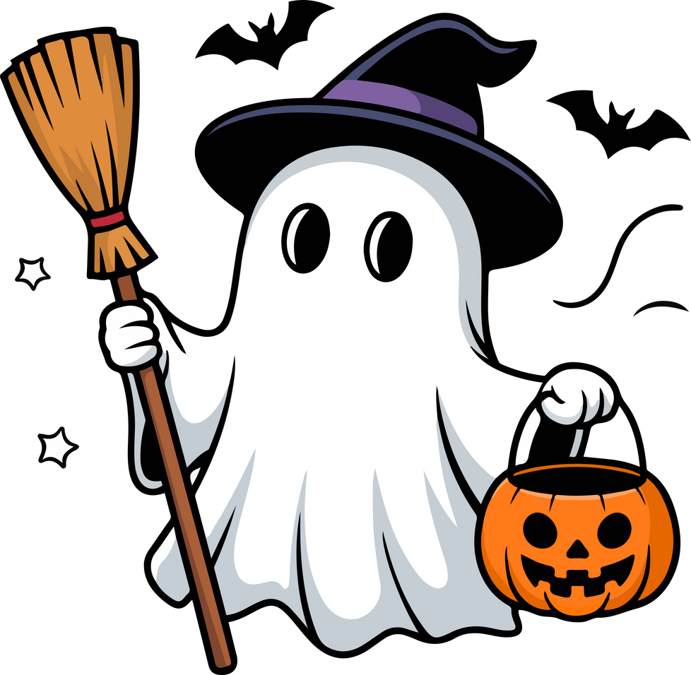
TRICK OR TREAT TUESDAY
  Trick or Treat Treasure Hunt
  Jokers Nerf
  Halloween Tag
  Eyeball Spoon Race
  Creepy Crafts

Slide 5

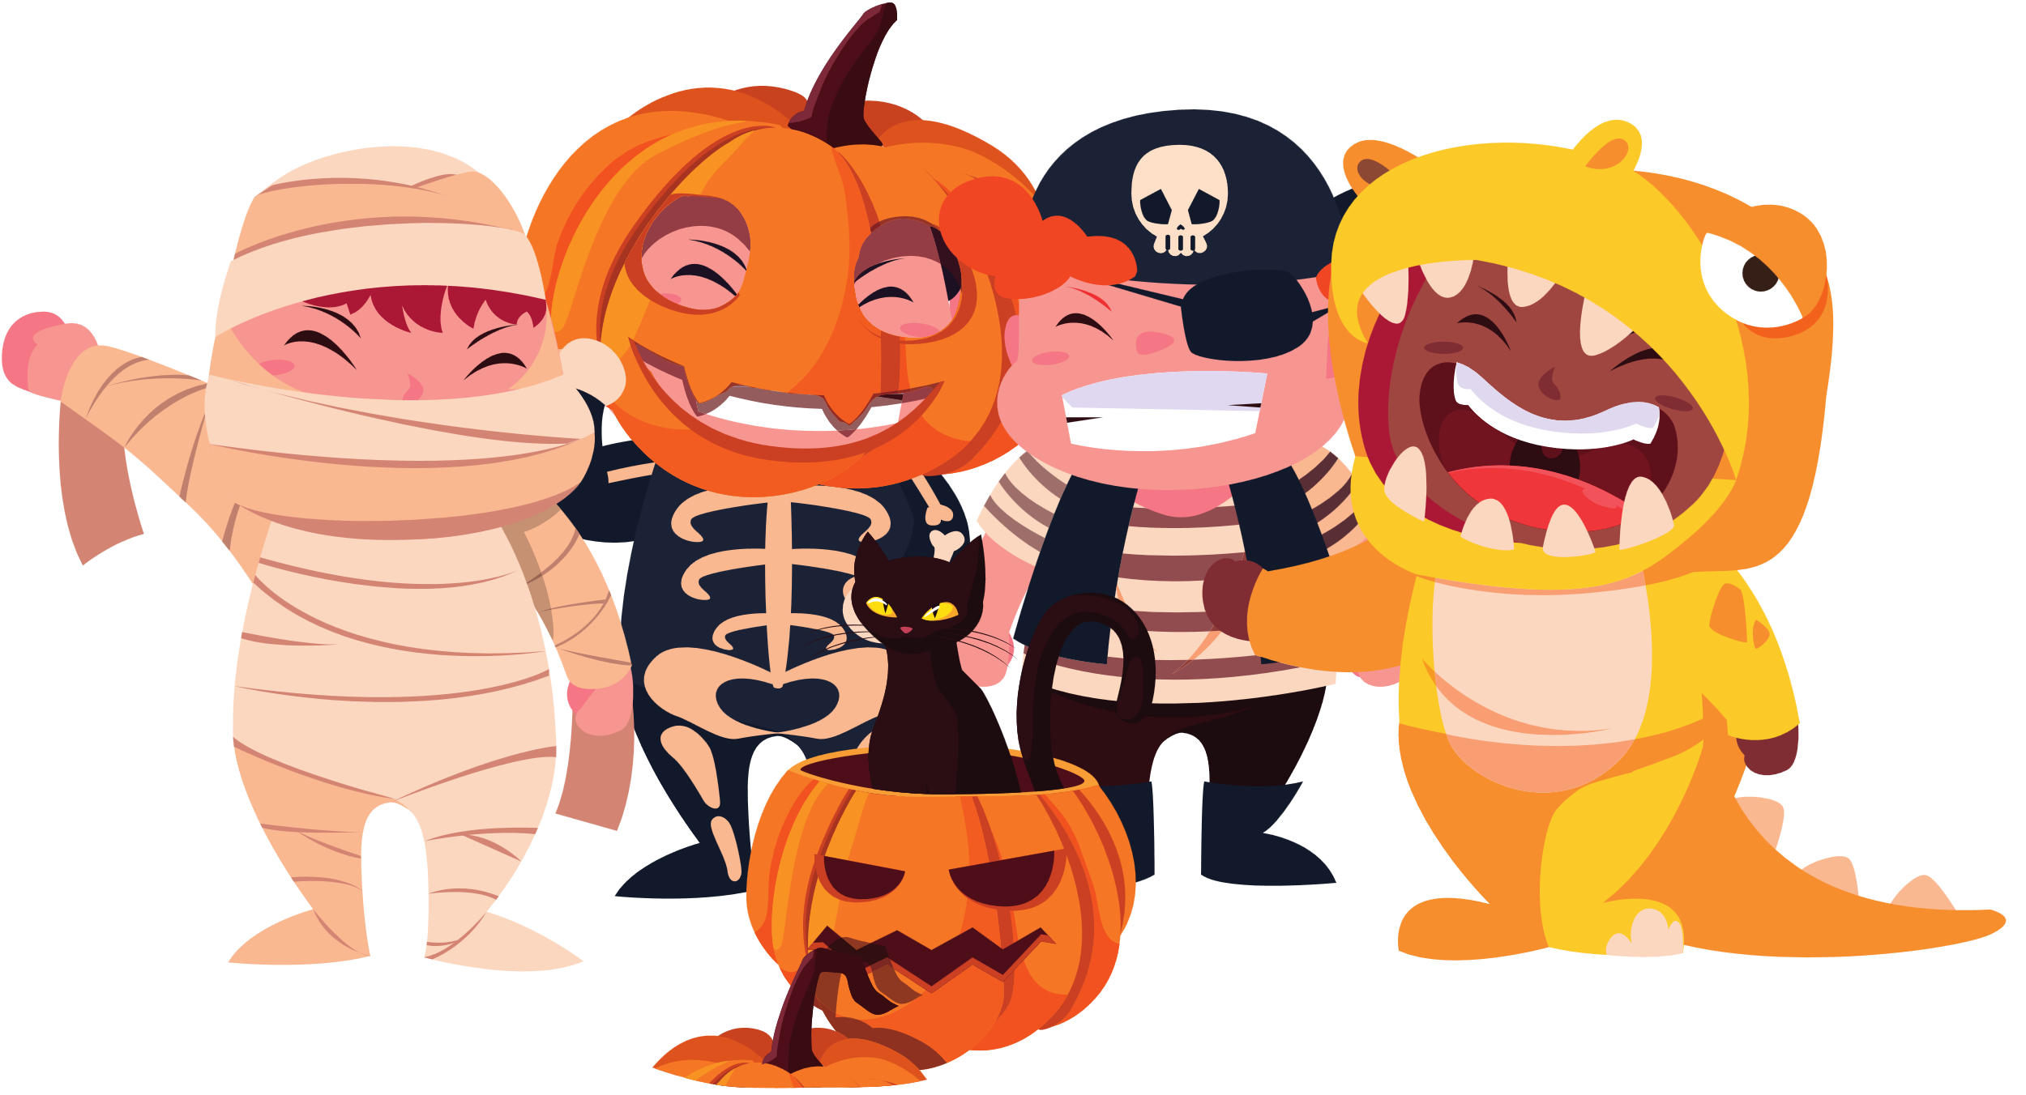
WACKY WEDNESDAY
  Spooky relays
  Zombie Dodgeball
  Spooky Glow Sports
  Ghostbusters Circuit
  Creepy Crafts

Slide 6
THURSDAY - PARTY DAY !
  Fancy Dress competition
  Glow in the dark Sports
  Pumpkin Carving
  Vampire Dodgeball
  Spooky Disco & dance offs
  Mummy Wrapping

Slide 7
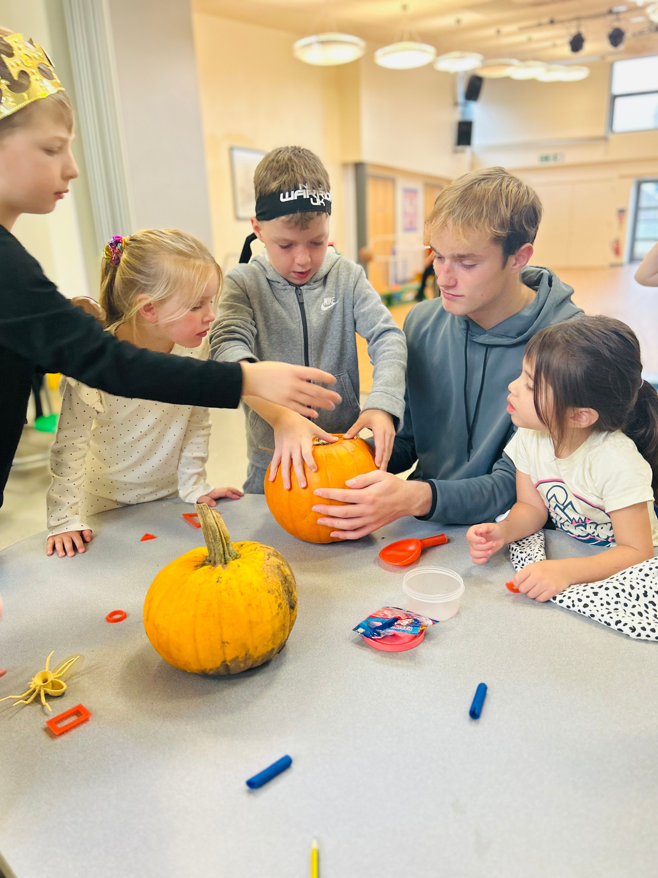
PUMPKIN CARVING

Slide 8

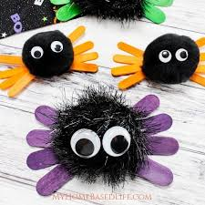
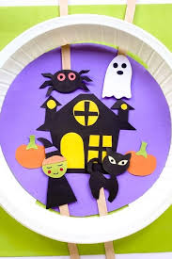
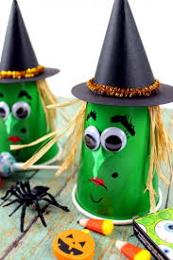
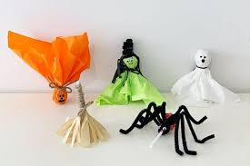
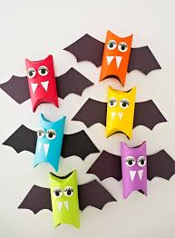
CREEPY CRAFTS
EVERY DAY
We will make a special creepy craft each day !

Slide 9
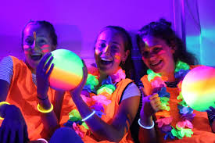
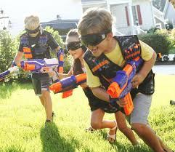
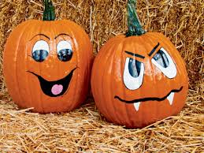
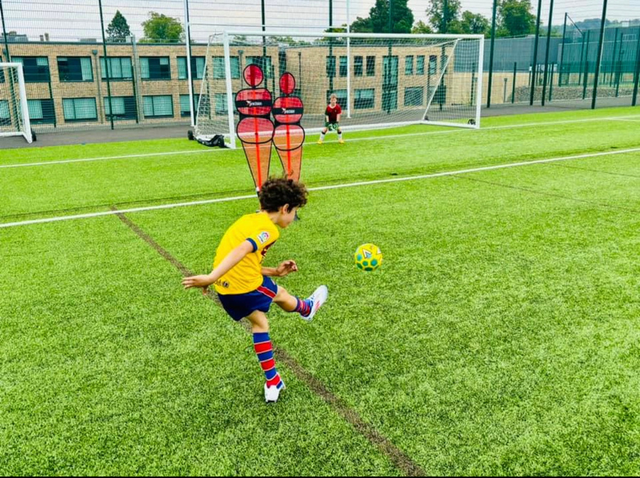
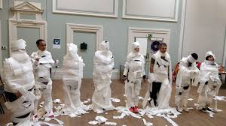
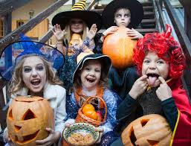

Slide 10
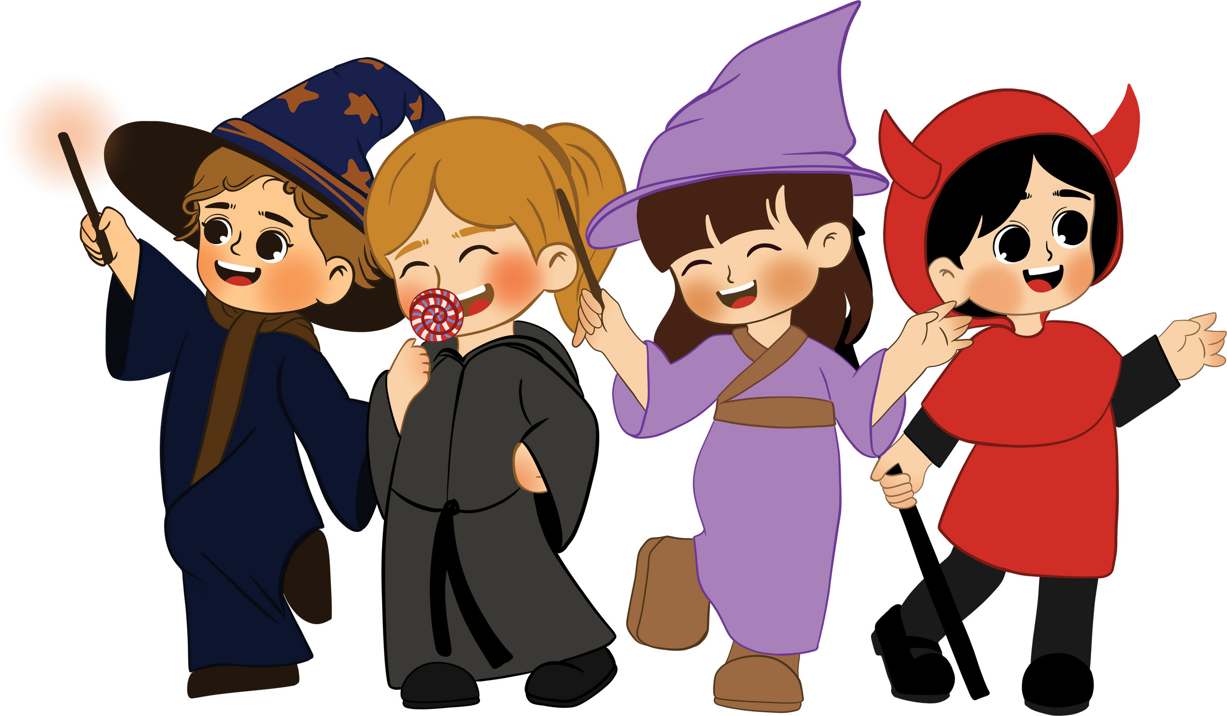
HOW DO WE BOOK?
Show Flyer to your families and head to our website!

