Slide 1
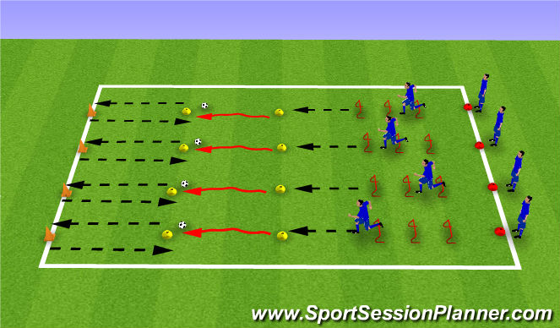
Camp Session Plans- Heart obstacle courses
Equipment: cones, bean bags, hoops and balls
S4K Sports Time: Obstacle courses |  | Time 45 mins | Image
How To Play Obstacle Course -​ Children can help you set up a course or coach set up a course​. See if you can set it up so children run in a heart shape. Children are times to see who can get around the track the fastest. ​ Children are timed with a stopwatch each time. ​ Children can run in and between cones, jump, do big steps and carry objects​ You can also split children into small groups and each group makes up an obstacle course. Give them 10 minutes to make it then call everyone together. ​ Each team shows their obstacle course off before everyone has a turn around it. Cupid’s races​ Split the children into teams of 4. They all stand behind the first cone and number them 1-4. ​ Children have to run one at a time to the end cone and back to their team. ​Add obstacles such as jumps, hoops over head etc. Once everyone has had a go their team sits down. ​ The first team to be sat down wins the race. ​ You can repeat with different movements
Coaching Tips & Questioning: Watch how children are moving during races, if they are struggling change the movements. If it looks easy make it harder. ​ Can the children think of ideas for relay races​. ​ Get children to keep track of their scores using cones. They can count after a few races to see who is in the lead.​ ​ Make this lots of fun and it doesn’t matter if they are first or second. | Phrase Perfect Script Today’s sport is Heart Obstacle courses. We are going to see if we can build and go around an obstacle course in the shape of a heart. Then we are going to battle in teams to see who can race and get through a small obstacle course first.
Progressions: Have the children move in harder ways e.g. hopping or each time a team wins they have to wait 3 seconds before they start next time as they did so well |  |  | Differentiation Differentiate the moves that you ask them to do e.g. Hopping instead of running.

