Slide 1
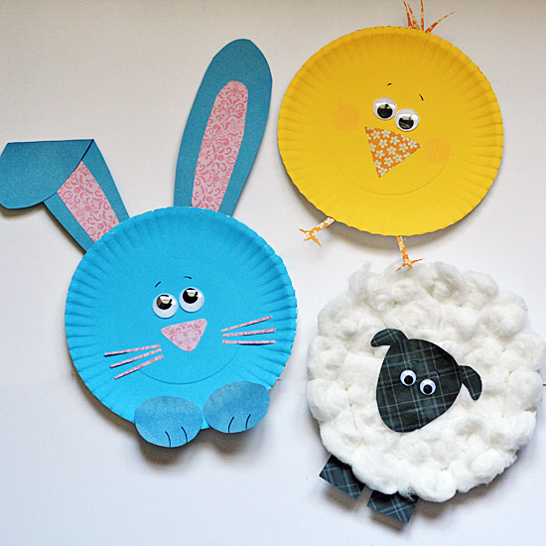
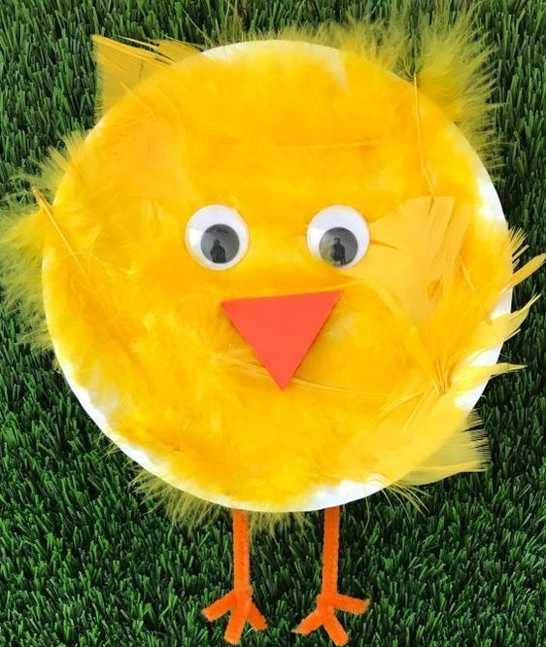
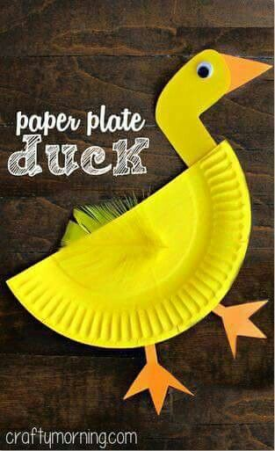
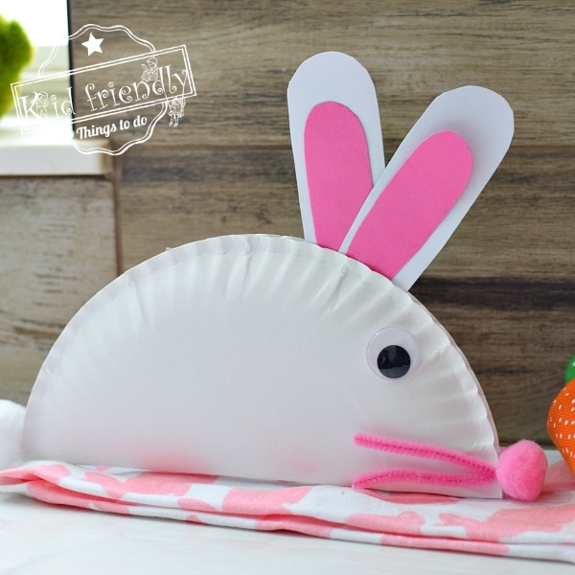
Camp Session Plans- Easter Plate Crafts
Overall Objectives | Outcomes/Success Criteria
Obj 1 Obj 2 Obj 3 | OC1 Oc2 Oc3
Equipment:
Theme/Focus: Bug Hunt | Time 45 mins | Image/Video link/ Parent Link
How To Play Children are given a paper plate to make into an Easter Animal Make sure they write their names on the inside of the plate They could make Chicks, Bunnies, Sheep, Ducks The Easiest things to do is to let them paint/colour the plate then you can add eyes, nose, ears with paper Sheep – Add glue and stick cotton wool/pompoms on then add feet and head Feather chick – add glue and stick on feathers. Then add eyes, beak and feet Duck – Cut a plate in half. Child can colour or paint. Make a head and feet to stick on. Add feathers, glitter etc Bunnies – Fold a plate in half and glue together. Make ears using card, add a nose and whiskers and a tail pompom/cotton wool) Set up Cover a table with newspaper/table cloth Have paper plates, card, feathers, coloured paper, eyes in pots for children to use You will also need glue and paint in a pot with a brush per pot
Coach Tips and Questions: See how many spring/Easter animals children can name. Do not limit their imaginations, although chicks are yellow if they want to have pink or a green sheep let their creativity shine. Watch how children are holding brushes, see if they can hold it like a pencil If a child needs help see if you can guide them first and move their hand before doing it for them Have templates of ears and feet ready to help children make these |  | Phrase Perfect Script For today’s craft we are going to make Easter animals from paper plates. Can anyone think of any Easter Animals? You can make whatever animal you would like and I will help if you need it. You can add glue and use pompoms/cotton wool to make a sheep or feathers to make a chick. Then add eyes, nose and legs You can paint and colour your plate, then make ears, eyes and stick on You could also fold or cut a plate in half and made a bunny or duck
Progressions: Let children cut, stick and do everything by themselves if you can. |  | Differentiation Help children with scissors and cutting if they need it Same with sticking things with glue, make sure they use enough to stick down.

