Slide 1
Camp Session Plans- Clown’s Silly Relay Races
Equipment: Cones, bean bags, hoop, balls
Rise and Energise; Relay Races |  | Time 45 mins
How To Play Clown off races Split the children into teams of 4. They all stand behind the first cone and number them 1-4 in each team. Give each team a coloured bib to wear so everyone knows what team they are on. Number 1 runs around the square once and grabs number 2. They hold hands and run round the square and grabs number 3. Repeat this till number 4 is collected. The first team to have all 4 players back to the start and sat down win the race. The next time around have them go around the square through different movement e.g. Running, jumping, skipping, backwards, balancing a bean bag on their head. Once the child is back the next person goes. They do not go together this time. Place a cone on top of the teams coloured cone if they win the race. Whichever team has the most cones at the end wins. If you have small numbers of children they can race and be timed, then see if they can beat their time. Clown Under and Over relays - ​ Put children into teams, make a line and person at the front has a ball​ Pass the ball, through the children’s legs, over their heads or over then under to the back of the line ​ Child at the back gets the ball and runs to the front ​ Keep going until the first person is back at the front and team sit down.​ Through the hoop relays​ - Children hold hands in a circle, with hoop over arms. ​ Children have to pass the hoop around without letting go of hands till it gets back to the start​ Clown Balance ​ Each team has a beanbag and take turns one at a time ​ They must balance the beanbag on their head all the way to the end and back ​ If it falls off they have to stop, pick up and put it on their head before they move again Set up Make a big square with 4 cones. Where the first cones are have 2 (or more if there is more than 2 teams) different coloured cones beside it so they can clearly see where they have to sit.
Coaching Tips & Questions: Watch how children are moving during races, if they are struggling change the movements. If it looks easy make it harder. Can the children think of ideas for relay races​. Get children to keep track of their scores using cones if possible, they can count after a few races to see who is in the lead.​ Make this lots of fun and it doesn’t matter if they are first or second. If you have small numbers children can be in one team or battles against a coach going multiple times. | Phrase Perfect Script Today we get to be like the silly clowns at the circus. Has anyone seen or met a clown before? What do they look like? Are they silly? We are going to do some relays races with all our clown friends today to get us warmed up and ready for our day at the circus.
Progressions: Have the children move in harder ways e.g. hopping or each time a team wins they have to wait 3 seconds before they start next time as they did so well |  |  | Differentiation Differentiate the moves that you ask them to do e.g. Hopping instead of running.

Slide 2
Camp Session Plans- Silly Scooter and water games
Equipment: Cones, scooters, small balls, water guns, buckets
S4K Sports Time: Scooter and Water games |  | Time 45 mins
How To Play Clown car Race Track Use the cones to set up a race track, if outside or in a bigger space you can set up multiple Children have to race around the track as quick as they can. Children can try it by using the scooter in different ways, on tummies, bottoms etc Time children to see who is the quickest or race against each other on a track each Clown nose collection Place lots of balls (clown noses) in the middle of the play area Split children into 4 teams and give them a coloured hoop each (R,Y,B,G) Children must scoot one at a time and collect 1 clown nose at a time They go back to their team and place the clown nose in their teams hoop then the next person can go Once all the clown noses has been collected the game ends Children can then count how many clown noses they have collected Clown Pie collection Place lots of small balls (pie’s) in a pile in the middle of the room Once child lays on the scooter on their tummy, hold a hoop in their hands and bend their knees or someone can hold their legs A friend pushes the child on the scooter to the pile of shells Using their hoop the child on the scooter must trap as many balls and they can with the hoop and take them back to their basket The person on the scooter stays on the scooter for the round with their friend pushing them the whole time there and back Once all the shells are collected it’s the end of the game Count how many shells, each team has collected Repeat with new person on scooter until everyone has had a go Clown bucket fill Split the children into two or more teams Give each team a sponge or empty paint pot/cup Children have to fill their cup with water and race with it to the other side and place it in the bucket They then race back and pass the cup to the next person After 3 minutes you can stop the game and measure to see which team has the most water in their bucket If children hold cups on top of their head they will start getting wet Clown confetti dash Split children into two teams and have a runway marked out with 2 long lines of cones. One team are the clowns, they get water guns and stand on the outside of the run way spread out rom end to end. They have to spray water (confetti) at the audience as they run past. The other team are the dolphins. They have to run from one end to the other and avoid getting hit by a water gun. Optional to collect an object and if hit they must drop the object. Once the team have had 3 minutes swap teams. Each time the children get to one side they have to wait for the rest of the team before they run back. Set up Each game has a different set up but will need cones, balls, bean bags, scooters and uni-hoc sticks
Coaching Tips & Questions: Make sure children take turns in races and wait for their teammate before starting When holding the tennis racket show them where their hand should be positioned. Make sure children use scooters correctly sit | Phrase Perfect Script Today we are going to join the clown’s playing some silly games with our scooter boards and water games. There are a few thing we need to know about the scooters before we play with them so listen carefully on how to use them then we can start our games.

Slide 3
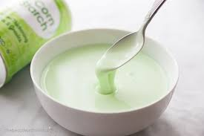
Camp Session Plans- Clown’s Crazy Oobleck
Equipment: Mixing bowl, cornflour, cup of water, food colouring and glitter
Messy Play; |  | Time 45 mins
How To Play Have 4 or 5 children round the tuff tray at a time Follow the messy play Gloop/oobleck sheet. Cornflour should be 1 cup to 1 cup of water. If children do not want to touch the oobleck put some in a zip lock bag and see if they will play without the mess Even children who have played with the slime can take some home in a named zip lock bag Set up . Tuff tray on table or floor with tablecloth underneath Obbleck is both a solid and liquid as it’s a non Newtonian fluid
Coaching Tips & Questions: See if children can name lots of mermaids and mermaid colours. Children can colour the slime individually or pick a colour as a group Give children time to play with the slime and then they can have some to take home in a bag Ask children what it feels like? Is it solid or liquid? | Phrase Perfect Script Today the clowns have got us a very silly messy play. We are going to be making oobleck, it’s a very funny name and a very strange thing to play with. We are going to make it and decide if we think it will be solid or liquid. Then we can have a play.

Slide 5
Camp Session Plans- Clown Colour games
Equipment: Soft Ball, bean bags
Circle Time: Colour Games |  | Time 30 mins
How To Play Clown Colour Catch Children have to say a colour before they catch the ball. Coach stands in the middle and gently throws the ball at the children, calls a child’s name and they must say a colour before catching the ball. If children are struggling catching the ball help them by getting their arms closer together and telling them when to catch. If they forget they loose a life or have to do a silly forfeit. Find the Clown colours The Coach calls out a colour from a Clown outfit and children have to find something in the room of the same colour. Red clown nose, Yellow bow tie, blue or green spotted outfit, purple clown car etc Find your clown partner Find enough bean bags or balls for 1 per child. Give out a Clown hat (bean bag) to each child They have to find one friend who has the same colour as them. You can repeat this with different number teams children have to find. Clown Spy with their little eye Start with the coach as the clown. They look around the room and find an object, it is then a game of I spy starting with a colour instead of a letter. Clown spies with their little eye something that is blue. Children can guess and more clues can be given to help children figure out the object. The child that guesses correctly can then have the next turn. Set up Sit the children down in a circle and go through the rules of the game.
Coaching Tips & Questioning: Go through an example with each game before you actually play the game. | Phrase Perfect Script: The Clowns have taken over our circle games today. Are clowns really colourful? Your right they are! That’s why they have told me lots of different games we can play that are all to do with colours. How many different colours do you think we can name? That’s a lot of colours. Now listen carefully and I will tell you what games we can play and then we can vote on which game to start with.
Progressions: If some of the children are struggling with the rules alter them slightly. |  |  | Differentiation You don’t have to get children out in any games, you can set a number of lives or have a silly forfeit.

Slide 6
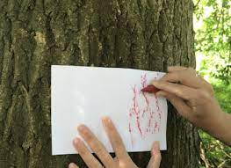
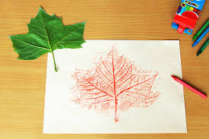
Camp Session Plans- Clown outfit bark and leaf rubbing
Equipment: paper, chalk or crayons
Outdoor Learning; Bark and leaf rubbing |  | Time 45 mins
How To Play Bark and leaf rubbing Children are each given a piece of paper and write their name on it Children go outside with their piece of paper and are given a piece of chalk or crayon Children find a tree, leaf, or textured object like a bench or playground Children place the paper onto the object and press hard onto the object whilst colouring. This should start showing the pattern onto the piece of paper. Children can repeat this a couple of times to get different patterns Once inside children can cut the piece of paper to make a clown top and trousers or hat. Alternatively they can draw a clown onto the paper. They can also collect different outdoor materials to add to their paper once inside. Different way is for children to draw or trace a clown outline on the paper before they go out and fill in different parts of the outfit with different outdoor patterns. Set up Make sure children have sun cream and hats on if warm.
Coaching Tips & Questioning: Tell children to only pick up leaves, sticks and items that are on the ground and have fallen off. We do not pick flowers or leaves of trees. If children find any bugs during their hunt remind them to use kinds hands and to be gentle. Children can make more than one bark rubbing if there is time | Phrase Perfect Script Today we are going to see if we can make a pattern on our piece of paper from a piece of bark, tree, bench or playground. You are all going to get a piece of paper and have to write your name on the back. Then we all need a piece of chalk or crayon each. Now we are outside watch what I do first. I need to hold my piece of paper onto the object and the press my crayon or chalk down onto the paper to show the pattern. When we get inside we will make our patterns into a clown hat, top, trousers or even make a whole clown.
Progressions: See if children can make a rubbing of more than one object on their piece of paper. |  |  | Differentiation See if children can hold the chalk sideways and use crayon out of a wrapper where possible.

Slide 7
Camp Session Plans- Paper plate clowns and circus animals
Equipment: Card, paper/card, paint, paint brushes, paper plates, pom poms, stick on eyes
Imagine and Create: Paper plate clowns and circus animals |  | Time 45 mins | Image/Video link/ Parent Link
How To Play Paper plate clowns Give each child a paper plate and write their name on the back Children can then either make clown hair with pom poms and add a nose and face OR Cut out 2 hand prints from paper. Trace around their hands then cut out Cut out a triangle to make a clown hat Add eyes, ears and a mouth either out of cut out paper or paint Paper plate elephant Give each child a paper plate and write their name of the back Children need to cut 2 section out of the top and bottom of the plate to make ears Mark with pencil/crayon the section and get children to cut out Stick on of the cut out sections onto the plate to make a trunk. Children can then paint and decorate their elephant Paper plate tiger Give each child a paper plate and write their name on the back Decorate with orange tissue paper/normal paper Add black paper stripes Add eyes, face and ears Set up Sit the children down at a table with all the equipment they will need in front of them. Put a table cloth down on the table or surface you are using.
Coaching Tips & Questioning: If using paint tell children it stays on the paper not on their bodies Get children to vote on what they want to make first a clown or a circus animal. If you have 2 coaches you can split the children up. Ask children if they have seen clowns before are they silly? What colours do they wear? Children may not be super creative and need ideas and help of what they can do, give them lots of different options on what to do. | Phrase Perfect Script Today we are going to use paper plates to make clowns or circus animals. First we need to decide what we will make first. So have a think and we will vote to make either a clown or animals first. If we get time we can then make the second one. Now we have decided you are all going to get a paper plate, what do we say when I hand it to you? Now we need to write our names on the plates so they don’t get mixed up. If you need help writing your name let me know.
Progressions: Let children do as much as they can themselves. If they are quick get them to add things like a hat, bow tie etc to their clown Encourage colourful and crazy clowns |  |  | Differentiation Try to help children hold paint brushes like a pen to help them make better marks on the plate. Try to assist by guiding hands before you do anything for them

Slide 8
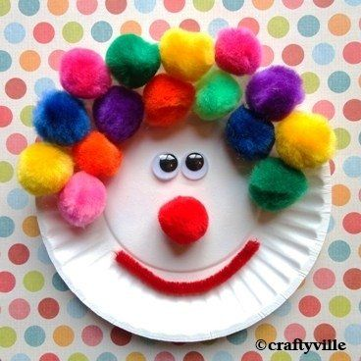
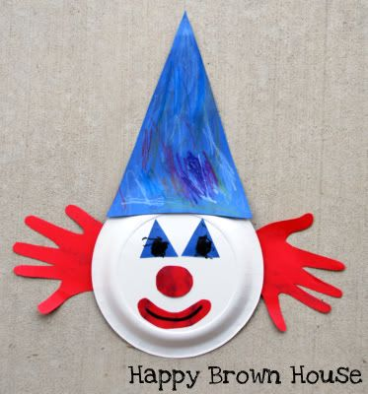
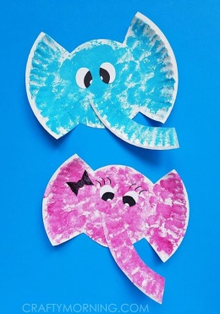
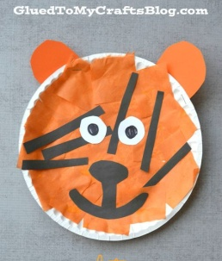

Slide 9
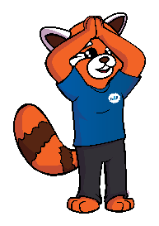
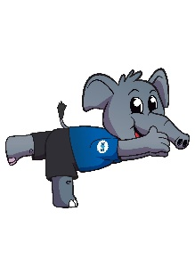
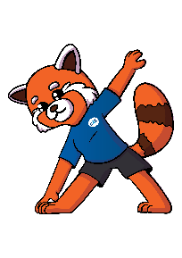
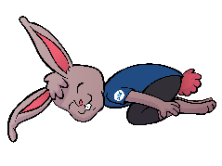
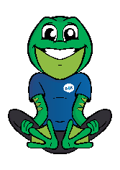
Camp Session Plans- Clown and Acrobat Yoga
Relax and unwind | Time 45 mins
How To Play Warm up First we need to get the children a bit calmer and ready for yoga. Start by shaking arms, legs and bodies to get all the sillies out. Have children sit on the floor and reach their hands in front of them linking fingers together, palm facing away from body. Reach arms connected above head and reach side to side. Hold your arms like you would rock a baby, pick up one foot and put it into your arm and rock it side to side like a baby. Swap sides Go on hands and knees and push tummy towards the floor so your back bends like a banana. Now try to push tummy to the sky so our back arches like an angry cat; tuck head in. Repeat 3 times. Acrobat breathing Balancing: As you inhale, bend one knee up and raise arms to the side in a T shape, as you exhale go back to standing then repeat on the other leg. Trapeze reach: As you inhale bring your arms out to the side and above your head when you exhale bring your arms back down to your sides. Acrobat roll: Inhale and reach arms out to the side, exhale and give yourself a hug bending your back and knees like you are going to do a forward roll. Strong man: Inhale, bringing your arms up to the sky. Exhale and bend elbows like you are showing off your big muscles and relax you arms back to your side. Yoga poses Entrance– First we need to show the audience we are in the ring. We are going to stand with your feet apart and breath in bringing our arms above our heads. In extended mountain pose. Then when we breath out we will wave our hands to the audience Leaping acrobat – Now we need to fly in the air. Can you try to balance on one leg, now see if you can reach your arms forwards, in front of you. Can you stretch your leg behind you like you are flying in the air doing an amazing trick. Stretching acrobat – We are not going to stretch out like the acrobats side to side. Can you step one foot out to the side making a big V with our legs. Next we need to take a big deep breath in and bring our arms out to the side. Now can you breath out and reach down to touch your ankle on one side, leaving your other arm in the air. Contortionist – Next we are going to make ourselves very small just like a contortionist. Can you kneel down on the floor and put your bottoms on your feet. Can you reach your hands by your feet and see if you can reach your forehead to the floor. We should now be in a tiny ball; just like a contortionist in a small box. Silly clown – The silly clowns have now arrived. Can we sit on our bottoms and put the soles of our feet together. Now lets see if we can put your hands under our legs and give everyone a wave. Can you try and lift your legs ups and have your arms underneath giving a wave. Can anyone also pull a silly face. Favourite Circus Performer– Ask children what their favourite sport is and make up a pose for them Set up Make sure children are in a circle or in staggered spaces to copy your movements and not bump into each other. Use the floor mats and blankets or jumpers for children to lie on.
Extended Mountain pose
Performer entrance
Warrior 3
Leaping acrobat
Triangle pose
Stretching acrobat
Child’s Pose
Contortionist
Flower pose
Silly clown

Slide 10
Coach Tips and Questions: This is time for the children to calm down and sit for a period. We do not want them running around and making lots of noise. Don’t be afraid to make the story silly or worry if it doesn’t make much sense. Creativity and imagination is what we want to see. Don’t worry if you struggle with a pose, do you best and tell children how well they are doing and point out people in good positions. |  | Phrase Perfect Script As it’s nearly the end of the day we are going to have some time to relax and think about our day. We are going to do Underwater Yoga today. To start with we need to make sure our bodies are ready for yoga. Can you shake you arm, the other one, leg, other leg, whole body and keep shaking to get the sillies out. Now we can start to stretch our bodies. Next we are going to focus on our super breathing like we are different underwater creatures.
Progressions: See how long children can hold the balancing poses. Do a competition to see who can hold for the longest. |  | Differentiation Break the poses down into stages so children can stop when it is difficult for them.

