Slide 1

LIFESAVING
CPR
v1.0 July 2025

Slide 2
WHY LIFESAVING CPR?
Lifesaving CPR (L CPR) is an evidence-based, standardised, and simplified approach designed to improve survival rates from cardiac arrest, both on and off the beach.
Based on the principles of High Performance CPR and supported by research and ANZCOR guidelines, L CPR focuses on doing the basics exceptionally well and reducing variation in practice across our organisation.

Slide 3
THE 6 AIMS OF LIFESAVING CPR
REDUCE TIME TO CPR
IMPROVE QUALITY OF
COMPRESSIONS
TARGET CHEST
COMPRESSION FRACTION OF 80%
A COORDINATED APPROACH TO CPR
EFFICIENT AND EFFECTIVE AED USE
BETTER INTEGRATION OF THE ART OPERATOR

Slide 4

1
Complete with a sense of urgency
Primary assessment can be undertaken in less than 15 seconds for non-complex patients
Danger and Response can be assessed simultaneously
If normal breathing is not detected within a few seconds, start CPR – don’t delay
REDUCE TIME TO CPR

Slide 5


Slide 6
DRSAB practice
Taking turns in pairs (1 as patient, 1 as rescuer)
Practice DRSAB in < 15 seconds
Time finishes when ready to start CPR

Slide 7

2
Exact hand and finger position do not matter – compressions will be effective so long as they are directly over the lower half of the sternum
A hands-off technique ensures complete chest recoil
Compressions should be delivered at a rate of 100-120 beats per minute (bpm). Set a metronome to 110 bpm if available
Deliver 2 breaths (1 breath per second). If the breaths aren’t delivered in time, do not re-attempt them, restart compressions
IMPROVE QUALITY OF COMPRESSIONS

Slide 8
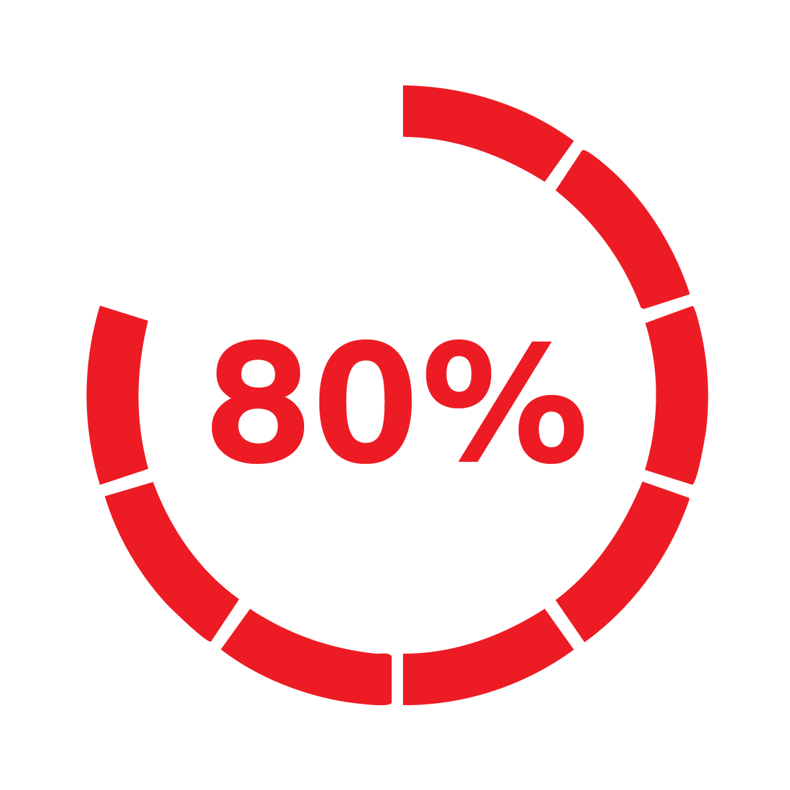
3
Chest compression fraction refers to the percentage of time spent performing compressions during CPR
Aim for a chest compression fraction of 80%, allowing 20% of time for breath delivery and AED analysis / shocks
For every 10% increase in compression fraction (up to 80%), survival increases by over 10%
TARGET CHEST
COMPRESSION
FRACTION OF 80%

Slide 9


Slide 10
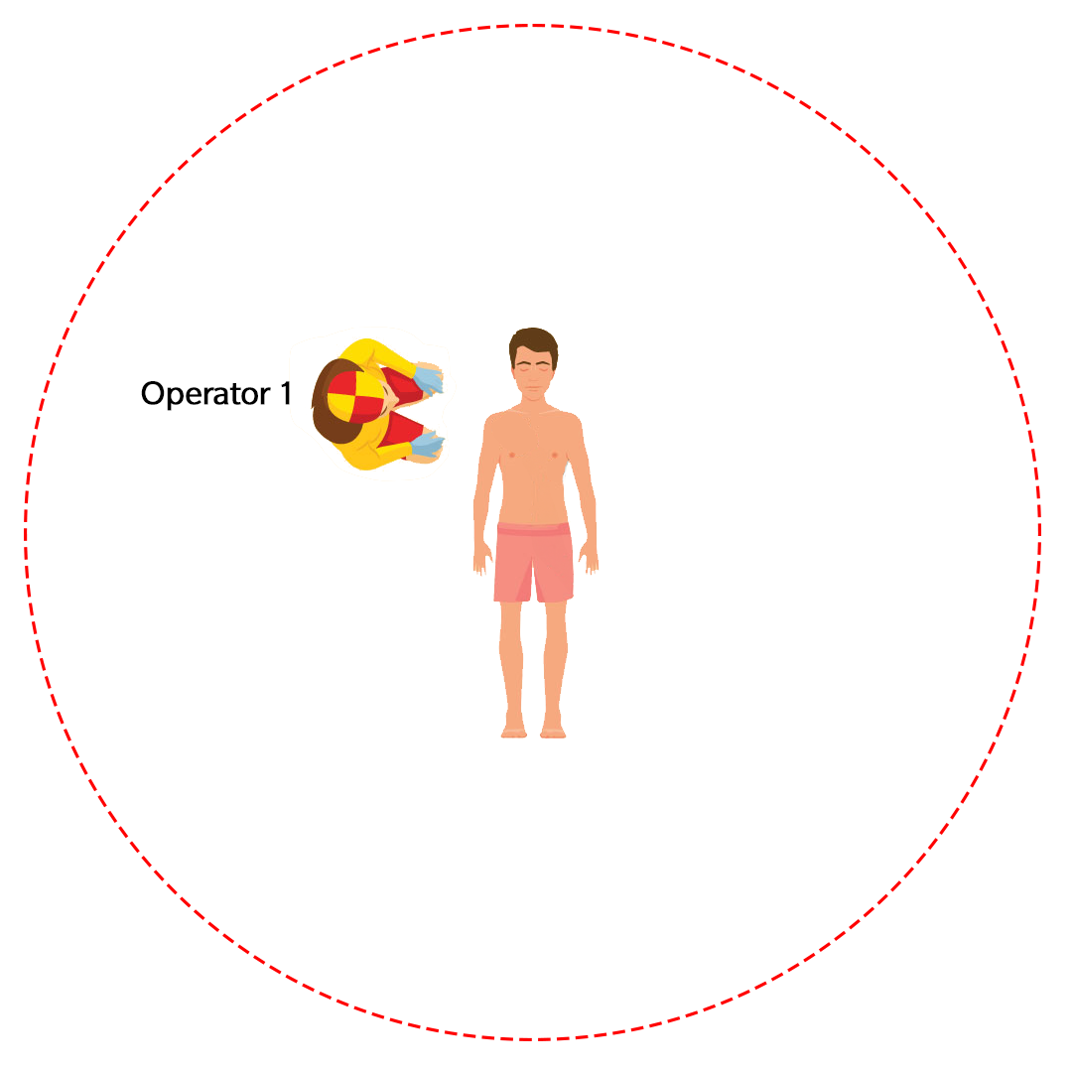
CPR
1-person practice
DRSAB has been completed, the patient is not responding and is not breathing normally:
  Perform 2 minutes of 1-person adult CPR on a manikin
  Use a metronome during practice

Slide 11

4
Use standardised operator positions to ensure a seamless approach to CPR
Swap roles at least every
2 minutes or during AED analysis
Work around the compression operator to apply AED pads during CPR
A COORDINATED APPROACH TO CPR

Slide 12

VIDEO 1

Slide 13
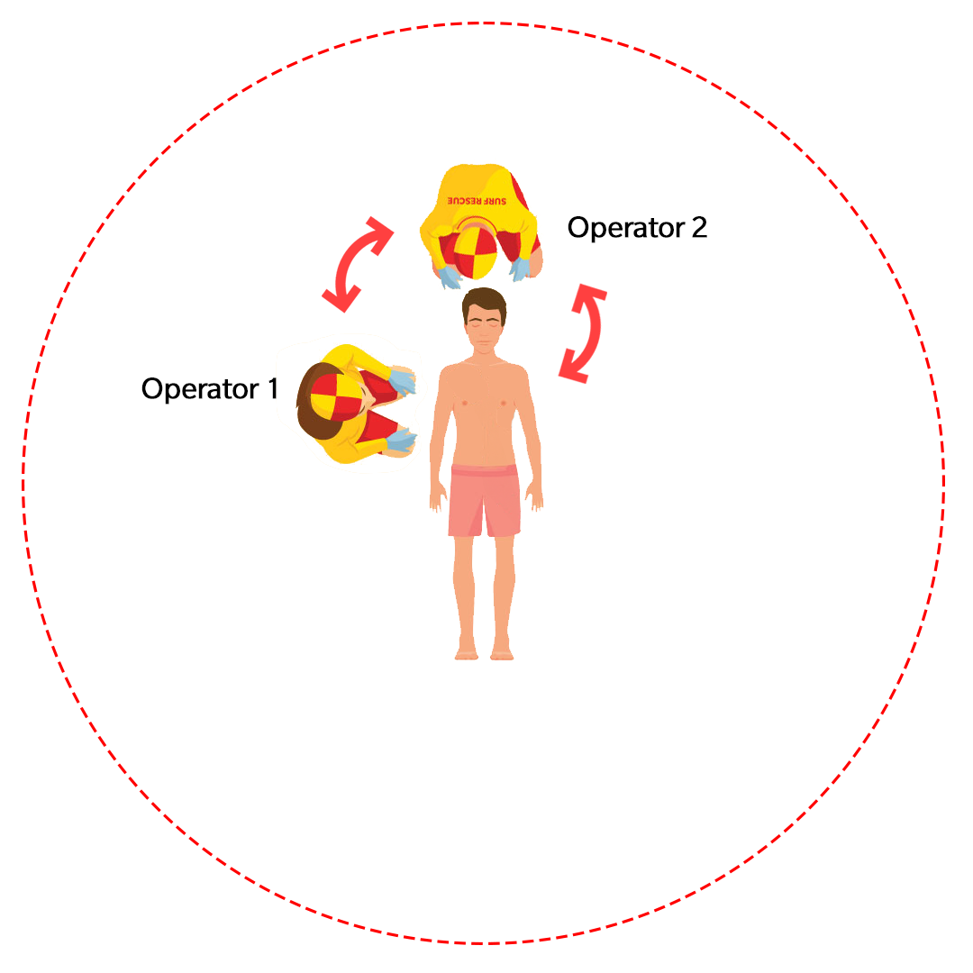
DRSABC
(2-person) practice
Assess DRSABC
  OP1 – perform D, R, S*, A and B, then start compressions at 30:2
  * (ask Operator 2 to Send for help)
  OP2 - send for help while OP1 assesses airway and breathing.
  Take over airway / jaw thrust position
  Swap roles after 2 minutes

Slide 14
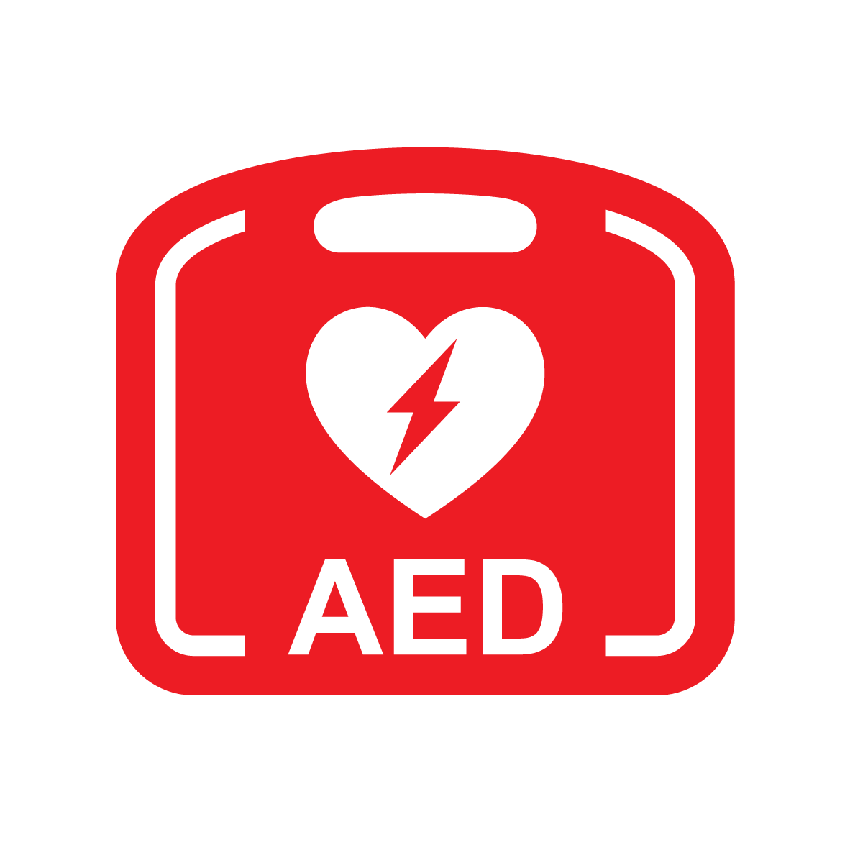
5
Place AED at the 2 o’clock position
Hover hands over the chest during analysis in readiness to restart compressions, ensuring you are not touching the patient
Don’t wait for the AED instruction to re-start CPR, it is safe to re-start immediately
Use touch (hand tap) and the verbal cue “CPR-Go” after “Shock” or “No shock” command
EFFICIENT AND EFFECTIVE AED USE

Slide 15


Slide 16
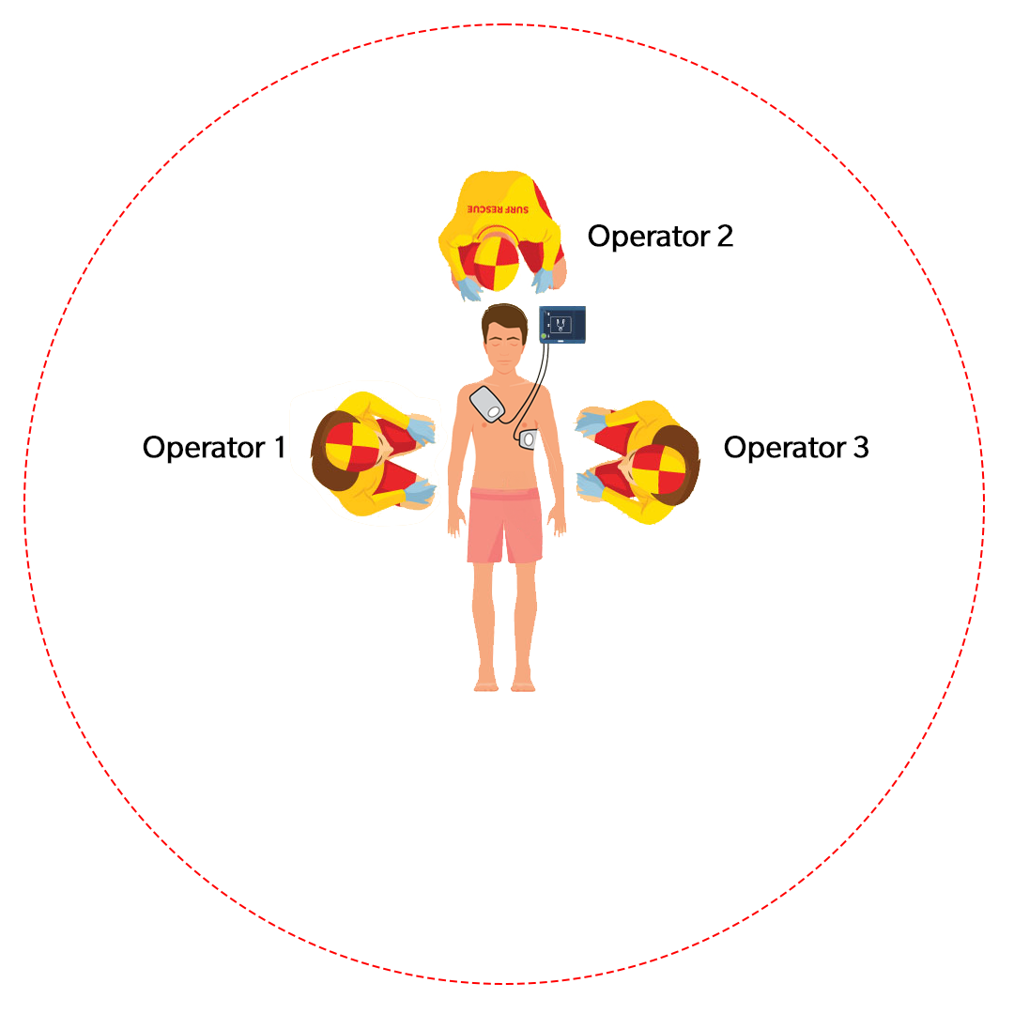
3-person CPR with AED
review
Operator 1 and 2 perform 2-person CPR starting with DRSABC
Operator 3 introduces AED and places at 2 o’clock position
(above patients’ left shoulder)
Operator 3 prepares patient’s chest, turns on AED and applies pads.
Once AED has been applied, Operator 3 prepares to take over compressions.
Operator 2 is now responsible for the AED use.

Slide 17

6
Place oxygen at the 10 o’clock position
(above patients' right shoulder)
ART operator becomes team leader after OP insertion and the effective delivery of two breaths via BVM
After this, the BVM can be operated by any trained CPR operator under direct supervision of the ART operator, using the Rule of 3s:
  using 1 hand (3 fingers and thumb)
  squeezing a maximum of 1/3 of bag volume
As team leader, the ART operator:
  oversees team performance, providing real-time coaching and feedback
  manages radio communication with SurfCom
  collects and documents information
BETTER INTEGRATION OF THE ART OPERATOR

Slide 18


Slide 19
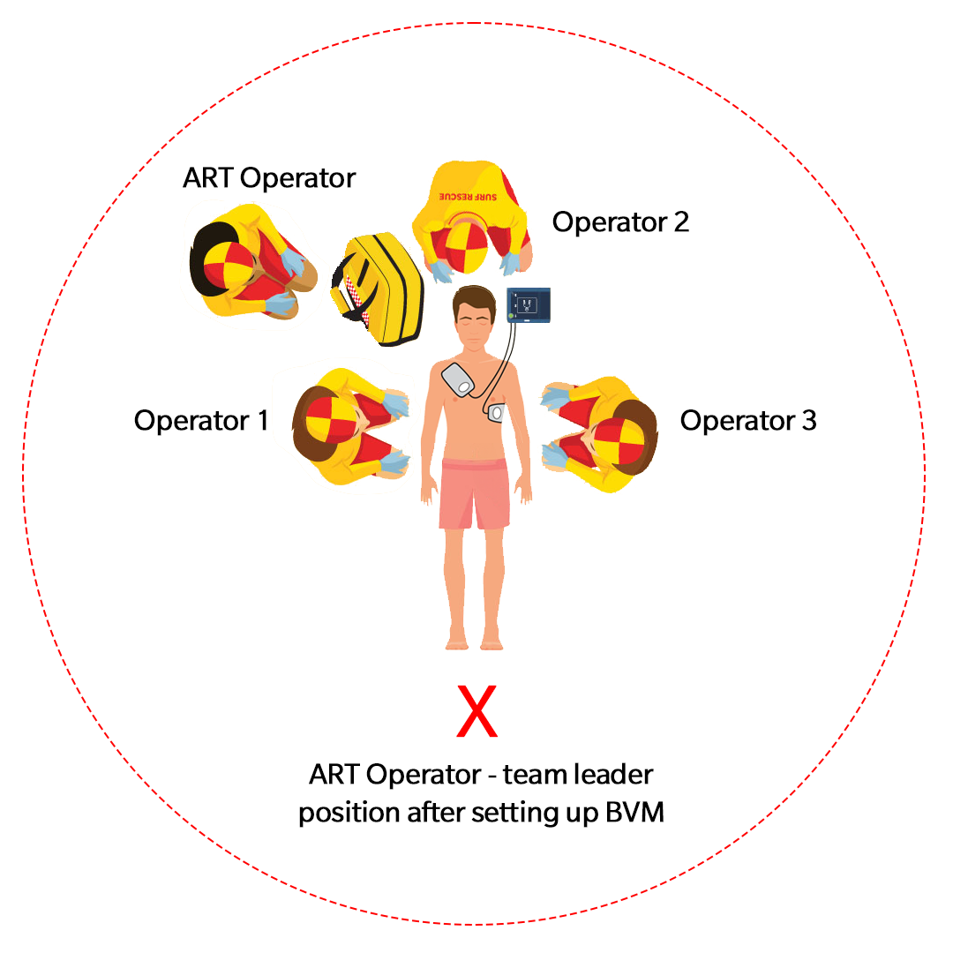
CPR with BVM & AED
4-person practice
2 person CPR starting with DRSABC
After 1 minute of 2 person CPR, simultaneously:
  OP3 comes in with AED
  OP4 comes in with BVM
Practice 2 person BVM ventilation: one person performs jaw thrust, the other delivers breaths

Slide 20
QUESTIONS?

