Slide 1
COMPLAINTS CLUB RESOURCES
This document contains a printable poster that Clubs can display within their facilities to ensure members have easy access to the Complaints Portal.
We encourage all Clubs to print and display this resource in a visible location within the Clubhouse to support member awareness and engagement.

Slide 2
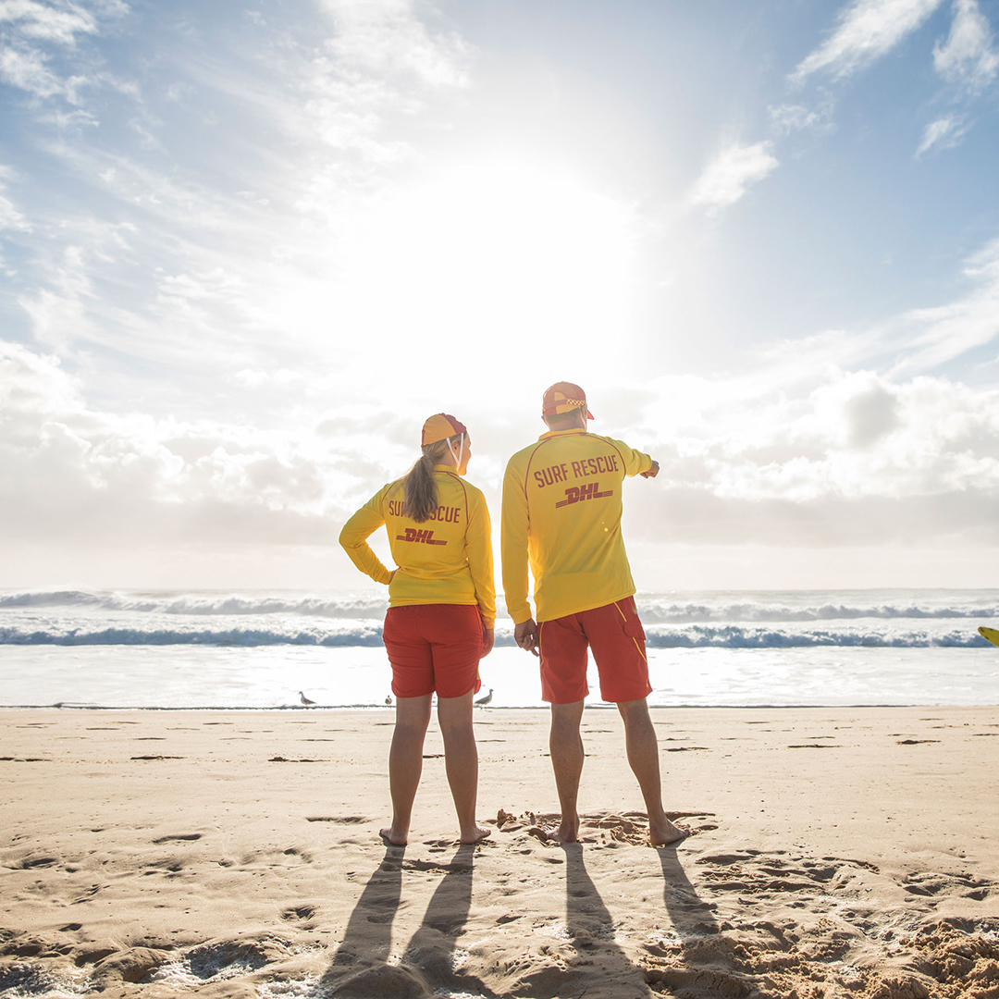
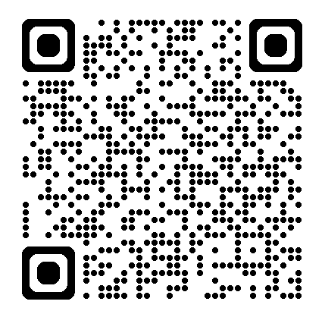
Complaints Portal – Quick Reference Guide
What is the Complaints Portal?
The Complaints Portal is Surf Life Saving’s secure online system for lodging formal complaints or reports. It is used across all levels of Surf Life Saving in Australia (SLSA, State Centres, Branches, and Clubs) to ensure fair, transparent, and consistent complaint management in line with Policy 6.06 – Complaints Resolution.
How Are Complaints Assessed?
Initial Evaluation
The SLSQ Complaint Manager will assess if the issue is:
  A valid complaint under Policy 6.06
  Submitted by an eligible person
  Within the scope and jurisdiction of SLS
Action Taken
Based on the assessment, the complaint may:
  Proceed to mediation
  Be referred for investigation
  Lead to a formal hearing or resolution process
  Be closed if not within scope or substantiated
Need Help?
If you're unsure whether your concern should be reported or how the process works, reach out to your Club/ Branches Complaints Manager. They can help guide you on whether to submit a Complaint or a Report.
INSERT CLUB LOGO HERE
Policy 6.06 – Complaints Resolution Policy

Slide 3
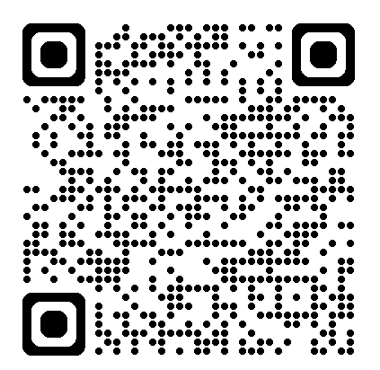
INSERT CLUB LOGO HERE
Member Complaints
At INSERT CLUB NAME HERE the safety, well-being and satisfaction of our members are of utmost importance. We strive to create a supportive and inclusive environment where every member feels valued and heard.
To ensure we continually meet our standards and address any issues promptly, SLSs has a robust complaints management process, in line with the SLSA Complaints Policy and we encourage our members to share their complaints and concerns with us.
We are committed to resolving any issues fairly, transparent and inline with the SLSA Complaints Policy.
We appreciate your contribution to the ongoing success and development of Surf Life Saving Queensland.
SLSA COMPLAINTS PORTAL

Slide 4
INSERT CLUB LOGO HERE
CLUB CONTACTS
Position | Name | Contact
SLSA COMPLAINTS PORTAL

Slide 5
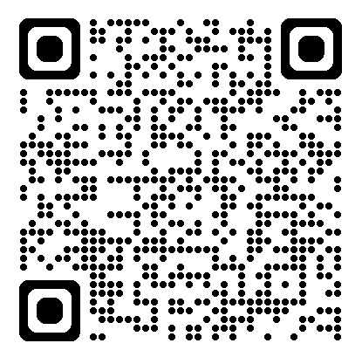
INSERT CLUB LOGO HERE
RESOURCES
SLSA COMPLAINTS
PORTAL
COMPLAINTS HANDLING
GUIDELINE
COMPLAINTS POLICY

