Slide 1
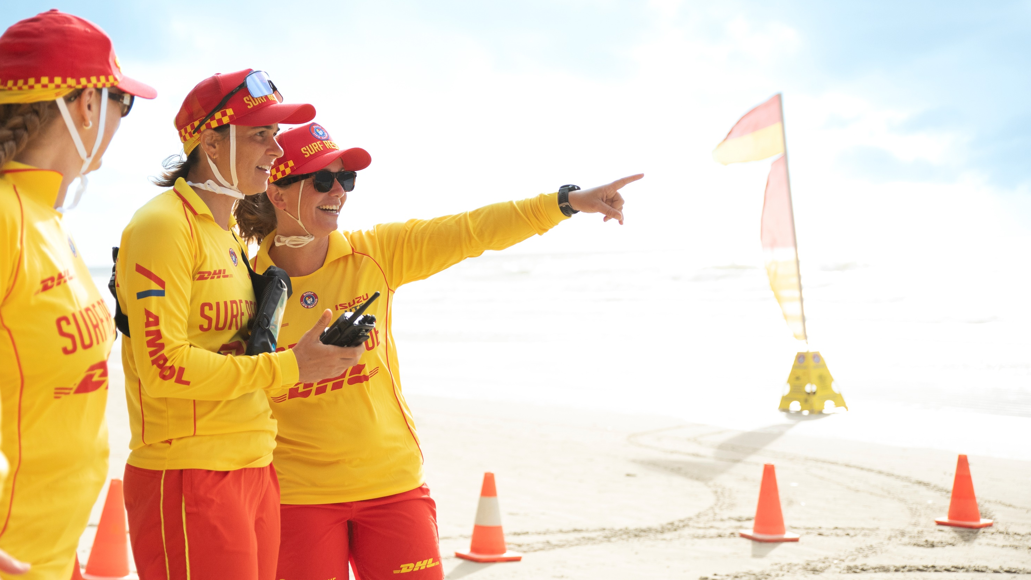

Trainer, Assessor, Facilitator

Slide 2
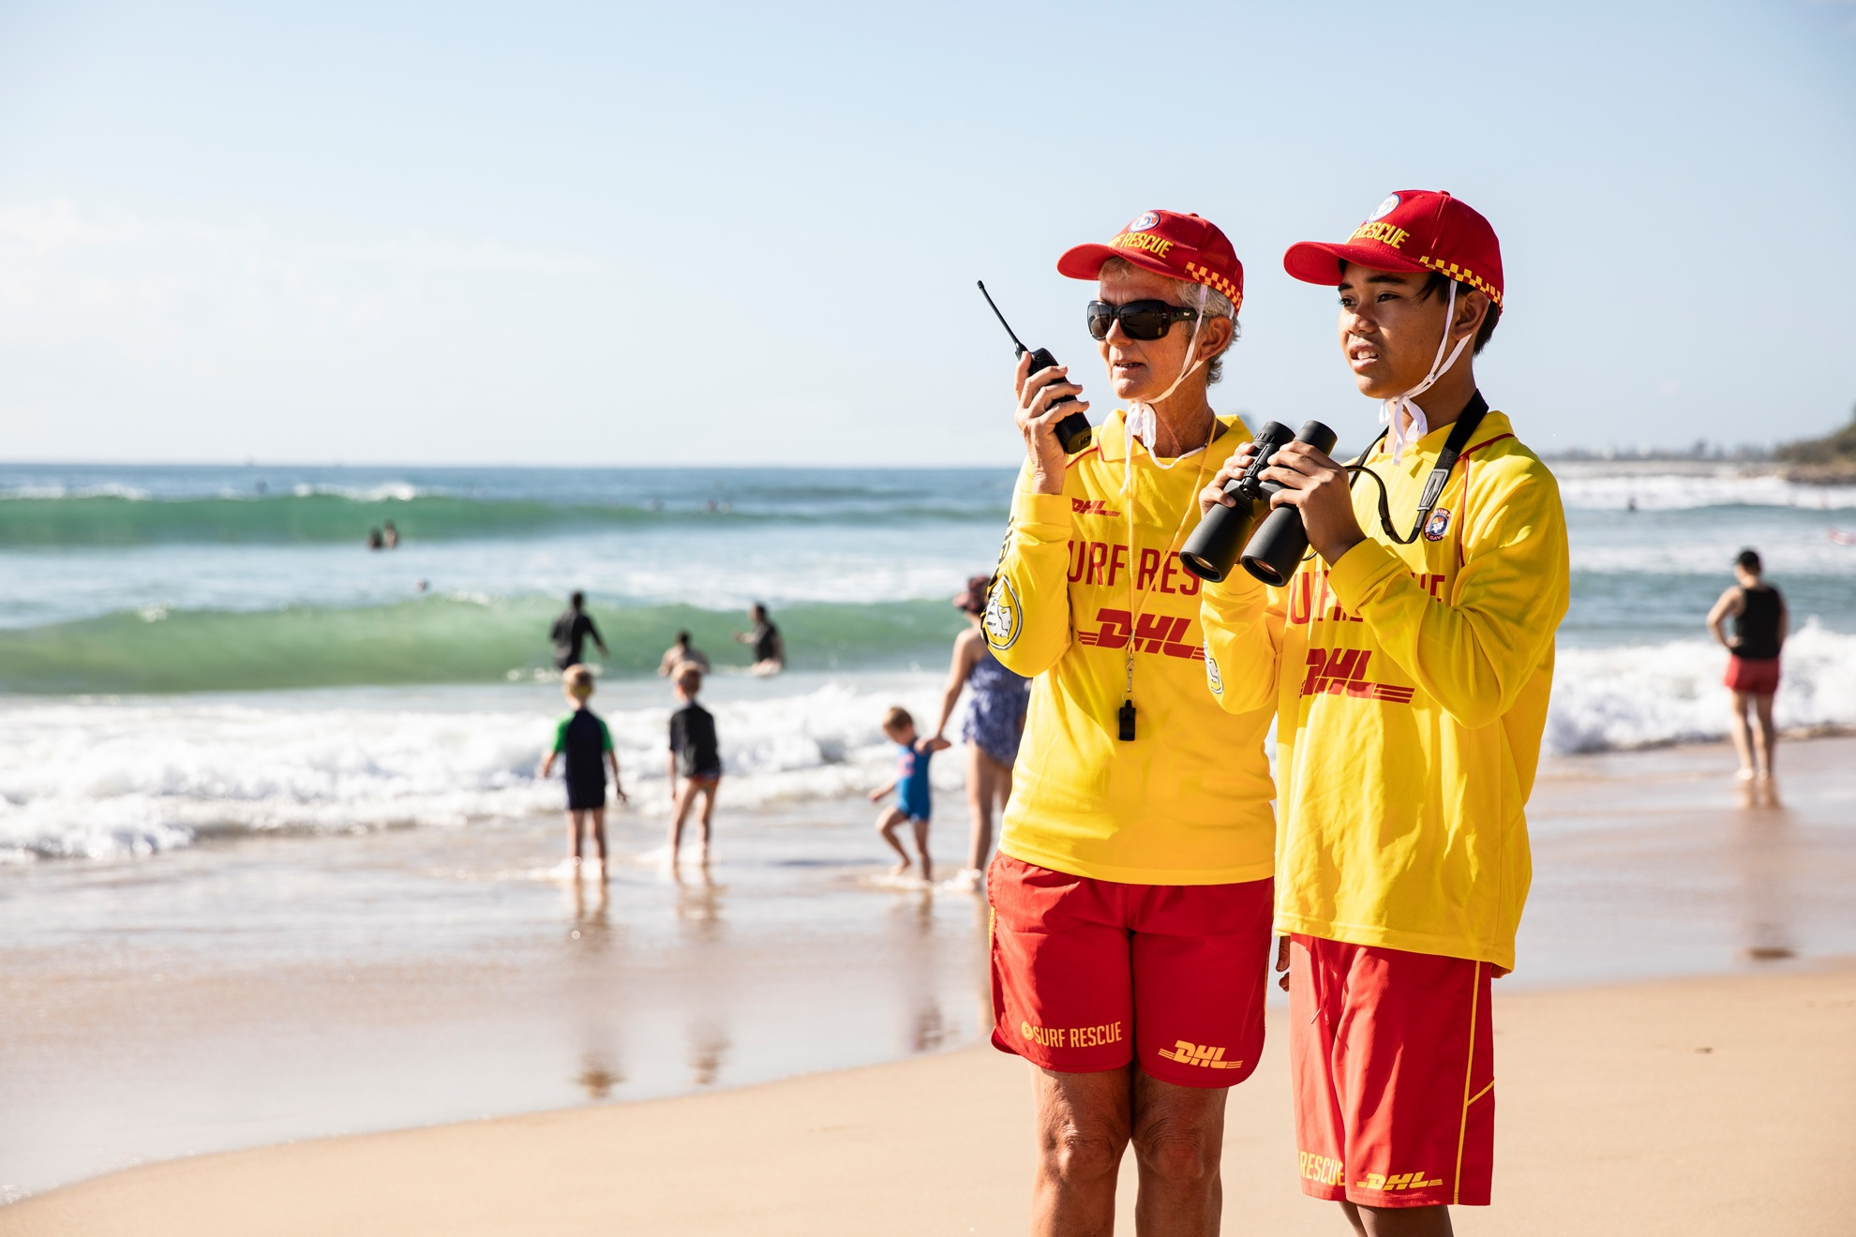
What is a Trainer ?
A Trainer can deliver Nationally Recognised units of competency in the workplace under supervision.
A Trainer can teach the required skills and knowledge of our courses but do not make any assessment decisions
ALL Trainers MUST hold....
Required Units of Competency (UoCs):
To be eligible to deliver training under supervision, individuals must hold one of the following:
- TAEDEL311 Provide Work Skill Instruction AND
- BSBCMM411 Make Presentations; OR
- FULL TAE40110 or TAE40116 or TAE40122
Competency Requirements:
Must hold the vocational competencies relevant to the unit(s) they intend to deliver.
Must have held the relevant SLSQ award for a minimum of 12 months and maintain current proficiency in that award.
Must be able to demonstrate current competency and ongoing professional development in both
training delivery and VET knowledge and skills.

Slide 3
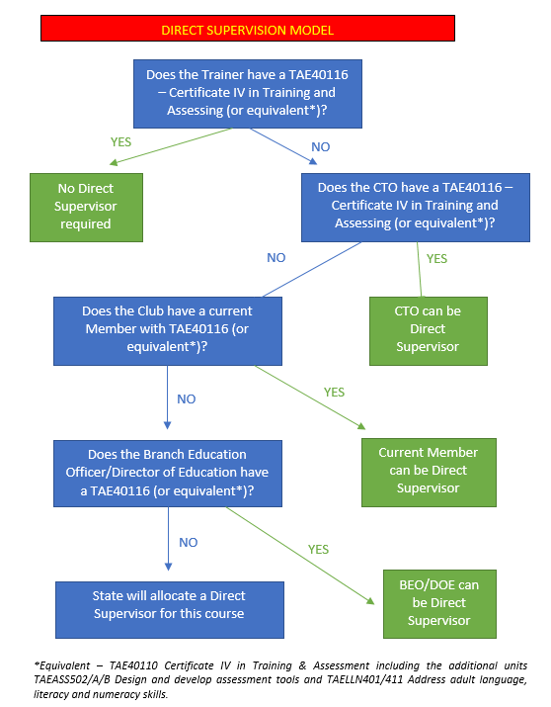
Direct Supervision

Slide 4
How do I become a Trainer ?
VET Accreditation
- Trainer Course SLSQ
OR
- Credit Transfer
a. BSBCMM411 Make Presentations
b. TAEDEL311 Provide Work Skill Instruction
Train a Squad
- Train a min. 1 x Squad and a Min. 2 x people in the award , whilst maintaining (12) months of minimum proficiency.
*Best Practice, first time Probationary Trainer will assist with one course prior to leading a formal course.
Paperwork
Ensure your name is listed on the Training Course as a Probationary Training Officer. Your Club CTO will have to confirm your competency and complete the SLSQ Probationary Trainer Observation/Supervisor Form requirements.
Processing
Once you have successfully trained a Squad (and your CTO has formally endorsed) the Branch will generate your Training Officer award and will forward to SLSQ Membership Training Team for processing
Skills Maintenance
To maintain currency, you MUST complete the Annual Trainer, Assessor and Facilitator (TAF) Proficiency module online vis the SLSQ Education Hub

Slide 5
How do I become a Trainer ?
1. VET Accreditation
COMPLETE Trainer Course [SLSQ]
OR
Credit Transfer a. BSBCMM411 Make Presentations + b.TAEDEL311 Provide Work Skill Instruction
2. Train a Squad
Train a min. 1 x Squad and a Min. 2 x people in the award , whilst maintaining (12) months of minimum proficiency.
3. Credential Paperwork
Ensure your name is listed on the Training Course as a Probationary Training Officer.
4. Processing
Once you have successfully trained a Squad (and your CTO has formally endorsed) the Branch will generate your Training Officer award and will forward to SLSQ Membership Training Team for processing.
5. Skills Maintenance
To maintain currency, mandatory completion of the Annual Trainer, Assessor and Facilitator (TAF) Proficiency Module online via the SLSQ Education Hub, is required.
*Best Practice, first time Probationary Trainer will assist with a min. of one course prior to leading a formal course.
Your Club CTO will have to confirm your competency and complete the SLSQ Probationary Trainer Observation/Supervisor Form requirements.

Slide 6
What is an Assessor?
A qualified assessor can assess a nationally recognised unit of competency within the workplace, in accordance with RTO Standards.
ALL Assessors MUST hold....
Required Units of Competency (UoCs):
To deliver training and assessment without direction, including making assessment judgements, individuals must hold the following:
- TAEASS412 Assess competence
- TAEASS413 Participate in assessment validation
- TAEDES411 Use nationally recognised training products to meet vocational training needs
OR
- FULL TAE40110 or TAE40116 or TAE40122
Competency Requirements:
Must hold the vocational competencies relevant to the unit(s) they intend to assess.
Must have held the relevant SLSQ award for a minimum of 12 months and maintain current proficiency in that award.
Must be able to demonstrate current competency and ongoing professional development in both training delivery and VET knowledge and skills.
Satisfactorily complete a minimum of 2 full probation courses.

Slide 7
How do I become an Assessor ?
1. VET Accreditation
COMPLETE Assessor Course [SLSQ]
OR
Credit Transfer a. Current Cert IV TAE and/or its successor b. TAEASS412 + TAEASS413 + TAEDES411
2. Assess Squads
Assess a min. 2 x Squads (one within club + one external) of a min. (2) people in the award , whilst holding the UOC and maintaining (12) months of minimum proficiency.
3. Credential Paperwork
Ensure your name is listed on the Training Course as a Probationary Assessor.
4. Processing
Once you have successfully assessed (2) squads and a current Assessor OR Direct Supervisor has deemed you competent, the Branch will generate your Assessor award and will forward to the SLSQ Membership Training Team for processing
5. Skills Maintenance
To maintain currency, mandatory completion of the Annual Trainer, Assessor and Facilitator (TAF) Proficiency Module online via the SLSQ Education Hub, is required.
*Best Practice, first time Probationary Assessor will assist with a min. of one course prior to leading a formal course.
Request the SLSQ Probationary Assessor Observation/Supervision Form be completed by the Chief Assessor for each course you assess.
One Course, may not be sufficient and there is no time limit on the number of Probationary courses an assessor may run prior to being signed off.
Sign FORM 14 , supported and endorsed by the Chief Assessor.

Slide 8
What is a Facilitator ?
A qualified Facilitator can Train, Assess the same group of candidates of a nationally recognised unit of competency within the workplace, in accordance with RTO Standards.
ALL Facilitators MUST hold....
Required Competency:
To deliver training and assessment without direction, including making assessment judgements, individuals must hold the following:
- FULL TAE40110 or TAE40116 or TAE40122
Competency Requirements:
Must hold the vocational competencies relevant to the unit(s) they intend to assess.
Must have held the relevant SLSQ award for a minimum of 12 months and maintain current proficiency in that award.
Must be able to demonstrate current competency and ongoing professional development in both training delivery and VET knowledge and skills.
Satisfactorily complete a minimum of 2 full probation courses.

Slide 9
How do I become a Facilitator ?
1. VET Accreditation
2. Awards
Ensure you hold the Trainer and Assessor Award that you intend of delivering
3. Credential Paperwork
Raise a FORM 14 I include details of all courses trained and assessed for the award, in the past (2) year period.
4. Processing
Submit the Form 14 to your Branch, once approved the Branch BOLS will endorse (must be noted in the minutes).
5. Skills Maintenance
To maintain currency, mandatory completion of the Annual Trainer, Assessor and Facilitator (TAF) Proficiency Module online via the SLSQ Education Hub, is required.
Hold a Current Cert IV in training and Assessment and/or its successor
-TAE40110 OR TAE40116 OR TAE40122
Have assessed a min. of one course in the past (2) year period

Slide 10
Content Expert |Subject Matter Expert [SME]
  A Subject Matter Expert does not replace the trainer but instead supports them by providing specialised knowledge and skills. For example, a club board coach may assist by sharing expertise in board paddling techniques.
  While an SME can contribute to the assessment process by offering insights and guidance, they are not permitted to make final decisions regarding a candidate’s competency.

Slide 11
Maintaining Currency
All SLSQ Trainers, Assessors, and Facilitators (TAFs) are required to:
Attend an annual TAF Proficiency session (professional development).
Maintain currency in the awards they are training and assessing by participating in annual Skills Maintenance.
Hold the most current version of the Unit of Competency (UoC) they are delivering.
Maintain workplace currency by being an active patrolling member.

Slide 12
Credit Transfer
Credit transfer may be granted for any formal learning previously completed by a member through another Registered Training Organisation (RTO).
Students may be eligible for a credit transfer towards a course based on qualifications they already hold for example, a current First Aid certificate.
Applications for credit transfer must be submitted using the appropriate form available in the Training Operations Manual (TOM). A copy of the relevant certificate must be included with the application to allow verification by the issuing RTO.

Slide 13
Recognition of Prior Learning [RPL]
Recognition of Prior Learning (RPL) is the formal acknowledgement of skills and knowledge gained through previous training, work experience, and/or life experience.
Surf Life Saving Queensland (SLSQ) recognises the value of learning acquired outside traditional education and training environments.
RPL is available to all members upon formal written request via Education@lifesaving.com.au

Slide 14
For Further Information on Training and Assessment
Refer to the Training Operations Manual (TOM), available online via Members Portal
Or speak with your Club Chief Training Officer for guidance and support
Our Education, Member Training Team are here to support and guide further via Education@lifesaving.com.au

