Slide 1
Occupational Exposure Assessments

Slide 2
How Do you Know When Controls are needed?

Slide 3
What is Occupational/Industrial Hygiene?
A
nticipating
R
ecognizing
E
valuating
C
ontrolling
'The discipline of anticipating, recognizing, evaluating and controlling health hazards in the working environment with the objective of protecting worker health and well-being and safeguarding the community at large.'
Notes:
'The discipline of anticipating, recognizing, evaluating and controlling health hazards in the working environment with the objective of protecting worker health and well-being and safeguarding the community at large.'
ANTICIPATION – this involves identifying potential hazards in the workplace before they are introduced.
RECOGNITION - this involves identifying the potential hazard that a chemical, physical or biological agent - or an adverse ergonomic situation - poses to health.
EVALUATION of the extent of exposure to the chemical hazards, physical or biological agents (or adverse ergonomic situation) in the workplace. This often involves measurement of the personal exposure of a worker to the hazard/agent in the workplace, particularly at the relevant interface between the environment and the body, e.g. breathing zone, hearing zone, and assessment of the data in terms of recommended occupational exposure limits (OELs), where such criteria exist.
CONTROL of the chemical, physical or biological agent - or adverse ergonomic situation, by procedural, engineering or other means where the evaluation indicates that this is necessary.

Slide 4







Slide 5
A
nticipating
R
ecognizing
E
valuating
C
ontrolling
Notes:
'The discipline of anticipating, recognizing, evaluating and controlling health hazards in the working environment with the objective of protecting worker health and well-being and safeguarding the community at large.'
ANTICIPATION – this involves identifying potential hazards in the workplace before they are introduced.
RECOGNITION - this involves identifying the potential hazard that a chemical, physical or biological agent - or an adverse ergonomic situation - poses to health.
EVALUATION of the extent of exposure to the chemical hazards, physical or biological agents (or adverse ergonomic situation) in the workplace. This often involves measurement of the personal exposure of a worker to the hazard/agent in the workplace, particularly at the relevant interface between the environment and the body, e.g. breathing zone, hearing zone, and assessment of the data in terms of recommended occupational exposure limits (OELs), where such criteria exist.
CONTROL of the chemical, physical or biological agent - or adverse ergonomic situation, by procedural, engineering or other means where the evaluation indicates that this is necessary.

Slide 6
RECOGNIZING HAZARDS
In the following photos, please identify the potential chemical and physical hazards
Notes:
As noted earlier in the webinar, we are going to examine the recognition of hazards in the workplace. Of course this would be a much easier exercise in an actual factory, but as a substitute, we will use photographs of some common processes in factories.
In the following photos, please identify the potential chemical and physical hazards. You can type your answers in the chat box. I may also call on some of you to answer via your microphone.
Let’s get started

Slide 7
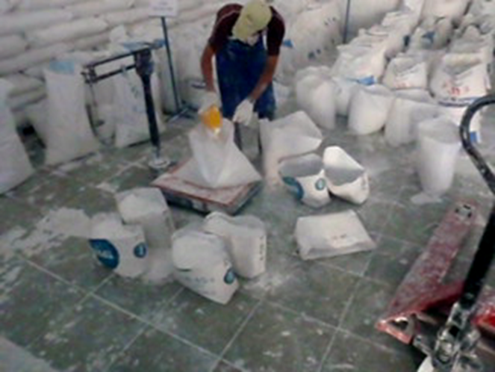
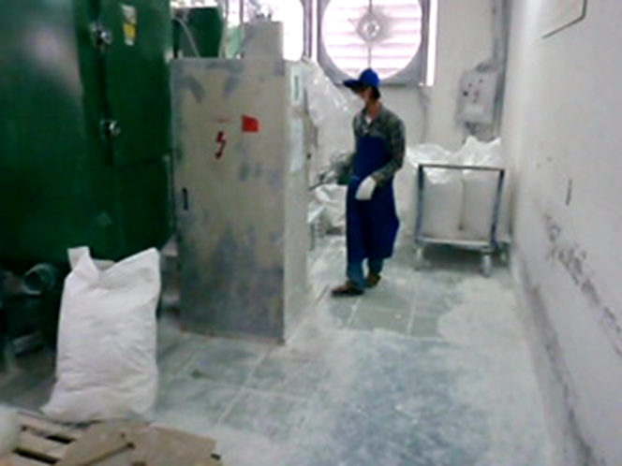
Activity – Dry Chemical Mixing
Notes:
Let the attendees come up with ideas and have them share with the group.
Hazards: obvious - inhalation of dust/chemicals
other - skin and eye contact, ergonomics
If the discussion comes up on controls:
A lot of groups will come up with ventilation.
Other things that can be considered:
Better packaging to eliminate dust escaping
Work practices no dropping bags, place them gently onto piles
Worker rotation to other duties with no exposure

Slide 8
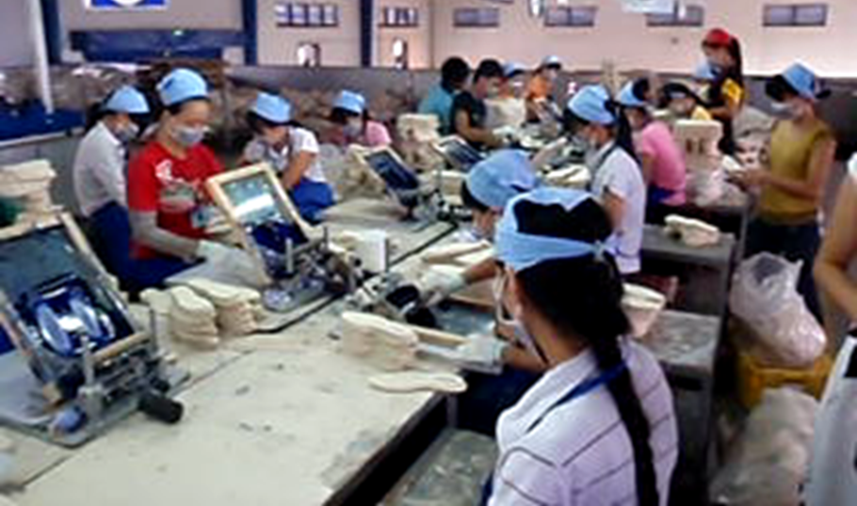
Activity – Screen Printing

Slide 9
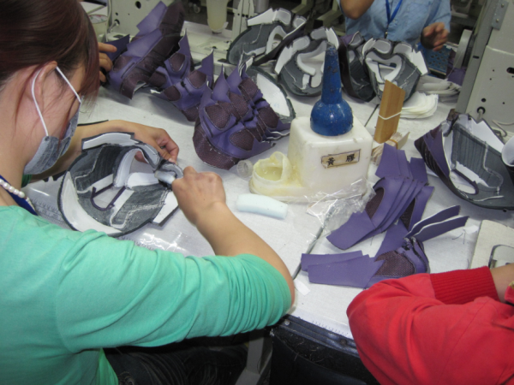
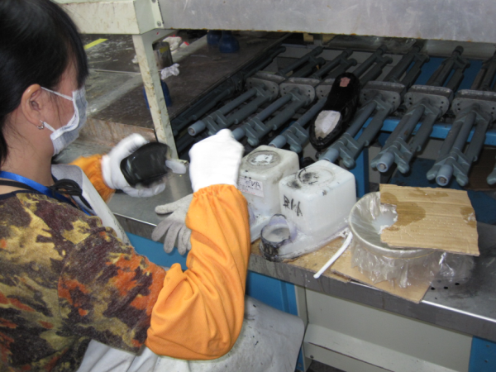
Priming
Gluing
Notes:
Recognizing Hazards
Call on an attendee to identify hazards in these processes or review chat responses.
Potential answers:
-Inhalation of chemicals
-Dermal / Skin exposure to chemicals
Noise?
Ergonomic hazards?
Heat stress?

Slide 10
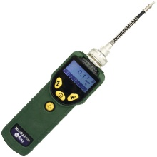
Worker Exposure
Notes:
Now that we understand something about the recognizing hazards, we are going to examine how to measure the exposure of workers to these chemicals.
The most basic question is how much exposure, is it a little [click mouse] or is it a lot [click mouse]. [Click Mouse] Also important will be how long will the exposure last.
At lastly, how do we measure this?

Slide 11
A
nticipating
R
ecognizing
E
valuating
C
ontrolling
Notes:
'The discipline of anticipating, recognizing, evaluating and controlling health hazards in the working environment with the objective of protecting worker health and well-being and safeguarding the community at large.'
ANTICIPATION – this involves identifying potential hazards in the workplace before they are introduced.
RECOGNITION - this involves identifying the potential hazard that a chemical, physical or biological agent - or an adverse ergonomic situation - poses to health.
EVALUATION of the extent of exposure to the chemical hazards, physical or biological agents (or adverse ergonomic situation) in the workplace. This often involves measurement of the personal exposure of a worker to the hazard/agent in the workplace, particularly at the relevant interface between the environment and the body, e.g. breathing zone, hearing zone, and assessment of the data in terms of recommended occupational exposure limits (OELs), where such criteria exist.
CONTROL of the chemical, physical or biological agent - or adverse ergonomic situation, by procedural, engineering or other means where the evaluation indicates that this is necessary.

Slide 12
What is an Occupational
Exposure Limit?
Useful measure with which exposures to chemical and physical agents in the workplace environment can be compared.
May include legally required limits (Permissible Limits)
Notes:
In addition to sampling, the exposure assessment should consider other factors that could influence worker exposure such as variations in production (High/Low periods), environmental conditions during the sampling i.e. Temperature, ventilation and general air flow throughout the Facility, open doors/windows and other factors that can effect results.

Slide 13
Distribution
Contaminant | Permissible Exposure Limits (all values in mg/m³)
 | Cal-OSHA* |  | China** |  | Vietnam***
 | 8-Hour TWA | STEL | PC-TWA | STEL | PC-TWA | STEL
Acetone (CAS# 67-64-1) | 1200 | 1780 | 300 | 450 | 200 | 1000
Methyl ethyl ketone (MEK) (CAS# 78-93-3) | 590 | 855 | 300 | 600 | 150 | 300
Cyclohexane (CAS# 110-82-7) | 1050 | - | 250 | - | 500 | 1000
Ethyl Acetate (CAS# 141-78-6) | 1400 | - | 200 | 300 | - | -
Toluene (CAS# 108-88-3) | 37 | 560 | 50 | 100 | 100 | 300
Xylene (CAS# 1330-20-7) | 435 | 655 | 50 | 100 | 100 | 300
*California Occupational Health & Safety Administration, Table AC-1 (2015)
** GBZ 2.1-2007 Occupational exposure limits for hazardous agents in the workplace Chemical hazardous agents *** No. 3733/2002/QD-BYT – Occupational exposure standards of Vietnam
TWA = Time Weighted Average STEL = Short Term Exposure Limit “-“ Indicates no exposure limit has been established
Notes:
Explain that most countries have established exposure limits that should be refenced for strict legal compliance, however other OELs/PELs can be adopted for ones that don’t exits in your country or if they are more protective. OELs demark compliance, however good practices should be to maintain exposures as low as possible.

Slide 14
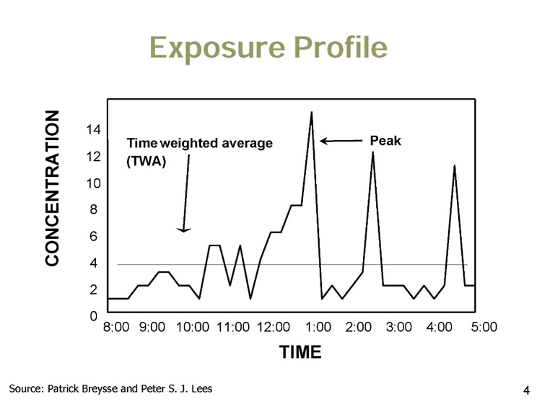
What is an Occupational Exposure Limit?
Time Weighted Average (TWA)
Short Term Exposure Limit (STEL)
Ceiling (C) or MAC
Notes:
Discuss exposure Profiles and the concept of STEL and TWA ,C/MAC measurements/values.

Slide 15

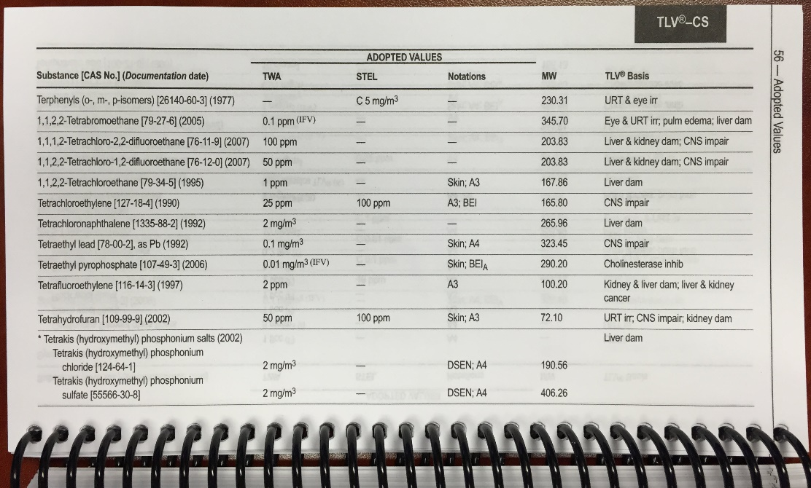
What they are NOT.
They do not represent a fine demarcation between good and bad practice or safe and unsafe.
If there is no OEL set for a chemical substance, it does not mean that substance is safe.

Slide 16
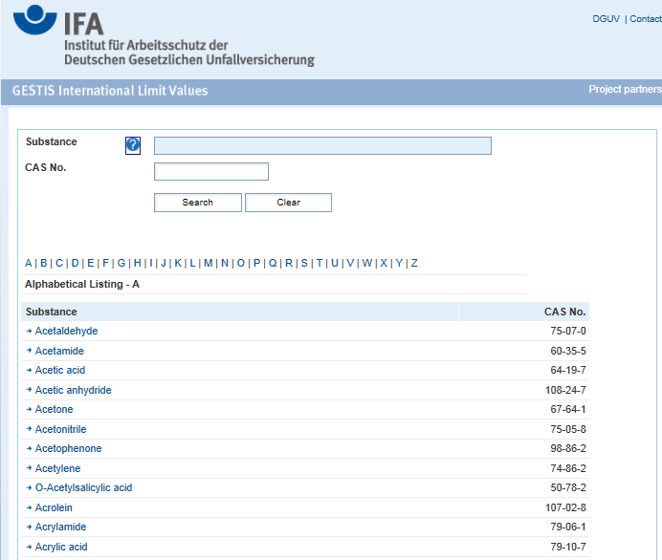
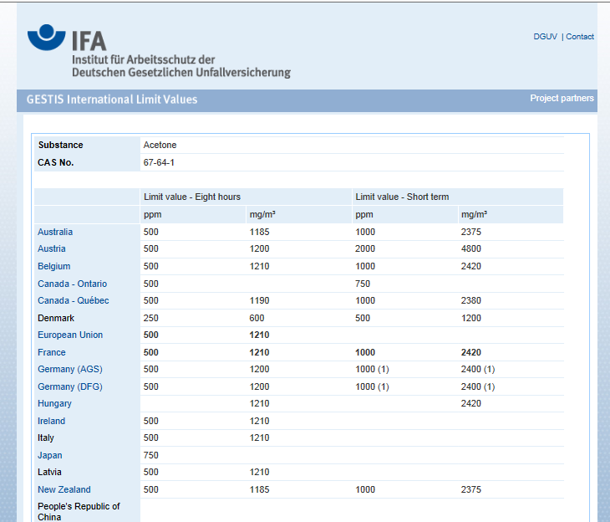
http://limitvalue.ifa.dguv.de/Webform_gw.aspx
Notes:
Reference website for international database of OELs by country

Slide 17
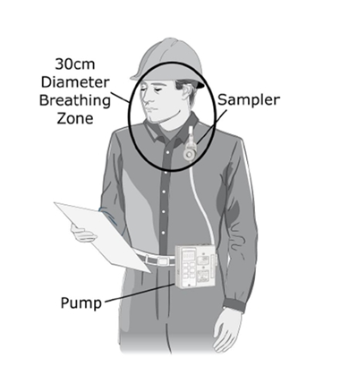
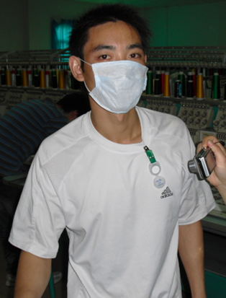
Exposure Assessment
Measurement of the exposure of workers to the hazard
Compare to Occupational Exposure Limit

Slide 18
Assessing Exposures
Key things to consider when estimating exposures:
  levels of exposure consistently high or low/continuous or intermittent
  Note any aspects of processes and tasks (non-routine) that may increase exposure
  Routes of exposure
  Take account of unplanned but foreseeable events
  Consider whether workers not directly involved in a particular activity, but present in the vicinity are exposed to a hazard.

Slide 19
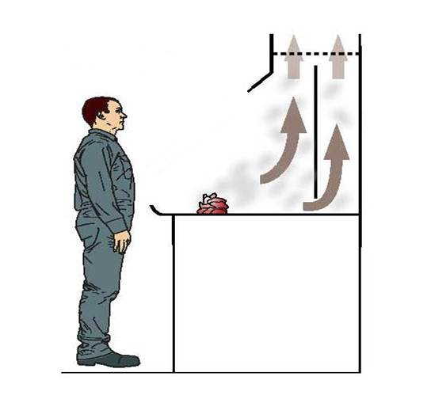
Collection of Samples
Where is the best place to sample to represent exposure?

Slide 20
Collection of Samples
What do we learn if we sample here?
Area Samples
Notes:
Area sampling is useful for evaluating overall air contaminant levels in a general work area and for investigating cross-contamination
Determine concentration gradients
Collected over a time period using typical methods.

Slide 21
Collection of Samples
What do we learn if we sample here?
Source Samples
Notes:
Used to check for exposure potential, leaks, etc.
Instantaneous
Example: Dosimeter Tube, PID

Slide 22
Collection of Samples
What do we learn if we sample here?
Personal Samples – Most useful in measuring exposure
Notes:
Personal samples give the best estimate of a worker’s exposure level since they represent the actual airborne contaminant concentration in the worker’s breathing zone during the sampling period

Slide 23
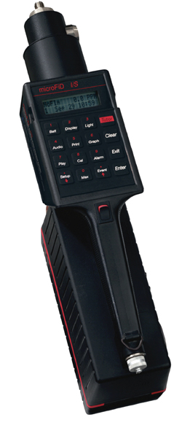
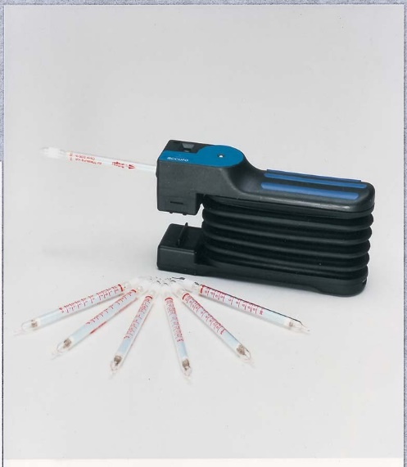
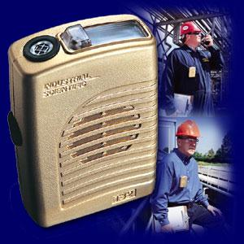
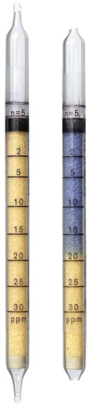
Direct Reading Instruments – Gases
Gas Monitors
Detector Tubes - Colorimetric Tubes
Flame Ionisation Monitor
Photo Ionisation Detectors (PID)
Notes:
Gas Monitors
Interchangeable sensors including:
O₂, CO, H₂S, H₂, SO₂, NO₂, HCN
Cl₂, ClO₂, PH₃
STEL, TWA, peak
Alarm
Data logging
PID
Dependent on lamp ionisation potential
Typically non specific VOCs
or total hydrocarbons
Some specific eg benzene, NH₃, Cl₂
Not for CH₄ or ethane
Affected by humidity, dust, other factors
Flame Ionization
Similar to, PID but flame
Non specific, broad range
Less sensitive to humidity &
other contaminants
Poor response to some gases
Needs hydrogen (hazard)
Detector Tubes
Change in colour of a specific reactant when in contact with a particular gas or vapour

Slide 24
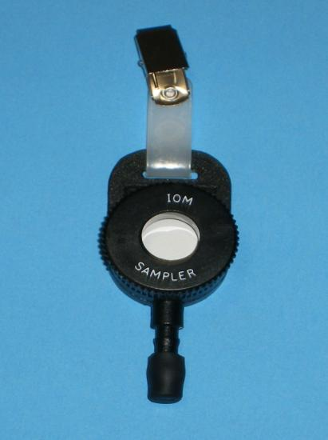
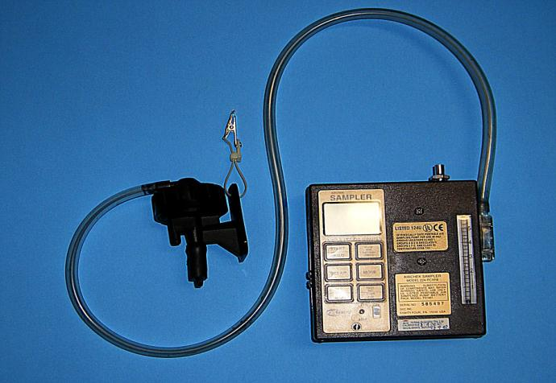
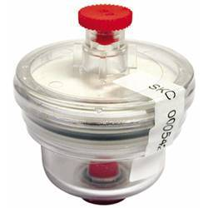
Typical Sampling Instruments 1
Notes:
Particulate and Dusts, metals

Slide 25
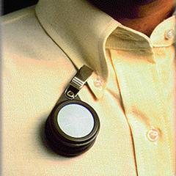
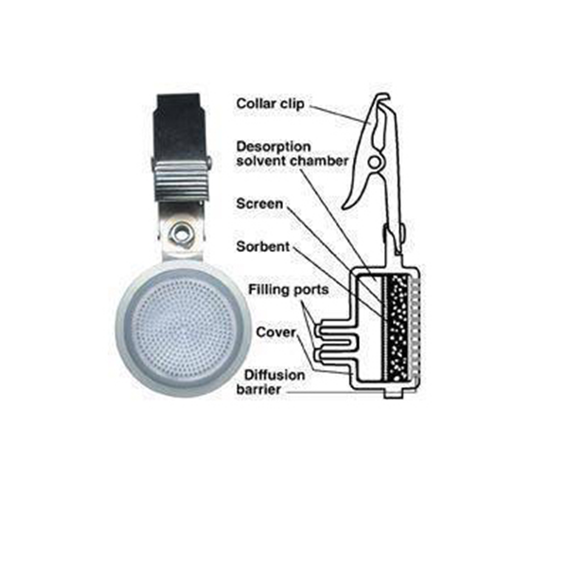
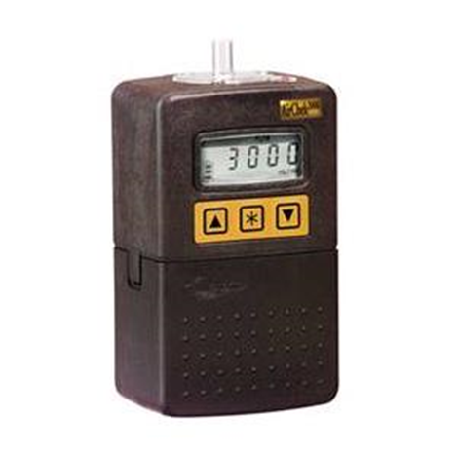
Typical Sampling Instruments 2
Notes:
Baadges and tubes – most common for VOCs

Slide 26

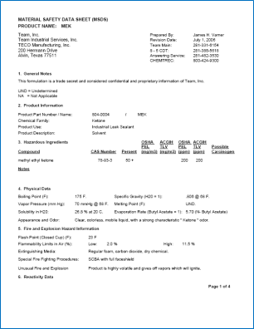
The What?
If this is the composition of our solvent, what should you sample for?
SDS
Notes:
Explain how to determine what is sampled for i.e. SDS, review of decomposition products, reactions, etc.

Slide 27
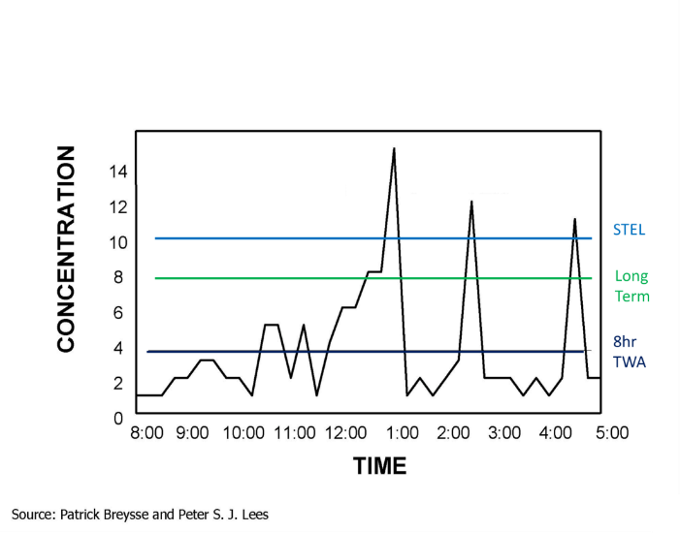
The When?
Intermittent
Full Shift
Once a month
10 minutes a day
Six days a week
Notes:
Explain the type of sampling (i.e. TWA vs STEL) can be based on expected exposure profile and associated health risks

Slide 28
Extended Work Shifts
Most OEL’s developed for conventional 8-hour workday followed by a 16-hour break from the exposure over a 40-hour week
Number of models used to adjust TWA for unusual & extended shifts
How many hours a day do your workers typically work? How many hours a week?

Slide 29
Example Model*
Reduces OEL proportionally for increased exposure & reduced recovery time
Adjusted OEL = 8 x (24 – h) x TWA
16 x h
where h = hours worked each day
*Brief and Scala Model

Slide 30
Example Calculation
Example: Toluene - 8 hr TWA is 20 ppm
Adjusted OEL (for 12 hr shift)
= 8 x (24 – 12) x 20 ppm
16 x 12
= 10 ppm

Slide 31
Multiple Exposures
Additive Effect - Combined effect of exposure to two or more chemicals = the sum of the effect of each agents given alone
2+2 = 4
Synergism: Effect of exposure to two or more chemicals > the sum of the effects of the individual chemicals
2+2 > 4
Potentiation – When exposure to non-toxic chemical and another chemical, it makes the second chemical much more toxic
0 + 2 > 2

Slide 32
Assessing Exposures
Exposure Rating |  | Action
Low | Less than 50% of OEL | SUPERVISORY Sampling or Assessment strategy aimed at routine checks
Medium | Between 50-100% of OEL | CONTROL -Workplace sampling strategy is aimed at quality control and checking on protective measures -Medical surveillance of workers exposed at >50% of OEL
High | At or greater than OEL | INTERVENTION Controls must be put in place (following the Hierarchy of Controls)
Rating Exposures 给曝露程度评级
Notes:
For reference only. Criteria and on-going Exposure Monitoring program should be defined based on actual assessment of conditions by a qualified Occupational Hygienist.
i.e. 50% of OEL can be used as action level for implementation of controls

Slide 33
This work is licensed under the Creative Commons Attribution 4.0 International License. To view a copy of this license, visit http://creativecommons.org/licenses/by/4.0/.

