Slide 1
Controlling Chemical Hazards

Slide 2
Reducing Exposure: Eye & Face Protection

Slide 3
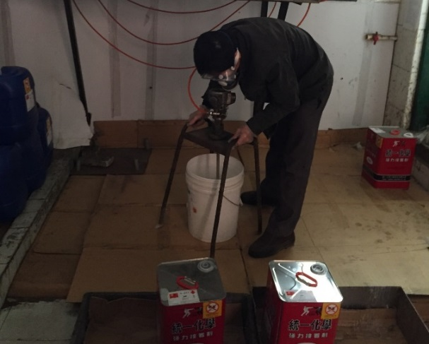
Eye & Face Protection
How do you know when eye protection is required?
How to select the appropriate PPE?
How to manage the use, care and maintenance of the selected PPE?

Slide 4
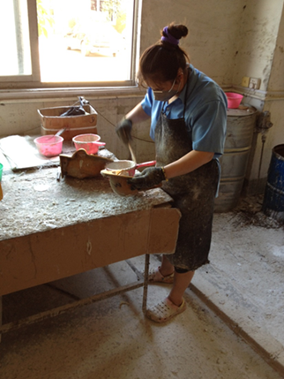
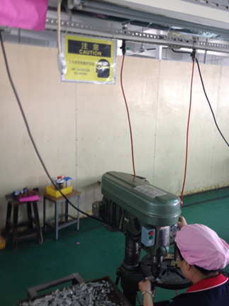
Eye & Face Protection
CHEMICAL
PHYSICAL
Notes:
Discuss the different risks. Chemical vs Physical. Noting that in general we will focus on chemical.

Slide 5
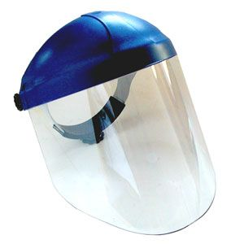
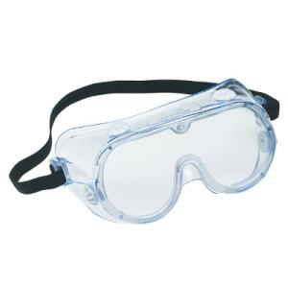
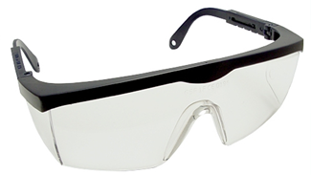
How to select the appropriate PPE?
Face shields are protective of the full face and neck
Can provide more comfort and ease of use for intermittent tasks such as chemical transfer, mixing or cleaning.
Goggles provide sealed eye protection
Can be useful for airborne mists also for mixing/transfer and cleaning, however ease of use may be a factor if task is intermittent
Glasses (with side shields) provide protection against splashes, however are not fully sealed
Can be useful for tasks that are continuous or have impact risk
Notes:
Note impact resistance versions of all types above can be obtained

Slide 6
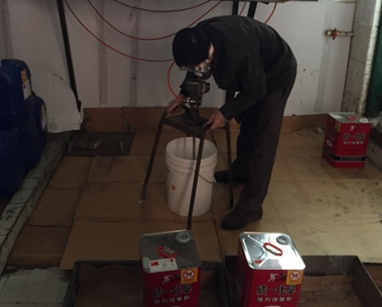
How to select the appropriate PPE?
Example
Mixing Chemicals
Task is intermittent (i.e. once every 1-2hours)
Only last ~2-3 minutes
A face shield may be appropriate as it:
Is easy to put on/take off
Provides added protection from splashes to face and neck

Slide 7
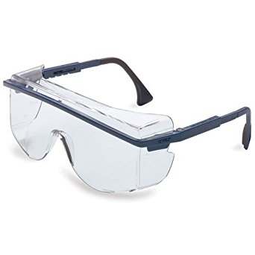
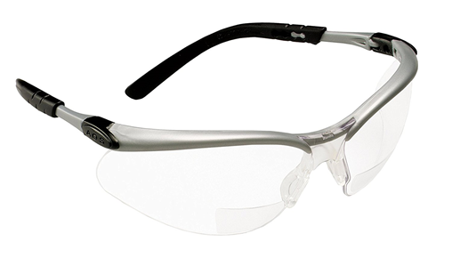
How to select the appropriate PPE?
Fit is an important factor
Often no one size fits all
It can be a good practice to have difference sizes available for workers to select

Slide 8
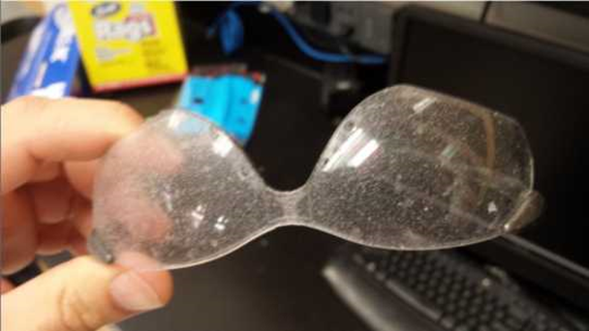
How to manage the use, care & maintenance of the selected PPE?
Inspection and Maintenance
Inspect for signs of damage
Cracks
Reduced vision
impacts
If maintained properly safety glasses, goggles, face shields can last a long time
Cleaned regularly
Stored in clean areas

Slide 9
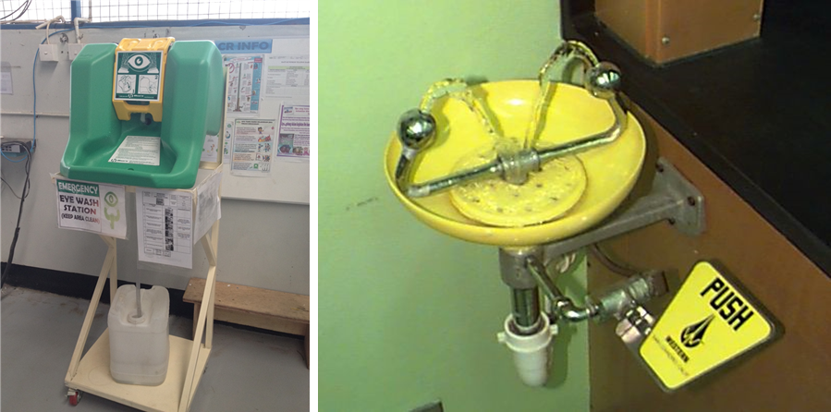
Other Considerations
Eyewash/Emergency Showers
Proper Flow for 15 min
Valve
Open in less than 1 sec
Stays open
Within 100ft (30m) of hazard
Path
Same Level
Unobstructed
ANSI/ISEA Z358.1-2014 American National Standard for Emergency Eyewash and Shower Equipment

Slide 10
Reducing Exposure: Dermal/Skin Protection & Glove Selection

Slide 11
Dermal/Skin Protection and Glove Selection
How do you know when gloves or other skin/body protections are required?
How to select the appropriate PPE?
How to manage the use, care and maintenance of the selected PPE?
Notes:
Discuss that PPE selection needs to be based on hazard/risk assessment of each individual task. Selection should be specific to the task, chemical, etc..

Slide 12
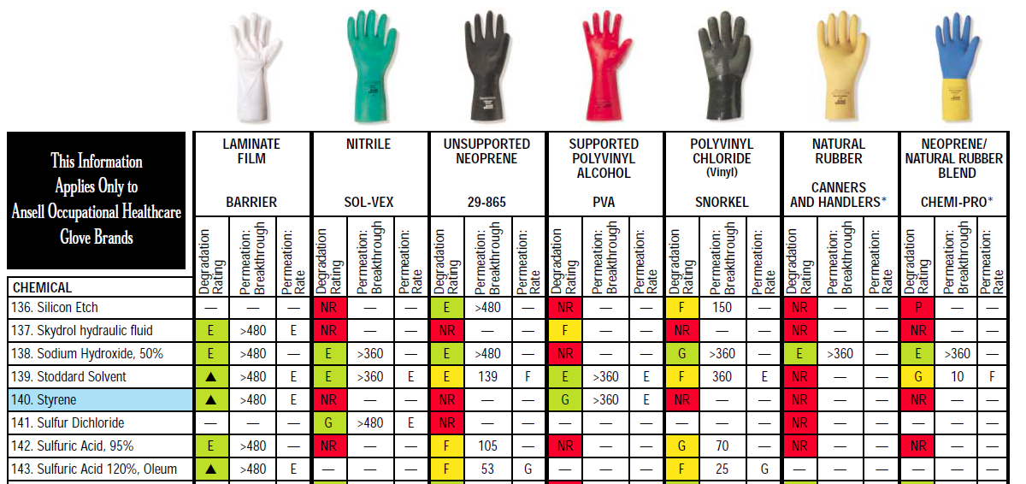
How to select the appropriate PPE?
Chemical Resistant gloves:
Many different materials available
Latex, nitrile, butyl rubber, etc..
No glove is good for all Hazards
To select the RIGHT glove we need the RIGHT information
Glove chart
Permeation/breakthrough data
Notes:
Use next few slides to explain glove charts, Permeation/breakthrough data etc..

Slide 13
Example – Glove Chart
Type of Chemical
Glove Material
Breakthrough Time

Slide 14
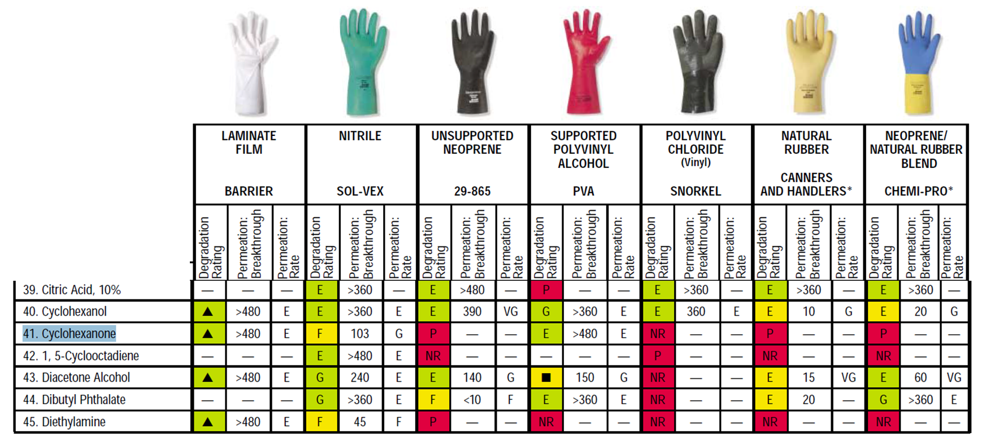
Example for Cyclohexanone

Slide 15
Glove Selection Process - General
Determine what chemical(s) the worker is potentially exposed to
(SDS review)
Select appropriately sized gloves for the workers and the task
Develop glove use program:
Training &
Change out Schedules
Contact glove suppliers to obtain most suitable glove material
(Glove Chart review)

Slide 16
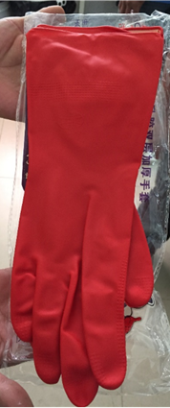
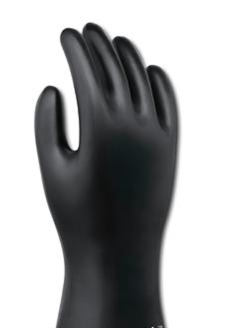
How to select the appropriate PPE?
Some tasks may require more dexterity/precision than others
Consider length and detail of task
Glove sizing and fit can be important
Often there is no one size fits all
Suppliers should have various sizes available
Selecting the right glove also includes fit
Form-fitting vs loose

Slide 17
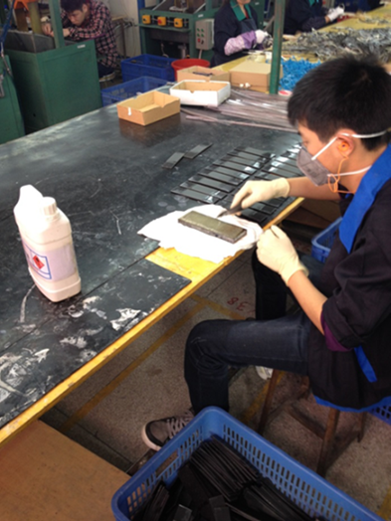
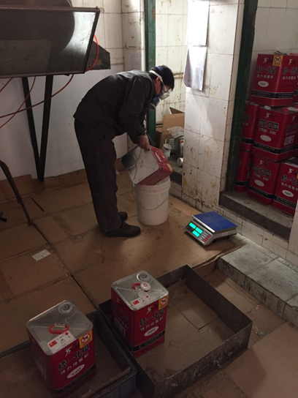
How to select the appropriate PPE?
Example – Formfitting vs lose fitting
Notes:
Explain that glove fitting is also important. Tasks like production line work may require tightfitting gloves as there can be dexterity needed as well as constant repeated contact. Whereas, tasks like chemical pouring/mixing may require workers don gloves intermittently and not require the same level of dexterity

Slide 18
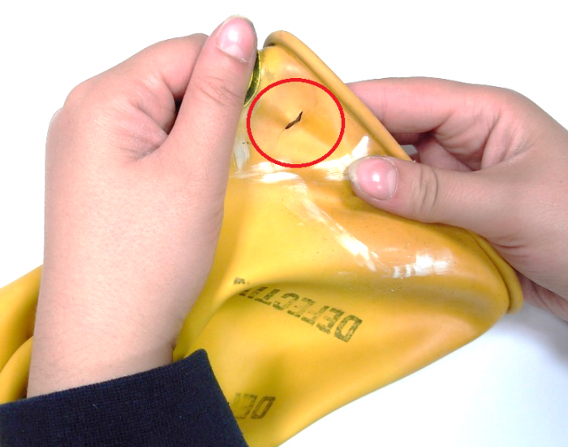
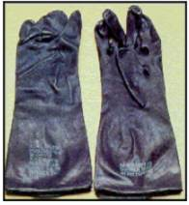
How to manage the use, care and maintenance of the selected PPE?
Inspection and Maintenance
Inspect for signs of breakdown
Discoloration
Drying or cracking
Swelling
Holes
Workers/supervisors should be trained on the signs of breakdown
Initial observations and monitoring of this can help define your change out schedule

Slide 19
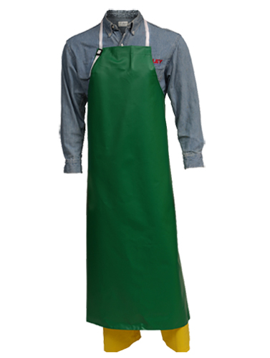
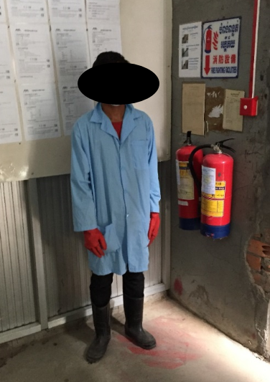
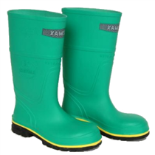
How to select the appropriate PPE?
Other Considerations
Body Protection
Close toed shoes/boots
Chemical resistant apron
Gloves with arm protection

Slide 20
This work is licensed under the Creative Commons Attribution 4.0 International License. To view a copy of this license, visit http://creativecommons.org/licenses/by/4.0/.

