Slide 1
Types of Chemistry Lists

Slide 2
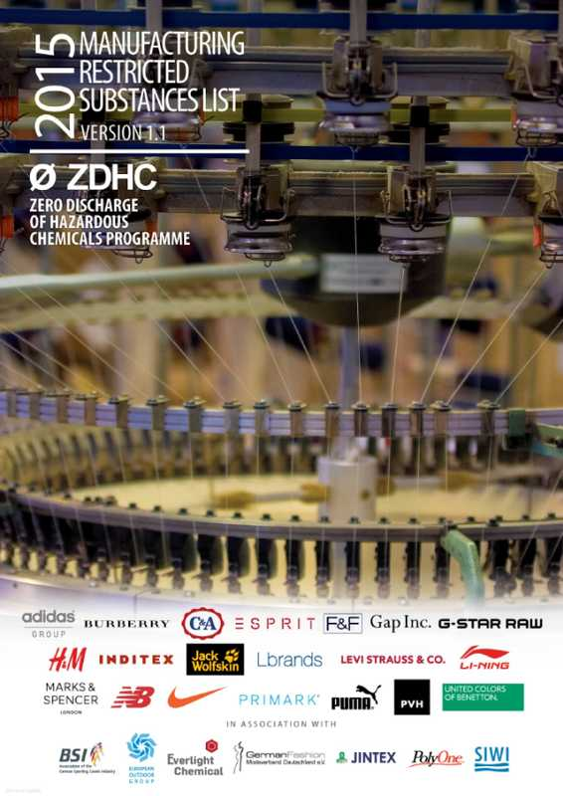
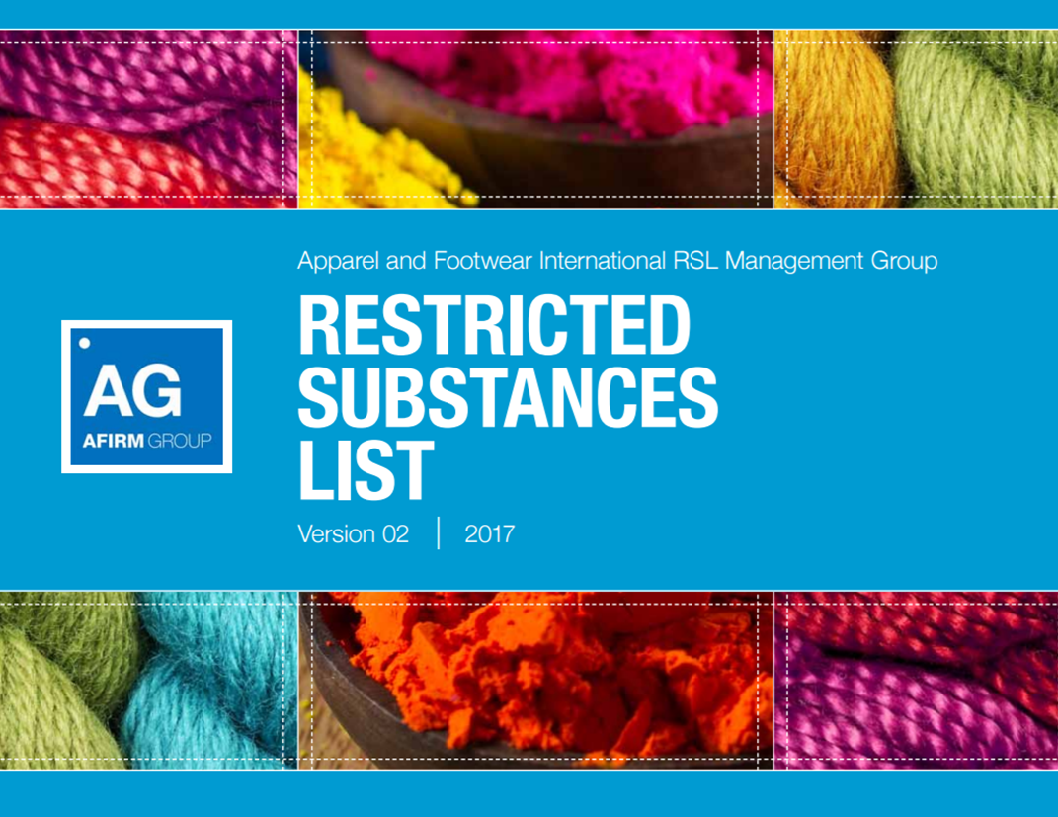
Types of Chemistry Lists
 | Positive Chemistry List | Manufacturing Restricted Substances List (MRSL) | Restricted Substances List (RSL)
Definition | List of substances which have been assessed for their human & environmental health attributes, safety, environmental impacts & performance properties & determined to be ones recommended for use. | Focuses on substances used in the production process or in the manufacturing facility. To test against the MRSL, chemicals are tested before they are used in the factory. | Focuses on substances that can be found in finished materials and products. To test against the RSL, finished materials and products are tested.
Notes:
Some samples of these lists are bluesign® bluefinder, ZDHC's MRSL, Affirm Group's RSL

Slide 3
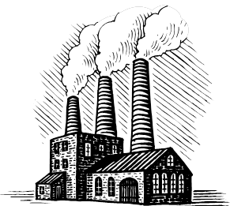
Chemical Lists – Selection and Testing
Positive Chemistry List
Manufacturing Restricted Substances List (MRSL)
Restricted Substances List (RSL)
SELECT
TEST
TEST
Products
Raw Materials & Chemicals
Waste Materials
Factory & Processes
Notes:
It is important to note that not all "Positive Chemistry Lists" are equal in their considerations. It is important to understand the criteria that were considered in making a positive chemistry list, what it aims to achieve, and what it doesn't do. Some positive chemistry lists may have heaver focuses on product quality, health and safety, environmental impacts. If you are provided with a “positive chemicals list” from a chemical supplier you can ask questions like what is the testing/classification criteria? (does this match your or your customers requirements/definition of positive chemistry)

